Slide 1
Genetic characterisation of β-tubulins in Ascaris from across the globe
Dr Ben P. Jones
Department of Veterinary Epidemiology and Public Health
University of Surrey
b.p.jones@surrey.ac.uk

Slide 2
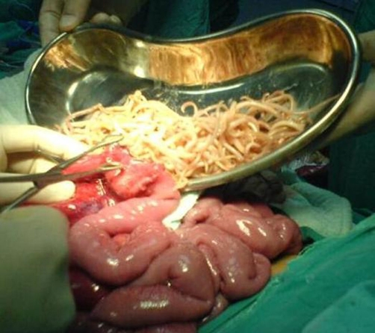
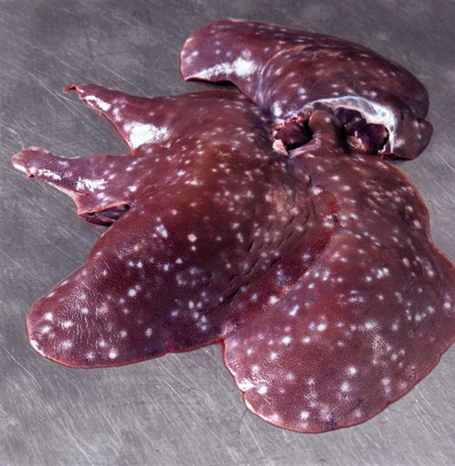
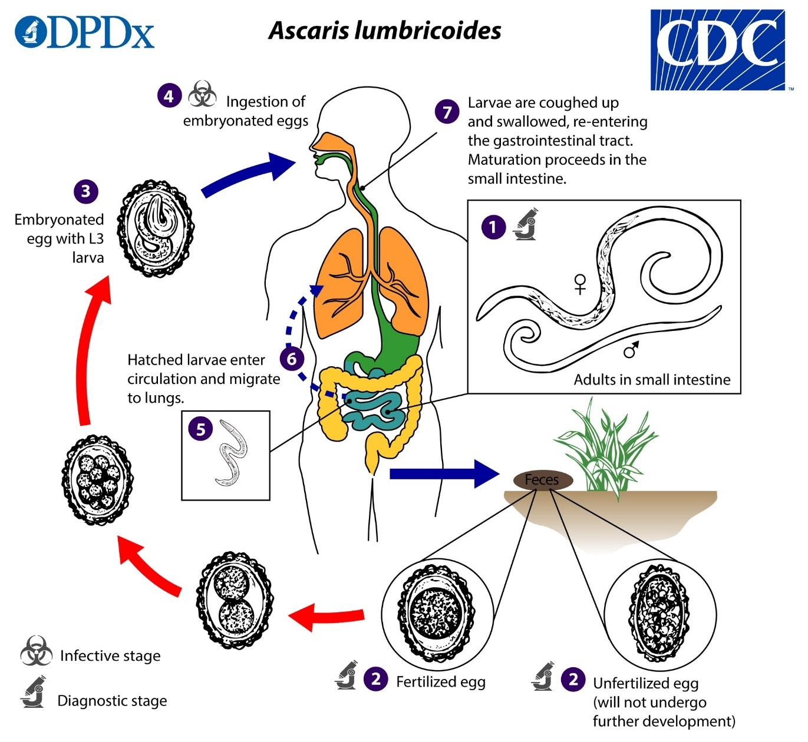
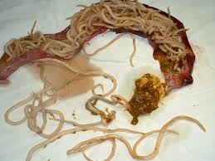
Ascaris – Large intestinal roundworm
A. lumbricoides & A. suum
Recent estimates of >700 million people infected
Most human infection in low-middle income counties
Most cases asymptomatic
Chronic or heavy infections can cause problems:
  Cognitive and developmental stunting
  Reduced meat yield and liver condemnation
  Blockage of organs

Slide 3

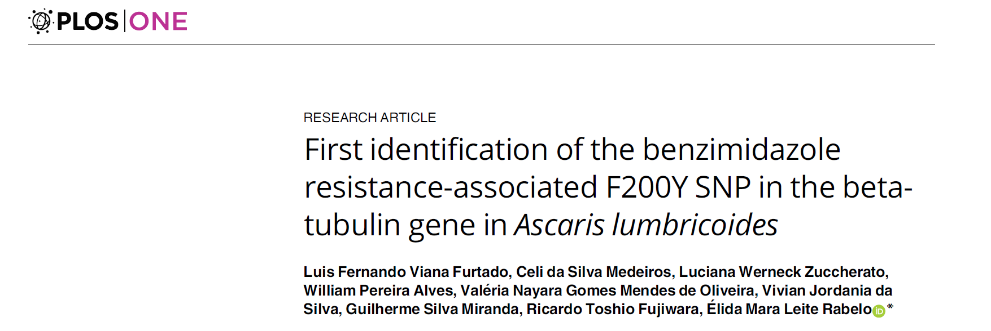
Treatment efficacy
Benzimidazoles are one of the main anthelmintics used for ascariasis
Benzimidazoles are highly effective (88-98% cure rate)
Mass drug administration is main strategy for control
Some evidence that BZ resistance may be starting to occur

Slide 4
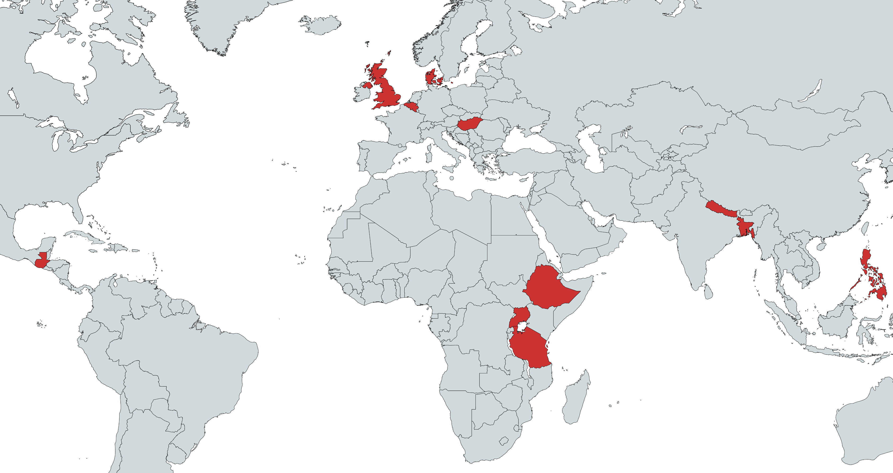
Genotyping study
Deep amplicon sequencing assay to screen for all 3 SNPs in 2 β-tubulin isotypes
Samples from 9 countries
Samples from humans and pigs
Tested β-tubulin isotypes A & B

Slide 5
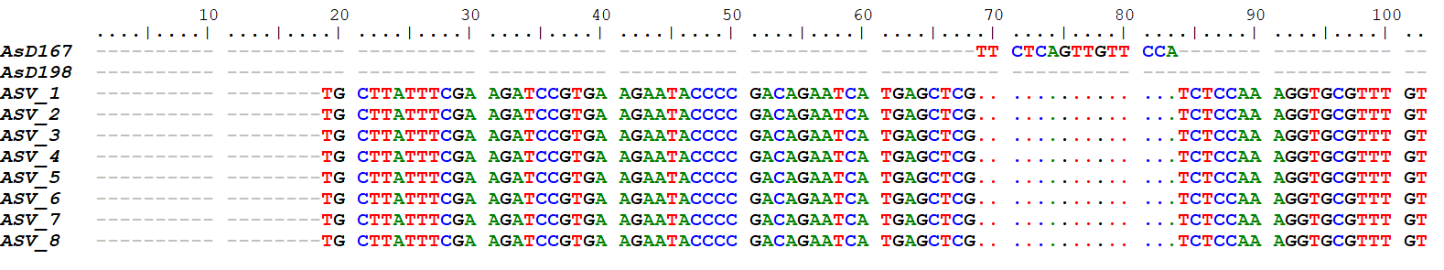
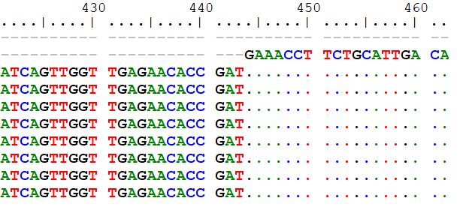
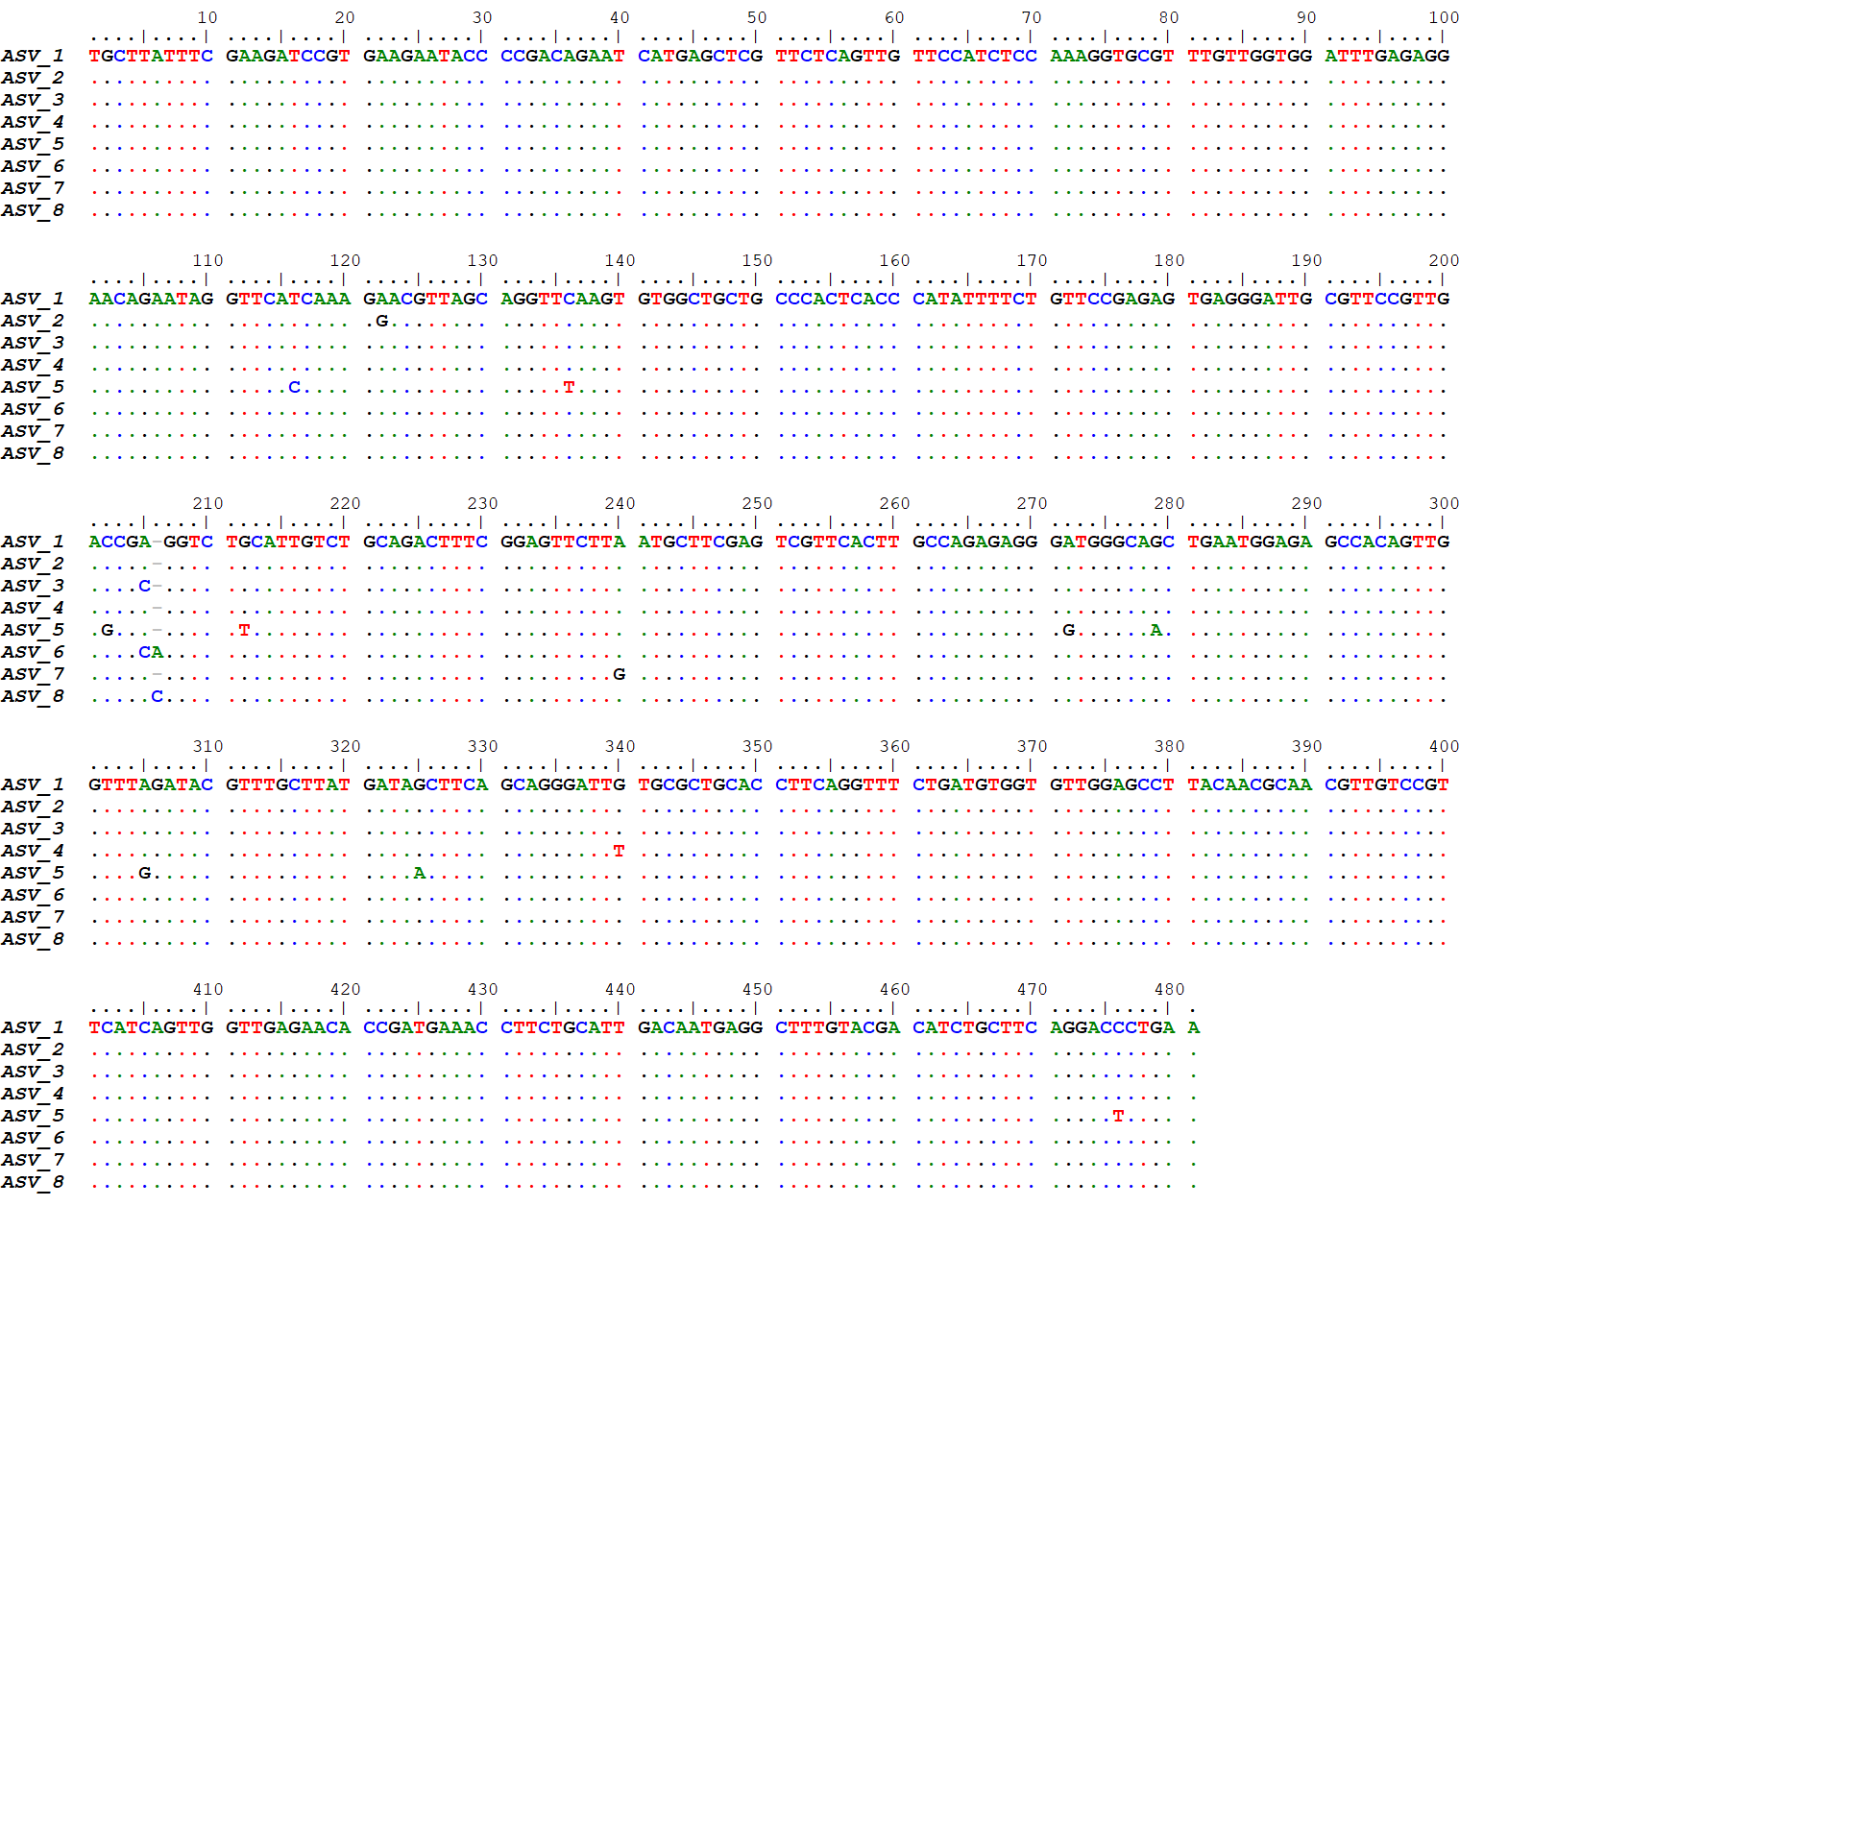
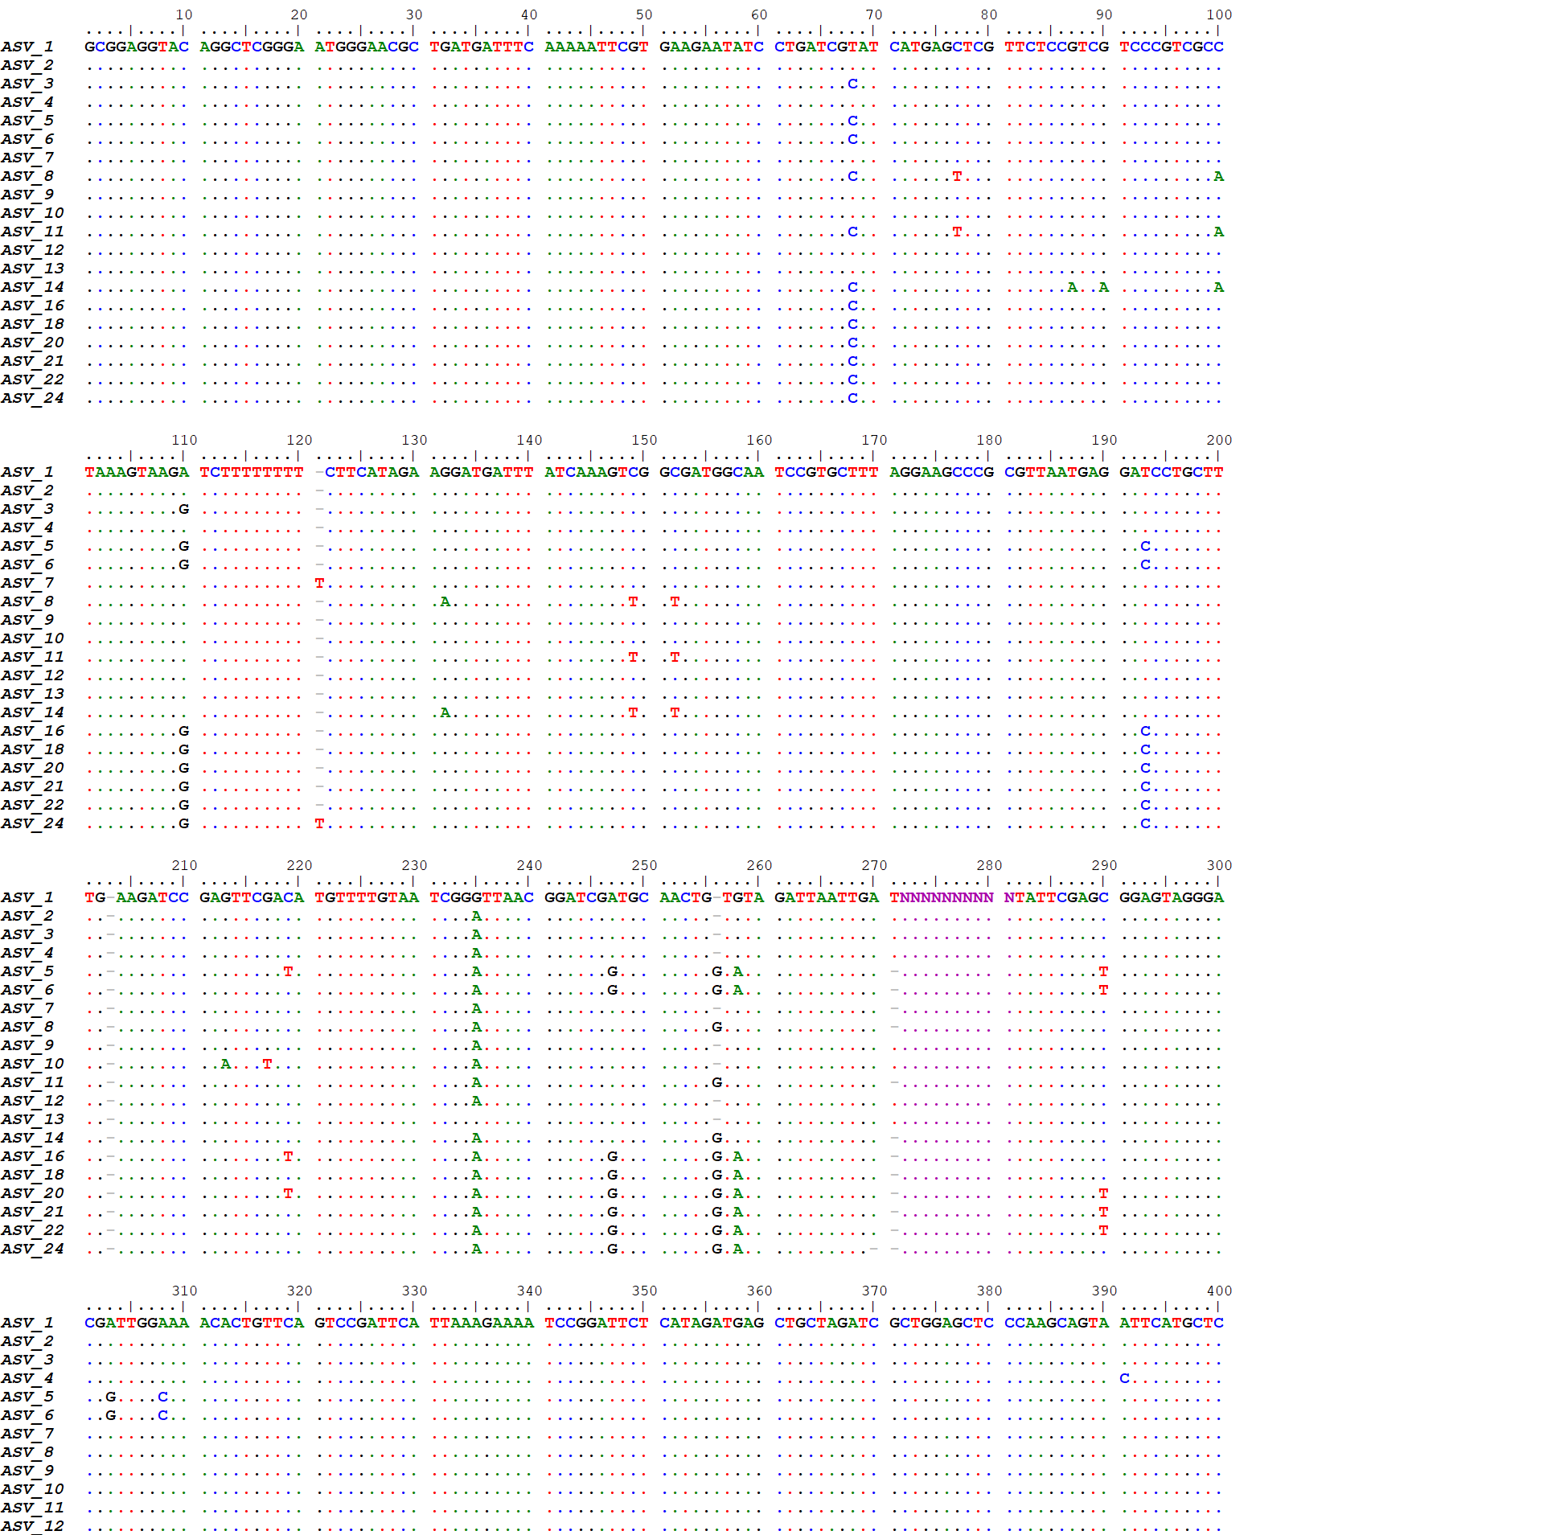
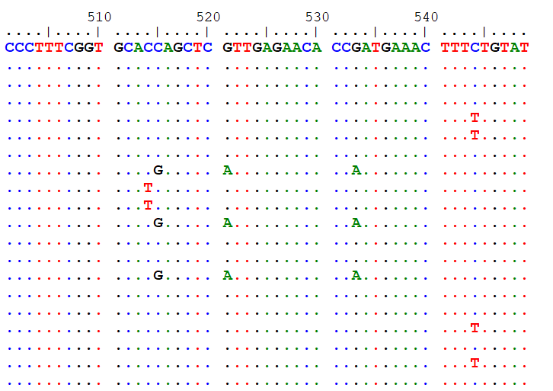

Deep amplicon sequencing SNP screening
167
198
200
167
198
200
β-tubulin A
BtA
167
198
200
β-tubulin B
BtB

Slide 6
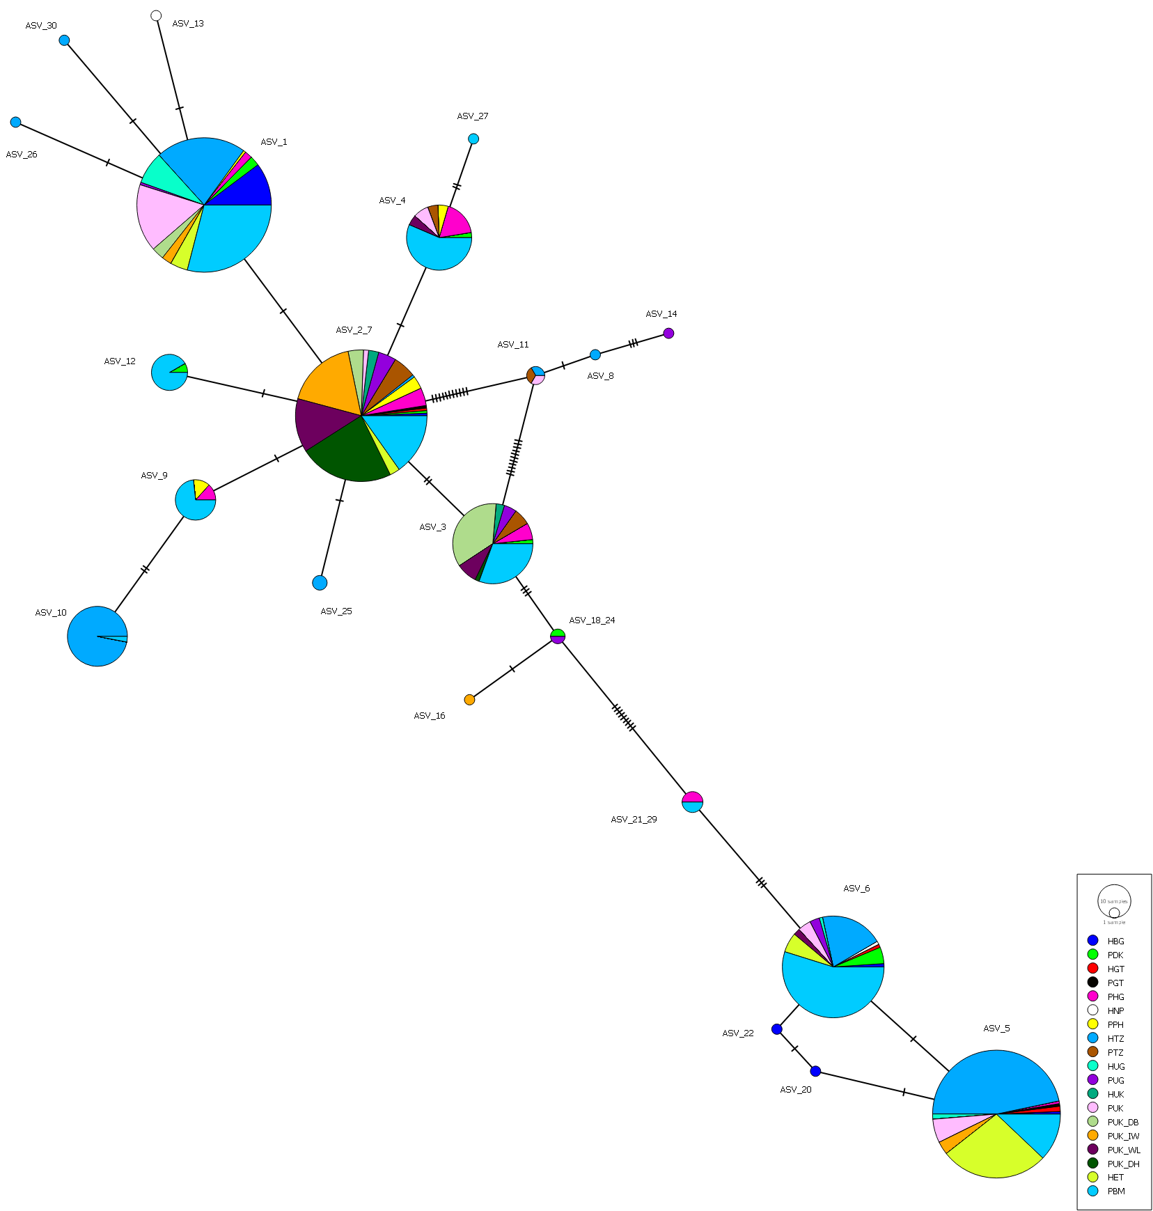
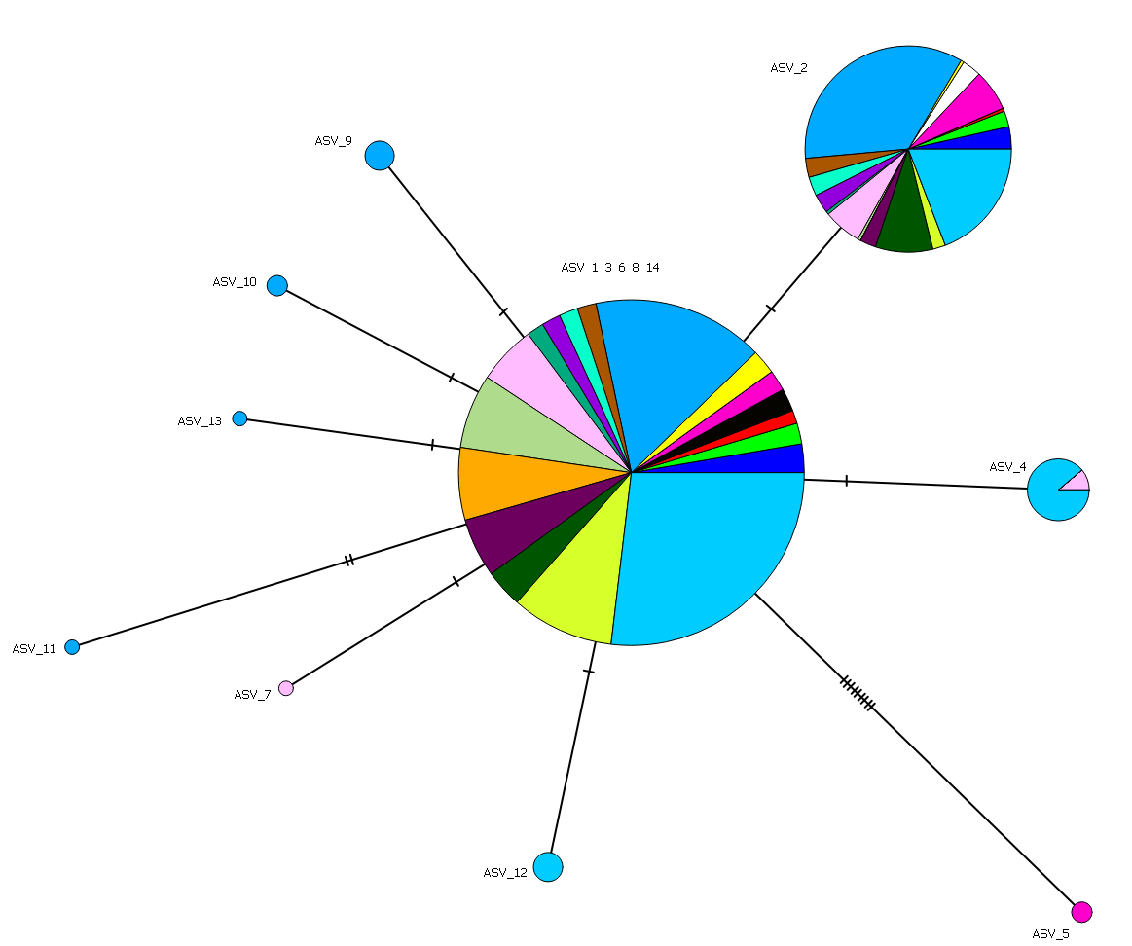
Population genetics
BtA
BtB

Slide 7
Population genetics
Combined data for both isotypes of each sample
Samples grouped by country of origin then separated in populations dependant on host species
Performed various tests of population differentiation

Slide 8
Population genetics
AMOVA (Analysis of MOlecular VAriance )
Shows little variation between groups (countries)
Most variation is seen between individuals
Pairwise Fst and Exact test show a small but significant difference between pig derived and human derived worms
Source of variation | d.f. | Sum of squares | Variance components | Percentage of variation | Fixation Indices |  | P-value
Among groups | 10 | 14.052 | -0.03802 Va | -14.93 | FCT | -0.14928 | 0.75367
Among populations within groups | 8 | 17.088 | 0.07576 Vb | 29.74 | FSC | 0.2588 | 0
Among individuals within populations | 361 | 104.882 | 0.07355 Vc | 28.88 | FIS | 0.339 | 0
Within individuals | 380 | 54.5 | 0.14342 Vd | 56.31 | FIT | 0.43693 | 0
Total | 759 | 190.521 | 0.25471
Population pairwise F_{ST}
Exact Test of Sample Differentiation
 | Human | Pig
Human |  | 0.02051+-0.0038
Pig | 0.01482
 | Human
Pig | 0.00000+-0.0000
Above diagonal | FST P values
Below diagonal | Population pairwise FSTs
Differentiation test between all pairs of samples (Markov chain length : 100000 steps):
Non-differentiation Exact P values : 0.00000+-0.0000

Slide 9
Multiple correspondence analysis
Looks for associations between categorical data
Limited separation based on geography
Shows clear separation between human and pigs

Slide 10
Summary
No resistance associated SNPs found in Ascaris so far
Need to identify phenotypically resistant samples
Difference between human and pig Ascaris

Slide 11


Acknowledgements
Dr Martha Betson (University of Surrey)
Dr Arnoud van Vliet (University of Surrey)
Dr James La Course (Liverpool School of Tropical Medicine)
Sara Roose (Ghent University)
Prof Peter Geldhof (Ghent University)
Prof Bruno Levecke (Ghent University)
Dr Johnny Vlaminck (Ghent University)
Dr Peter Nejsum (Aarhus University)
Prof Tim Anderson (Texas Biomedical Research Institute)
Prof Rashidul Haque (icddrb)
Dr Harriet Namwanje (Ministry of Health, Uganda)
Prof Helen Ngowi (Sokoine University of Agriculture)
Dr Alexandra Juhasz (Liverpool School of Tropical Medicine)
Dr Vachel Paller (University of the Philippines Los Baños)
Prof Russell Stothard (Liverpool School of Tropical Medicine)
Dr Richard Bendall (Royal Cornwall Hospitals NHS Trust)

