Slide 1
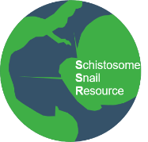



Adam Cieplinski, PhD
NHM | Science Department
Schistosome & Snail Resource (SSR)
Wellcome Trust funded open access biomedical resource
Notes:
One of our main focuses is to offer material reflecting natural diversity of Schistosomes and Snails ,,,,NEXT slide

Slide 2
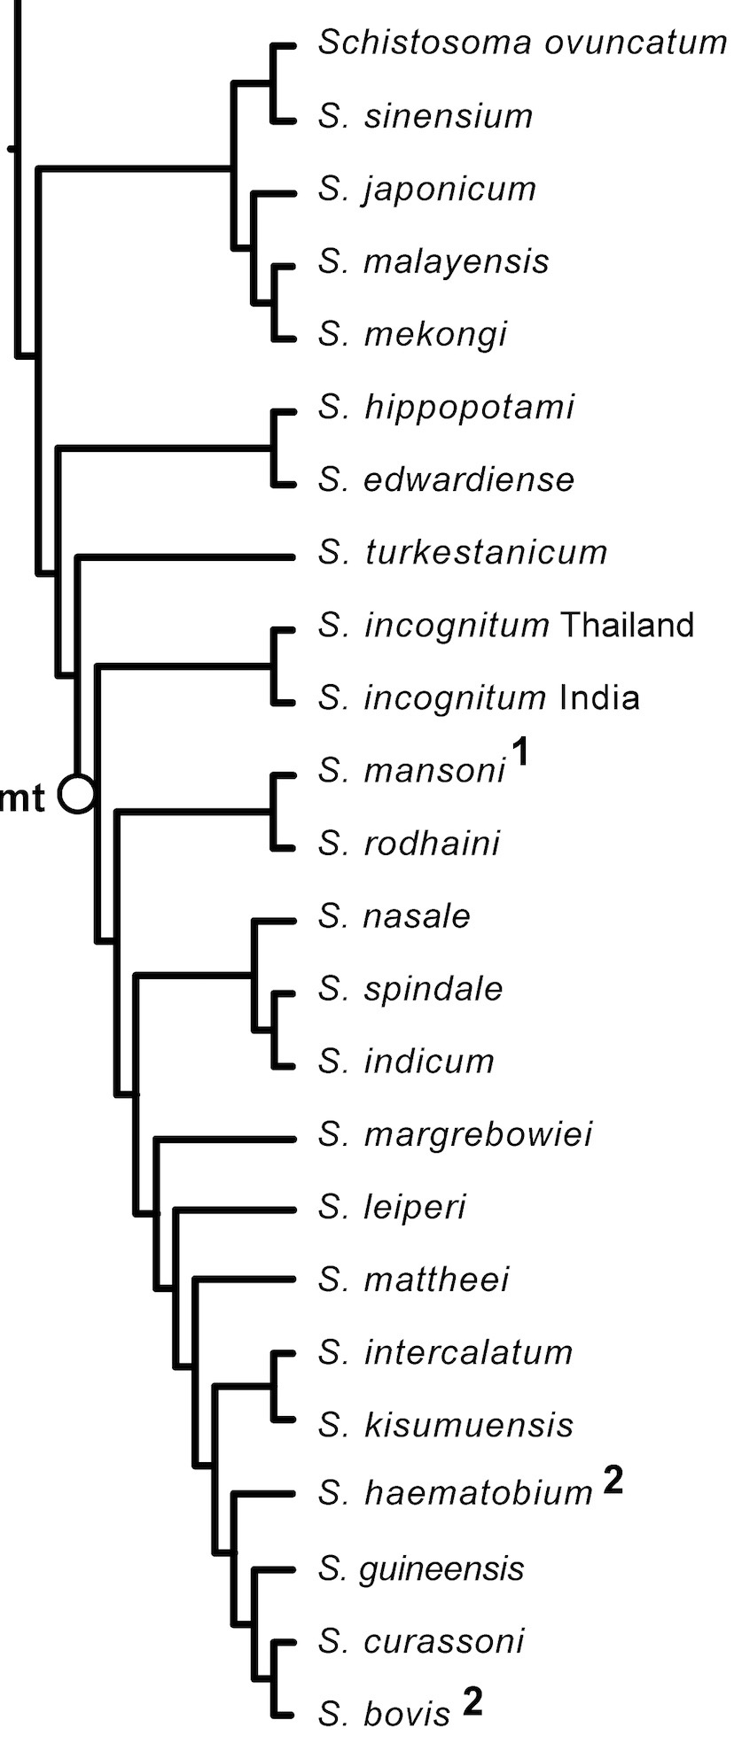



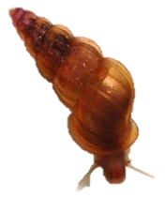
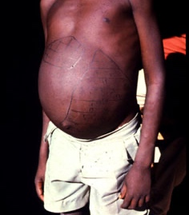

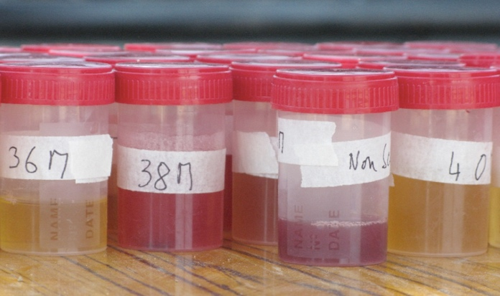
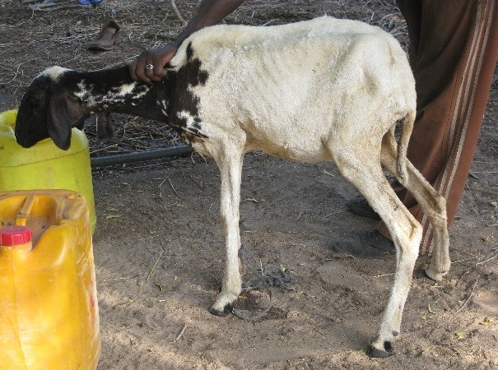
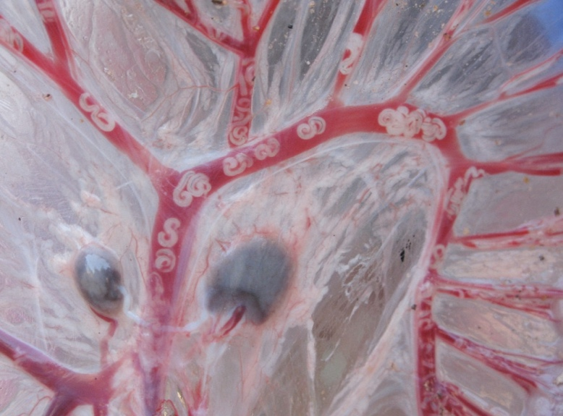
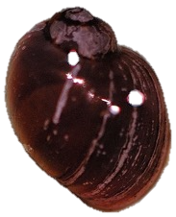
Schistosoma species phylogenetic tree
Diverse Schistosoma species and intermediate snail hosts
23 Schistosoma species
S. japonicum
Many specific snail species and strains
Oncomelania spp.
Human Schistosomiasis
6 species
3 main species
S. mansoni
Biomphalaria spp.
Animal Schistosomiasis
11 species veterinary importance
9 species wildlife importance
S. haematobium
Bulinus spp.
main mammalian hosts
Notes:
….As you can see schistosomes are highly diverse and Schistosmes – snails compatibility is highly complex ….

Slide 3
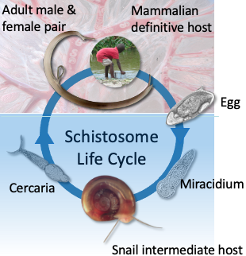
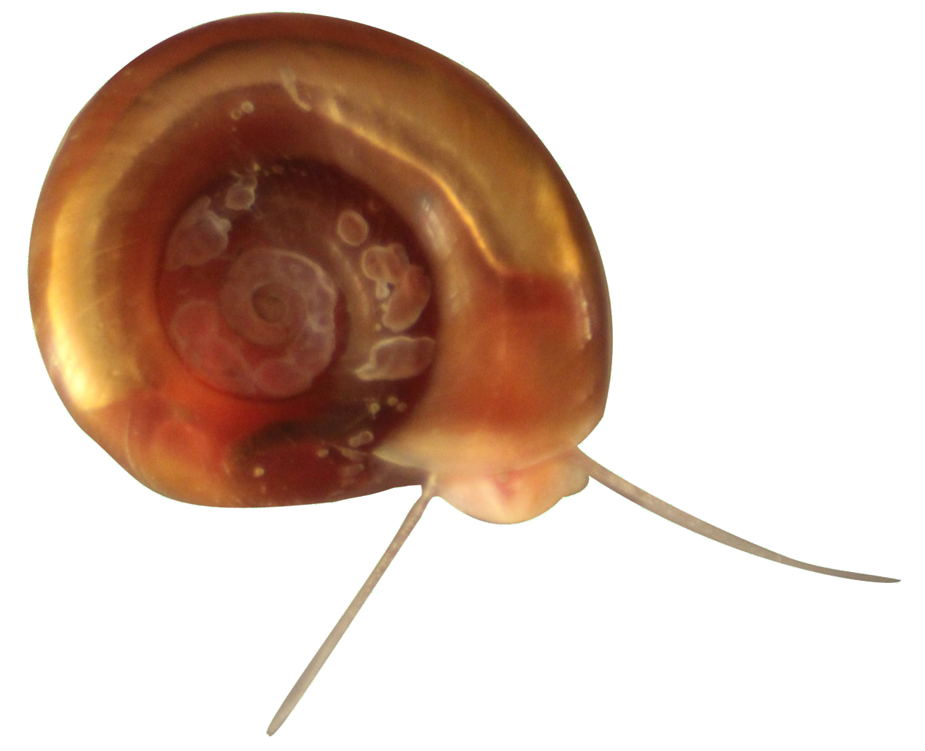
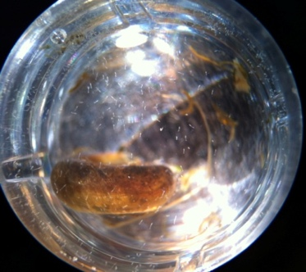
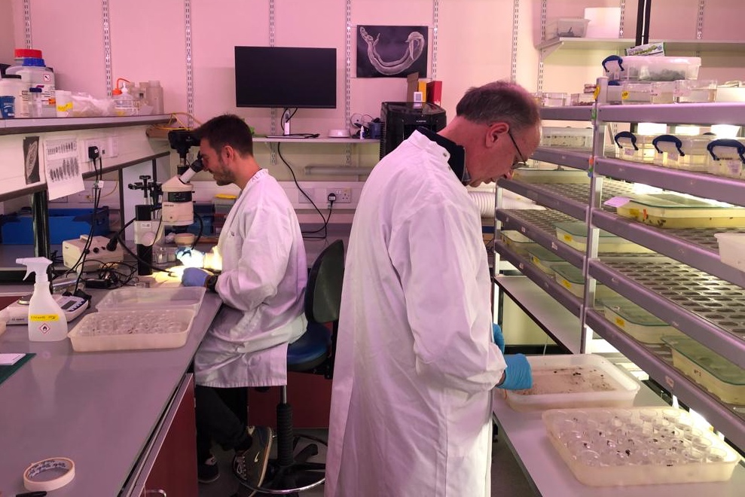
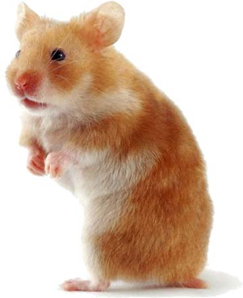
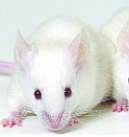
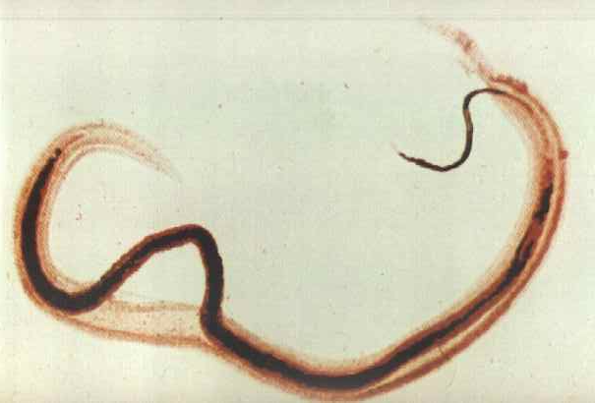
The benefits of a centralised resource
Few laboratories can maintain schistosomes and snails
Complex life-cycle
Lab. snail cultures (Biomphalaria spp. and Bulinus spp. (NHM and LSHTM)
Infrastructure
Animal ethics
Cercariae
High costs
Centralised
Life-cycles
Miracidia
Designated and trained staff
Lab. rodents (LSHTM)
Notes:
3

Slide 4
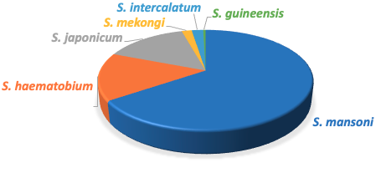



Why do we need a schistosomiasis biomedical resource?
Research articles – Google scholar search
Only few species/strains widely available in cultures
SNAILS:
Biomphalaria glabrata
2 strains (Puerto Rican, 1950 and Puerto Rican/Brazilian, 1955)
Bulinus t. truncatus - 1 strain (Egyptian 1950s/1977/ 1980s)
PARASITES:
S. mansoni – 1 strain (Puerto Rican, 1955)
S. haematobium – 1 strain (Egyptian 1950s/1977/1980s)
Potential bias in research
Lack of natural genetic heterogeneity
Particularly detrimental for diagnostics, drug development, vaccine development
Increased access is needed
Notes:
4

Slide 5
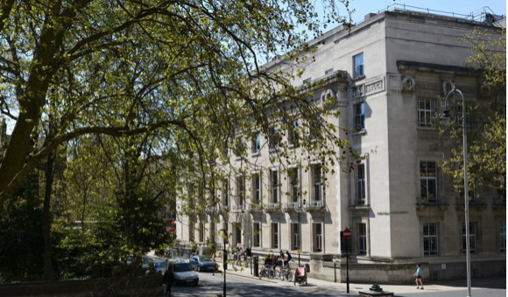
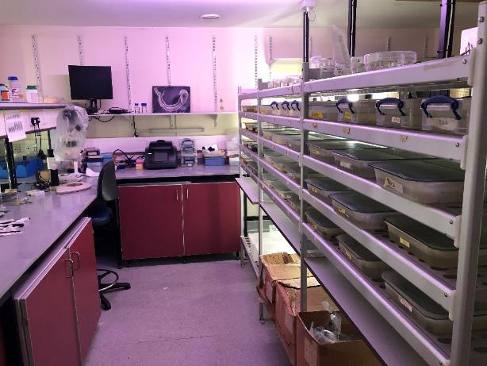
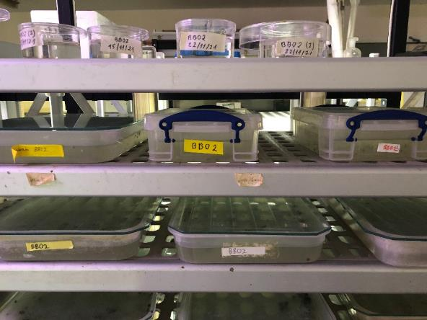
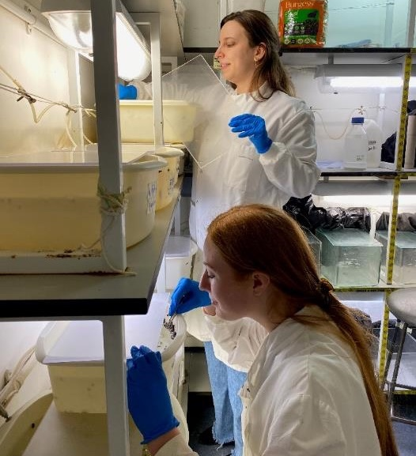
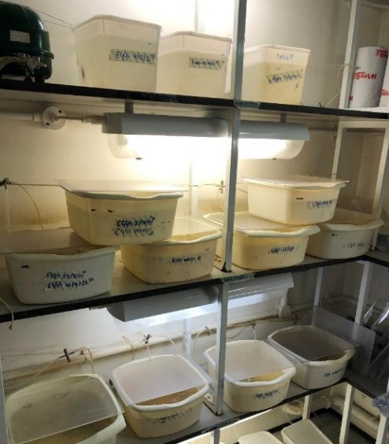






Main snail facility
Snail and rodent facility
NHM Team
LSHTM Team
Bonnie Webster
Aidan Emery
Adam Cieplinski
Amaya
Bustinduy
Vanessa Yardley
Fernanda Sales Coelho
Main snail facility
Main snail facility

Slide 6
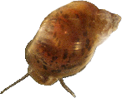
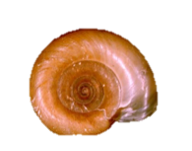
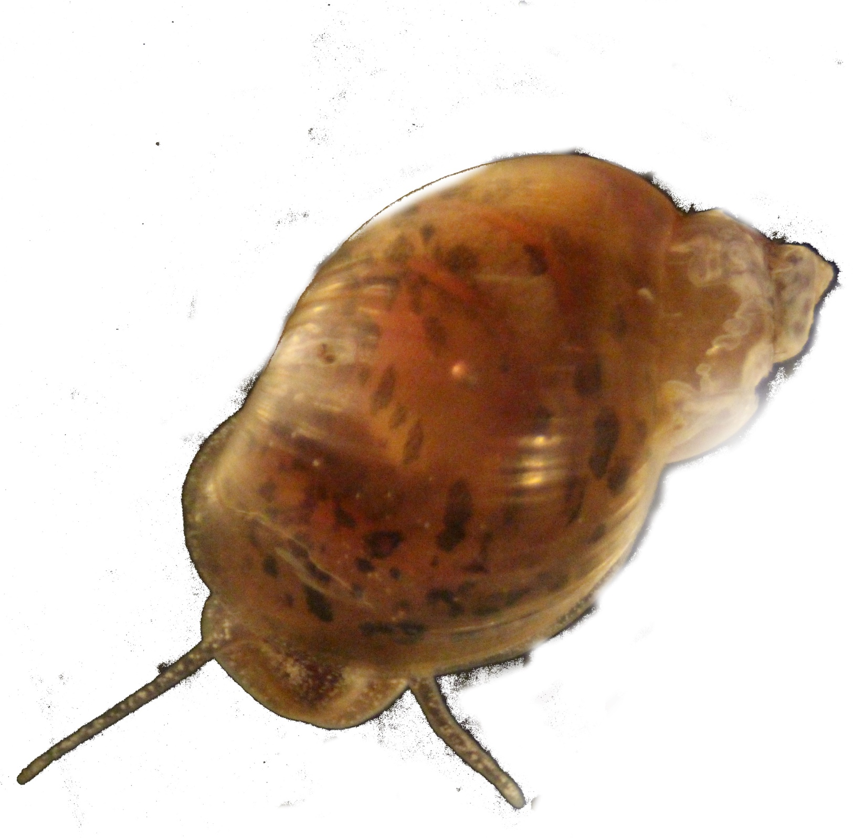
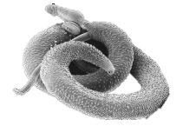
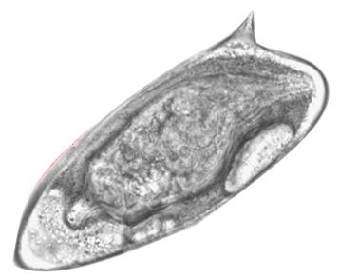
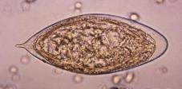
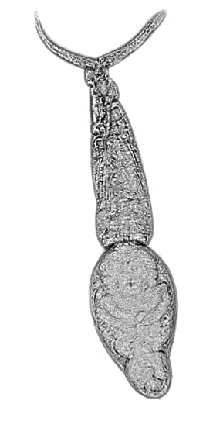
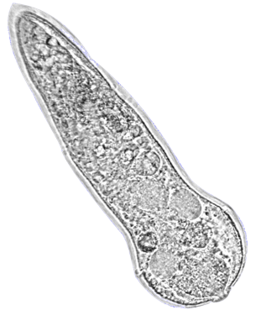
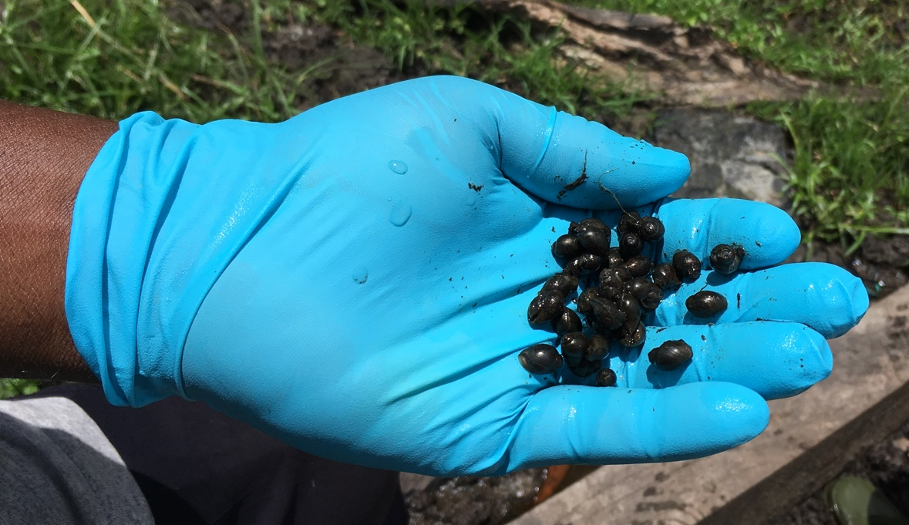
Current and future resources
  Current: Standard strains: S. mansoni (Puerto Rican), S. haematobium (Egyptian) and their standard intermediate snail hosts
Snails (infected and uninfected)
Adult worms
Eggs
Miracidia
Cercariae
Bulinus truncatus
Biomphalaria glabrata
S. mansoni worm
S. haematobium egg
S. mansoni egg
S. mansoni cercaria
S. mansoni miracidium
  In the future: Non-standard strains; more authentic African species and strains
Higher genetic diversity
Driven by user need

Slide 7
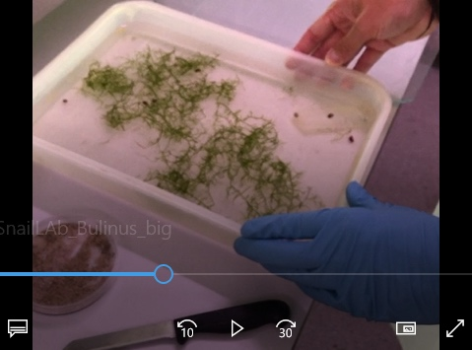


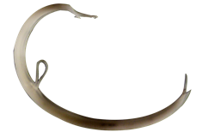
Achieved
In progress
Open access SOP’s
Snail facility development
Main objective
Optimised life-cycles protocols. Reducing animal use
Facilitate and Support Schistosomiasis Research,
Collaborations and Partnerships
Cercarial and Soluble Egg Antigens for serology testing (NHS and beyond)
New egg shipment methods (together with BRI, US) – establishing life-cycles
Logistics for obtaining new material from endemic countries
Reduction in rodent use; in vitro culturing, cryopreservation
Supporting research and teaching

Slide 8






Thank you!
Funder
Supporters and SSR users
Collaborators
@SchistoSSR
SSR@lshtm.ac.uk
NHM Website

Slide 10
Examples of what the SSR has supported
  Xenomonitoring tool development
  Water treatment research
  In-vitro studies
  Cell signalling
  Immunological research
  Diagnostics optimisation
  Biological control research
  Host-parasite interactions
  Protocol sharing and support for other labs.
  Teaching

Slide 11
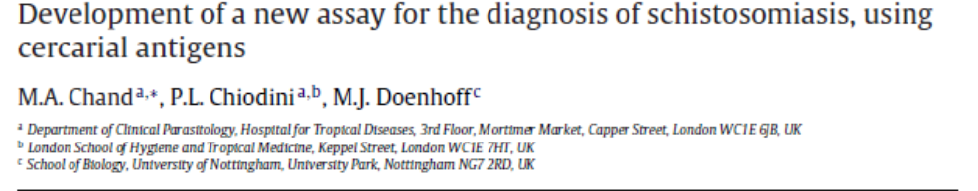
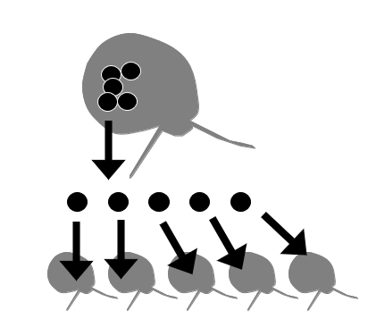
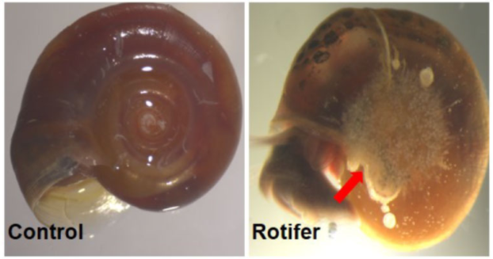
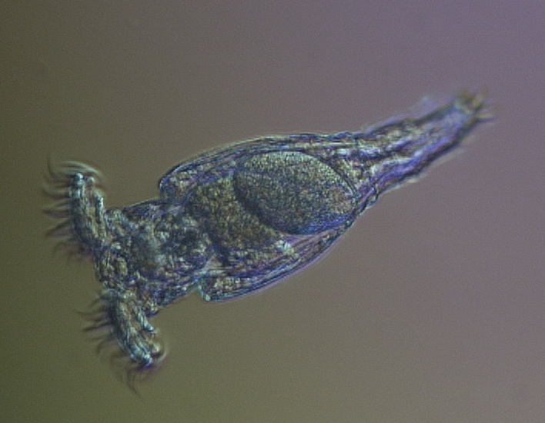
Other future plans
4) Replace SEA ELISA with cercarial antigen
1) In vitro culture
Closing the lifecycle in vitro without host - reduce the need for laboratory rodents in maintaining Schistosoma life-cycles
2) Sporocyst transplantation
5) Protocol for rotifer control
Dissect sporocysts from an infected snail.
Creating a series of clonal schistosome lines.
3) Cryopreservation
Lin et al., 2021
Rotifers interfere with cercariae – can they be used as an infection biocontrol?

Slide 12
Corsica
Endemic in 74 tropical and sub-tropical developing countries (most in Africa)
Notes:
12

Slide 13


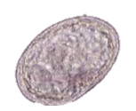


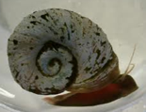
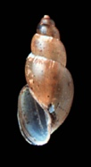
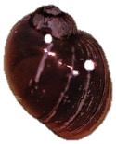
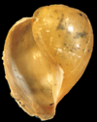

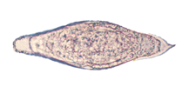


Schistosoma and their snail hosts
S. japonicum clade
Oncomelania spp. + Tricula spp. + Neotricula spp.
Asia
S. japonicum egg
Africa
S. hippopotami clade
?
3 evolutionary time points for human species – red dots on the tree)
Asia*
Proto - S. mansoni clade
Radix spp. (Lymnaea spp.)
Near East, C. E. Europe
Africa* +
S. America
S. mansoni clade
Biomphalaria spp.
S. mansoni egg
Asia
S. indicum clade
Indoplanorbis spp. (mainly Indoplanorbis exustus) +
unsuccessful trial to infect Radix luteola
India
Africa*
S. haematobium clade
Bulinus spp. + Planorbarius spp. (only S. bovis)
*and adjacent regions
= Bovids
S. guineensis egg
S. bovis egg
S. haematobium egg

Slide 14
Snail-Schistosome Relationships
Schistosome clades
S. bovis
Radix
S. curassoni
Pulmonata
Bulinidae
Bulinus
S. intercalatum
S. haematobium
light blue – haematobium clade
Indoplanorbis
S. mattheei
Planorbidae
Ancylidae
Ferrissia
S. leiperi
S. margrebowiei
Drepanotrema
S. indicum
brown – indicum clade
S. spindale
Planorbis
S. nasale
Planorbinae
Segmentina
S. rodhaini
red – mansoni clade
S. mansoni
Planorbarius
S. incognitum
blue – proto mansoni clade
Helisoma
S. turkestanicum
S. mekongi
Biomphalaria
S. malayensis
Caenogastropoda
S. japonicum
green – japonicum clade
Pomatiopsidae
S. sinensium
Other schistosome genera
Chimaerohemecus trondheimensis
Lockyer, A.E., Jones, C.S., Noble, L.R. & Rollinson, D. (2004) Canadian Journal of Zoology 82 251-269.

Slide 15
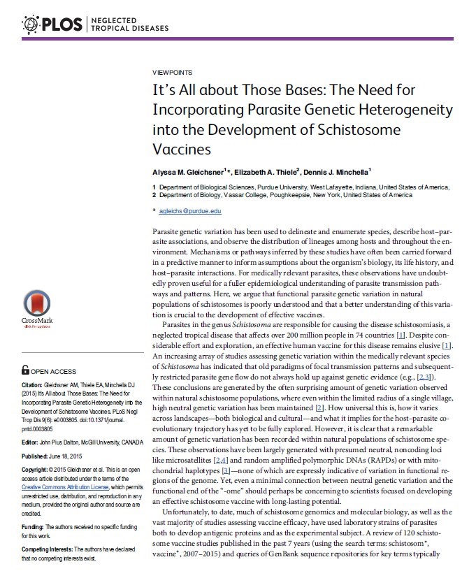
Gleischner et al 2015
There has been an over-reliance of laboratory isolates in schistosome research.
Schistosoma spp. |  | Published Experiments (n = 121) |  | GenBank Genomic and EST Entries (n = 1,409)
 |  | Parasite | Host | Parasite
S. mansoni | Lab strain | 80% | 93% | 79%
 | Field | 8% | 7% | 2%
 | Not specified | 12% | 0% | 19%
S. japonicum | Chinese mainland | 74% | 87% | 84%
 | Other | 12% | 10% | 6%
 | Not specified | 14% | 3% | 10%

Slide 16
Partners and Supporters
SRC
Perpignan
TBRI
Species | Snail Host | Isolate Country of Origin | Disease | Species Endemic Range | Source
“standard” species available
S. haematobium | Bulinus (B.) truncatus | Egypt | Human (urogenital) | Sub-Saharan Africa, Indian Ocean Islands, Arabian Peninsula | SR3 (BRI-NIH) (USA)
S. mansoni | Biomphalaria (Biom.) glabrata | Puerto Rico PR-1 and NMRI strains | Human (intestinal) | South America, Sub-Saharan Africa, Arabian Peninsula | LSHTM (UK) BRI-NIH (USA) + other places
“non-standard” species and strains that are available* to be incorporated into the SSR or planned to be isolated^ (B. w) = will also be maintained in laboratory B. wrighti. |  |  |  |  | Institution (see collaborator section for details)
S. haematobium* | B. globosus^, truncatus* (B. w) | Senegal | Human (urogenital) | Sub-Saharan Africa, Indian Ocean Islands, Arabian Peninsula | Vitrome (Senegal)
S. haematobium* | B. truncatus* | Egypt |  |  | TBRI (Egypt)
S. haematobium* | B. truncatus* | Cameroon |  |  | CSP (Cameroon)
S. mansoni^ | Biom. pfeifferi* | Senegal | Human (intestinal) | South America, Sub-Saharan Africa, Arabian Peninsula | Vitrome (Senegal)
S. mansoni* | Biom. alexandria* | Egypt |  |  | TBRI (Egypt)
S. mansoni* | Biom. pfeifferi* | Cameroon |  |  | CSP (Cameroon)
S. guineensis* | Bulinus forskalli* | Cameroon |  | Central Africa | CSP (Cameroon)
S. bovis^ | B. truncatus* (B. w) | Senegal | Veterinary (intestinal) –potential zoonotic | Sub-Saharan Africa and Mediterranean | Vitrome (Senegal)
S. curassoni^ | B. umbilicatus* (B. w) | Senegal |  | West Africa

