Slide 1
Engaging London’s Latin American population in screening for Chagas disease LCNTDR anniversary event 26th January 2023
Dr Natalie Elkheir
MRC Clinical Fellow

Slide 2
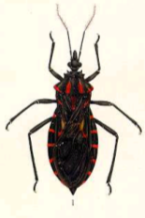
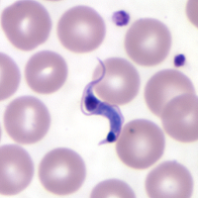
Chagas: a one-minute summary
American trypanosomiasis
Vector-borne parasitic infection
Lifelong infection if untreated
End-organ damage to heart +/or GI tract in ~30% seropositive
10-40 years after initial exposure
Vector transmission limited to Americas (largely Central, South and Mexico)
Triatomine vectors
Trypanosoma cruzi

Slide 5
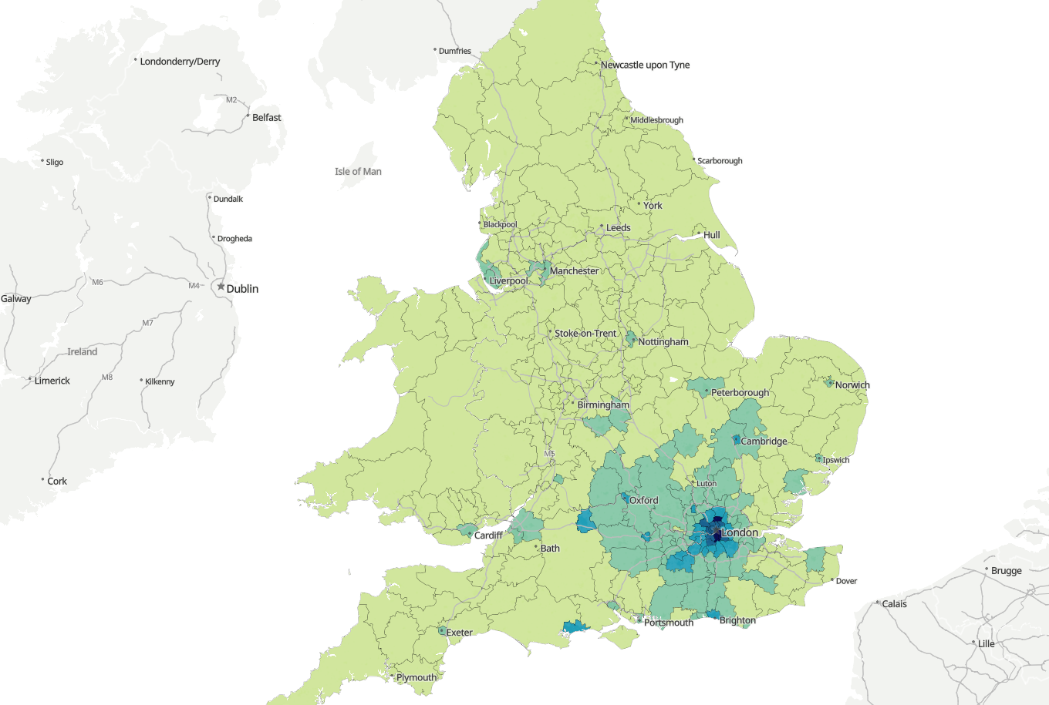
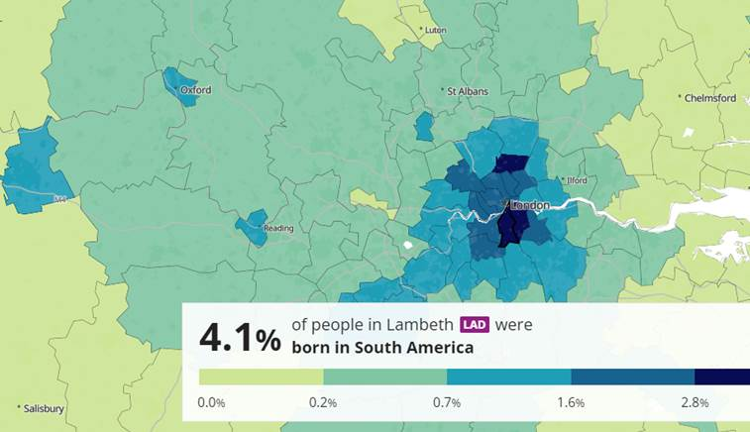
280,000 Latin Americans in England
Notes:
~ 250,000 in England
~150,000 in London
Country of birth
England and Wales
The Americas and the Caribbean: North America: Other North America
5926
The Americas and the Caribbean: Central America: All Central American countries
23573
The Americas and the Caribbean: South America: All South American countries
254222
Total
283721
England
The Americas and the Caribbean: North America: Other North America
5787
The Americas and the Caribbean: Central America: All Central American countries
22932
The Americas and the Caribbean: South America: All South American countries
251256
Total
279975
London
The Americas and the Caribbean: North America: Other North America
1027
The Americas and the Caribbean: Central America: All Central American countries
8331
The Americas and the Caribbean: South America: All South American countries
142318
Total
151676

Slide 6
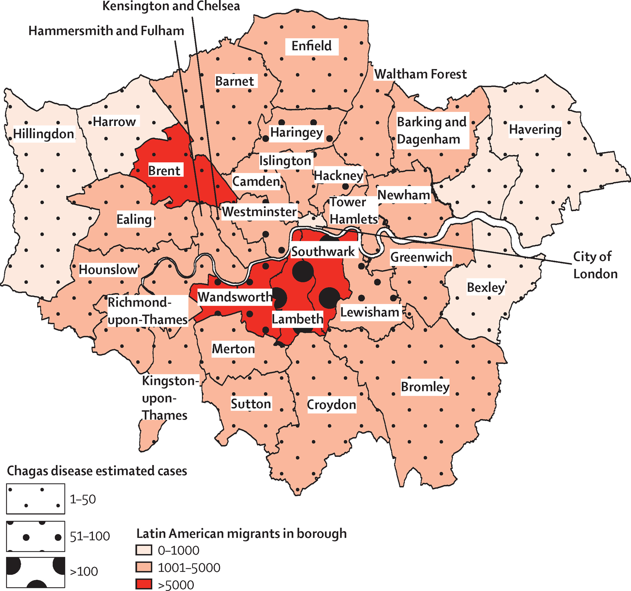
The diagnosis gap
97% people with Chagas in UK undiagnosed
Lancet Global Health 2016; 4: e232-3
Notes:
The total number of reported cases of T cruzi infection diagnosed in London from 2001 to 2014 was 41 (Allen J, Hospital for Tropical Diseases, personal communication), giving a prevalence among Latin American migrants in London of 0·043%. The rate ratio between the observed and the expected prevalence of T cruzi infection was 3·34%, resulting in an index of underdiagnosis of 96·6%.

Slide 7
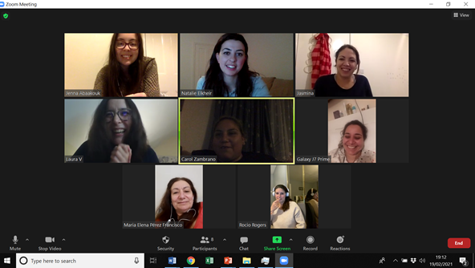
Patient & public engagement

Slide 8
Addressing the gap: a community screening pilot
Social media advertising
Screening events
Eligibility
Survey + POCT
Clinic follow-up
Aim: co-produce & evaluate a community-based screening initiative for Chagas disease in London
Notes:
Eligibility criteria: Adults born in, or whose mothers were born in, the 21 endemic countries
Screening events in community centres were co-produced with community members and local charities
Advertised on social media channels and by word-of-mouth
A questionnaire captured demographic information and risk factors for Chagas disease
A finger-prick lateral flow blood test was used for qualitative detection of lgG to Trypanosoma cruzi.
Follow-up: Individuals who screened positively were seen in the Chagas clinic at the Hospital for Tropical Diseases with consultation and confirmatory serology (ELISA & IFAT) and PCR
Add Pasa la voz arrows

Slide 12
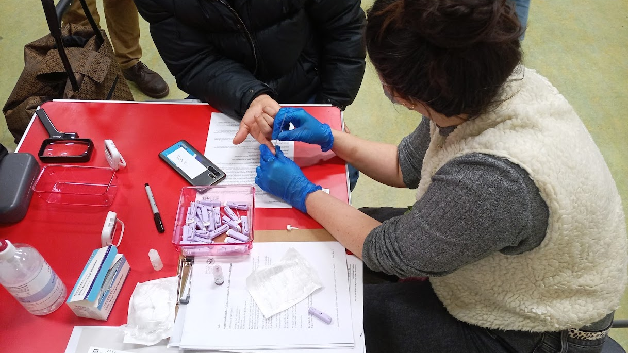

Slide 13
258
people screened
Notes:
Add note to this slide

Slide 14
67%
56%
Notes:
Type your notes

Slide 15
58%
born in Bolivia
Notes:
Add note to this slide

Slide 16
59 (23%)
positive
Notes:
Type your notes

Slide 17
59 (23%)
positive
Notes:
Type your notes

Slide 18
49
confirmed with serology
89% positive predictive value
Notes:
Type your notes

Slide 19
40
(68%)
Notes:
Type your notes

Slide 20
Notes:
Type your notes

Slide 21
13 (27%)
PCR positive
Notes:
Type your notes

Slide 22
Conclusion
Engaging and collaborating with local communities can address some of the underdiagnosis of Chagas in our Latin American migrant community and link individuals into care

Slide 23
