Slide 1
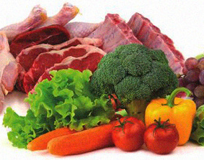
Toxocara spp. contamination of food - assessing the risks to public health
Martha Betson
Sara Healy
University of Surrey

Slide 2
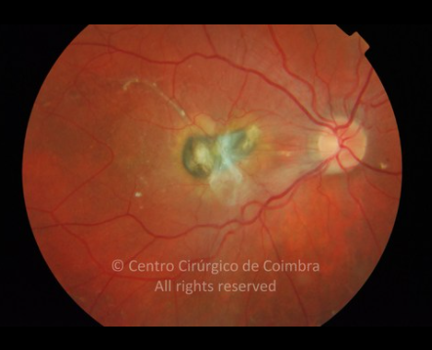
Human toxocariasis
Caused by Toxocara sp. (canis/cati)
Humans accidental hosts
Wide clinical presentation: from no signs to epilepsy, asthma, allergic skin disease, blindness…
19% global population have anti-Toxocara antibodies (Africa ~40% and SE Asia ~34%) (Rostami, 2019)
Neglected disease
Notes:
Humans are paratenic hosts, larvae migrate from the gut to a variety of organs
Clinical signs vary – dep on where the larvae migrate to and Thought to be immune system of host -> pathology. Vague – poss Underdiagnosed?

Slide 3
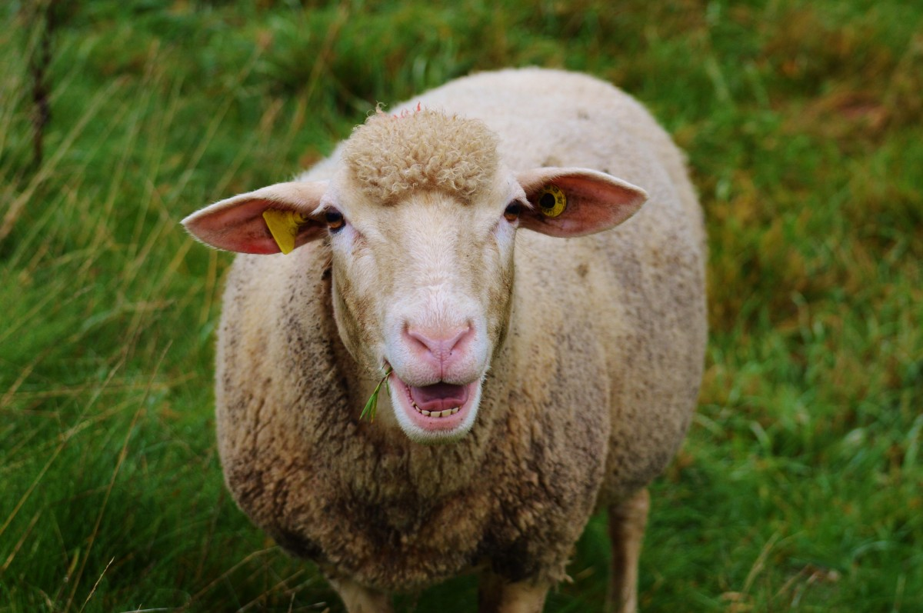
Epidemiology
Definitive hosts excrete eggs in faeces
Eggs last for long periods in the soil
Pasture and crops contaminated

Slide 4
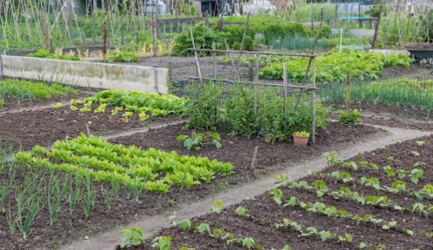
Pilot study
16 allotment sites (Surrey/SW London, UK)
12-week study (Summer 2021)
Lettuce, spinach, spring onion and celery (‘ready to eat’ veg types)
Plot holder questionnaire in each donation bag
First time this has been investigated in UK
Could Toxocara eggs from infected animals contaminate vegetable crops in allotments?

Slide 5
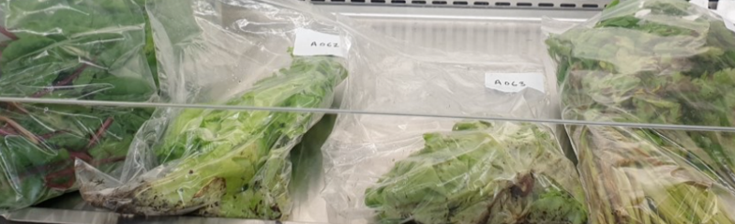
Allotment sample analysis
82 vegetable samples obtained in total
100g of each tested – sedimentation & microscopy
For 8 samples, at least 100g soil from around the vegetable plant was also available to analyse

Slide 6
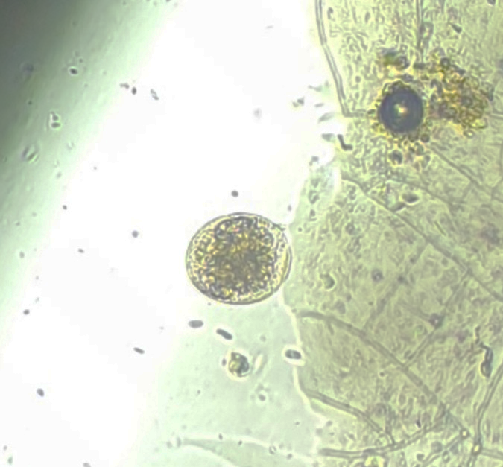
Results of the pilot study
Vegetables
2/82 positive for Toxocara sp. eggs (both were lettuce) = Prevalence of 2.4%
(Lettuce (N=31) prevalence = 6.5%)
Soil
1/8 positive for Toxocara sp. eggs

Slide 7
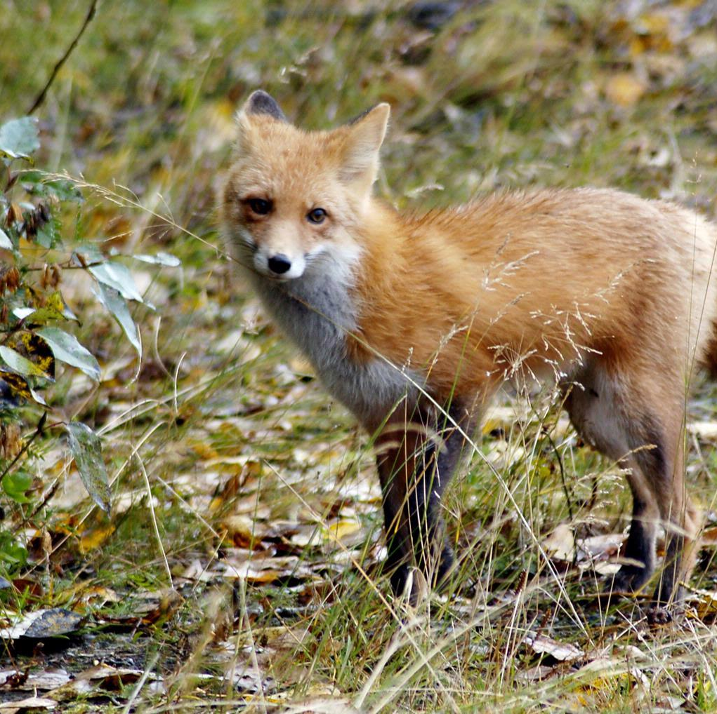
Questionnaire results:
88% (68/77) of respondents had seen a definitive host species or the excrement of a definitive host on their site
29% (22/77) of respondents reported seeing foxes, cats and dogs at their community garden
Image source: nhpbs.org

Slide 8
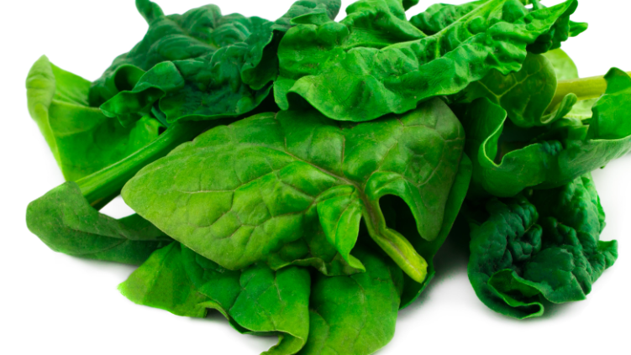
Commercial farm study (summer 2022)
Investigated produce field-grown on larger-scale commercial farms
Spinach selected as leafy, widely available on farms and can be eaten without prior peeling/cooking
120 samples from 4 farms in south of England
Sampled along every row in the field at 1m intervals

Slide 9
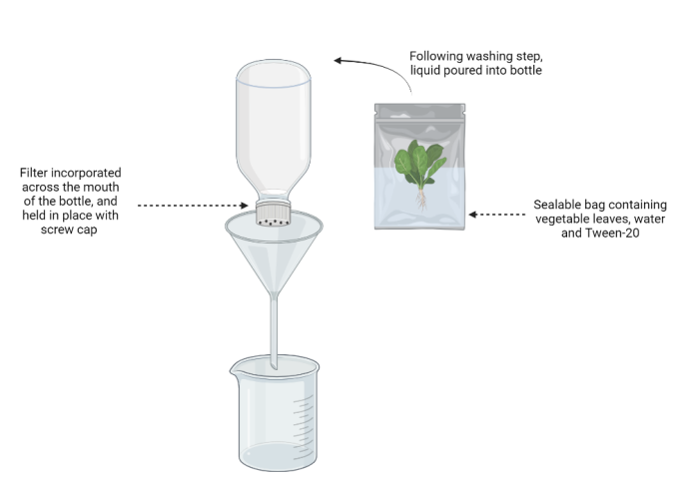
Methodology
300g spinach samples
Washed with 500mL of water containing 0.2% Tween 20 – passed through sieving system (Guggisberg et al. 2020)
Nylon filter (40µm diameter) in bottle neck captures eggs
Extracted DNA from eggs retrieved -> multiplex qPCR
Spiking experiments detected down to 4 eggs
Image adapted from Guggisberg et al. (2020) created with Biorender.com

Slide 10
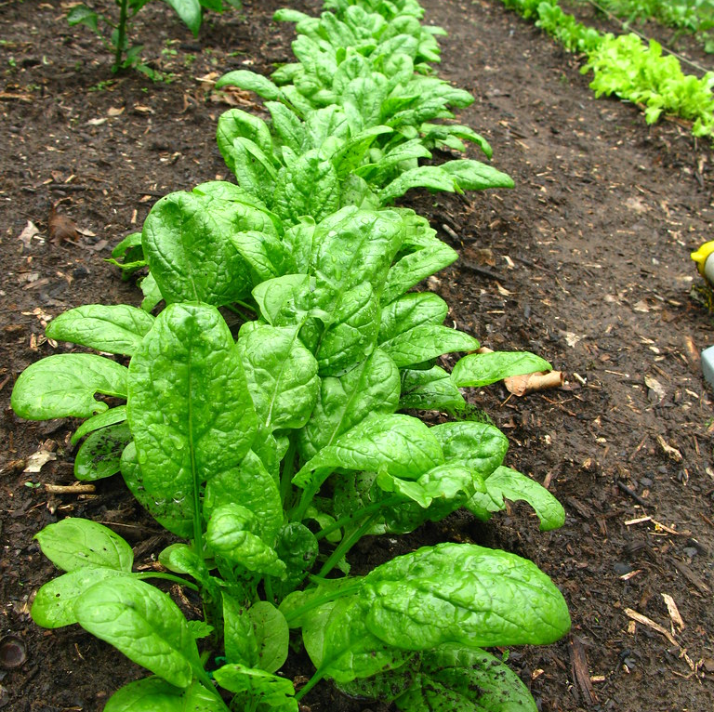
Results of spinach study
23.0% of samples were positive for T. canis (28/120)
1.7% positive for T. cati (2/120)
Difference in the number of positive samples between farms statistically significant (P = 0.0064)

Slide 11
What do these findings tell us?
Toxocara spp. is present on food products destined for human consumption in the UK
Definitive hosts are able to access fields/allotments where food is grown – biosecurity implications
Increasing public awareness of the importance of thorough vegetable washing before consumption is crucial
Our research continues to investigate food products for Toxocara spp. contamination, aiming to assess the risks to pubic health and whether intervention measures are needed

Slide 12
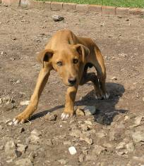
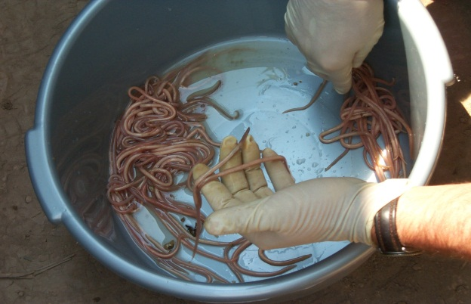
NTD research at Surrey
Diseases (some examples)
A multidisciplinary approach involving >20 researchers
Buruli ulcer
Biology
Medicine & veterinary medicine
Epidemiology & mathematical modelling
Social science & economics
Engineering/WASH
One Health approach is key for sustainable policy
https://www.surrey.ac.uk/neglected-tropical-diseases-research
Rabies
Echinococcosis & schistosomiasis
Intestinal helminthiases & food-borne trematodiases

Slide 13
Questions?

