Slide 1
26th January 2023
Temporal changes in Toxoplasma gondii exposure in human populations
Dr. Gregory Milne
@GC_Milne
gmilne@rvc.ac.uk

Slide 2
Background
Aim & methods
Results
Discussion
Toxoplasma: an NTD?
Global distribution but…
Disproportionately affects lower income, minority & indigenous populations
Severe opportunistic infection
Interventions mostly in high-income countries
Notes:
Why higher in lower income?
I’m going to begin by persuading you that while toxo is not on the current WHO list of NTDs & its distribution is not limited to the tropics, it meets many of the other criteria required of NTDs
Firstly, there is a larger burden of infections in lower socioeconomic status & minority groups, as shown in these examples here of Germany and the US, where seroprevalence is higher among lower income populations. And indeed this pattern holds when we instead look globally by country income status, with poorer countries shouldering the burden of higher parasite exposure.
Secondly, furthering its impact on disadvantaged groups, it is a chronic condition & can be a fatal opportunistic infection among immunosuppressed individuals.
Thirdly, it is neglected in the fact that the few public health interventions that exist are largely based in high-income countries
And if that doesn’t sufficiently persuade you of T. gondii’s neglected status, listen to the CDC

Slide 3
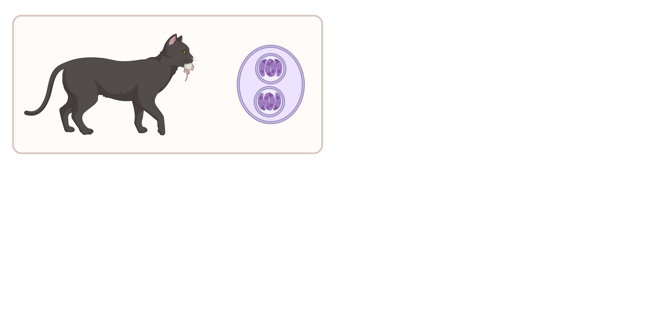
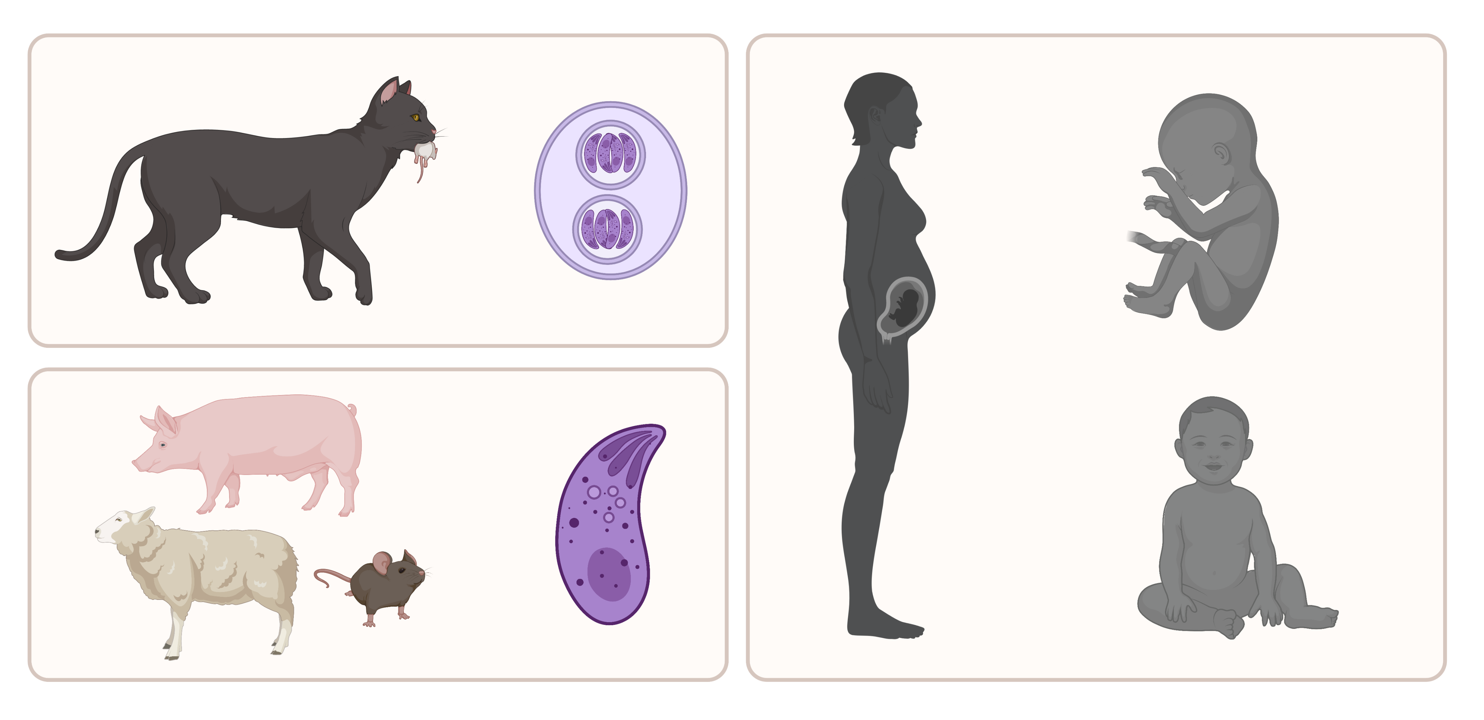
Background
Aim & methods
Results
Discussion
Epidemiology
Notes:
-cats are the definitive hosts, shed oocysts which contaminate the environment
-other warm blooded animals acquire the infection by ingesting oocysts or by eating other infected animals containing the parasite in their tissues
-people can become infected through either of these two routes
-pregnant women are considered a high-risk group, since those who become exposed for the first time during pregnancy are at risk of vertical transmission from mother to foetus
-this may result in congenital toxoplasmosis, which can cause spontaneous abortion, stillbirth, or if the foetus is brought to term, a range of craniocerebral and ocular effects

Slide 4
Background
Aim & methods
Results
Discussion
Temporal changes in T. gondii seroprevalence
France
Notes:
- since the mother’s immunological status determines the risk of vertical transmission, it is important to have information on the proportion of the population that have specific antibodies, known as seroprevalence
- It is also important, therefore, to understand how seroprevalence might be changing over time
- Interestingly, in recent decades, some countries have reported decreases in seroprevalence
This graph shows the age-seroprevalence curves for the general population of France
However it is unclear to what extent this trend holds across other countries, and no study has yet collected these data

Slide 5
Background
Aim & methods
Results
Discussion
Aim & Methods
Milne, Webster & Walker 2022
Aim: To identify if T. gondii exposure is consistently decreasing over time
By collecting: representative IgG seroprevalence data, longitudinal sampling
Notes:
To fill this evidence gap, we aimed to extract representative seroprevalence data from the literature to assess trends over time

Slide 6
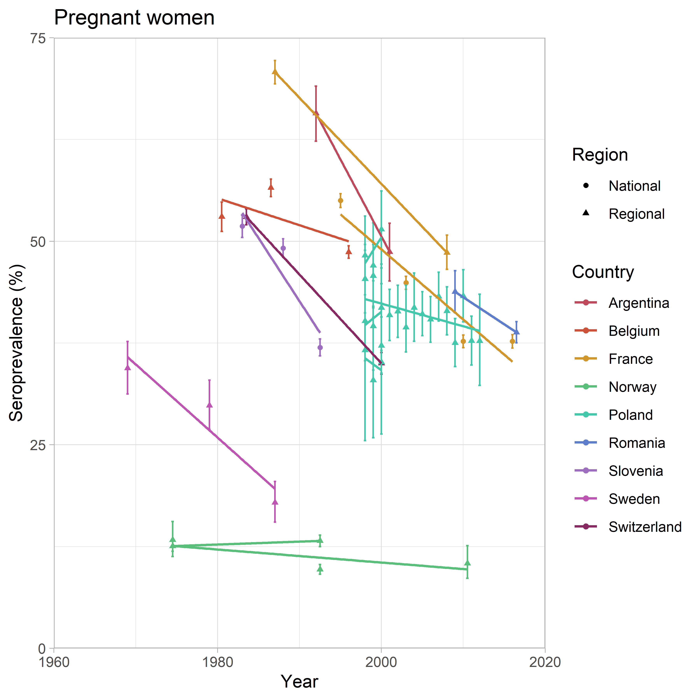
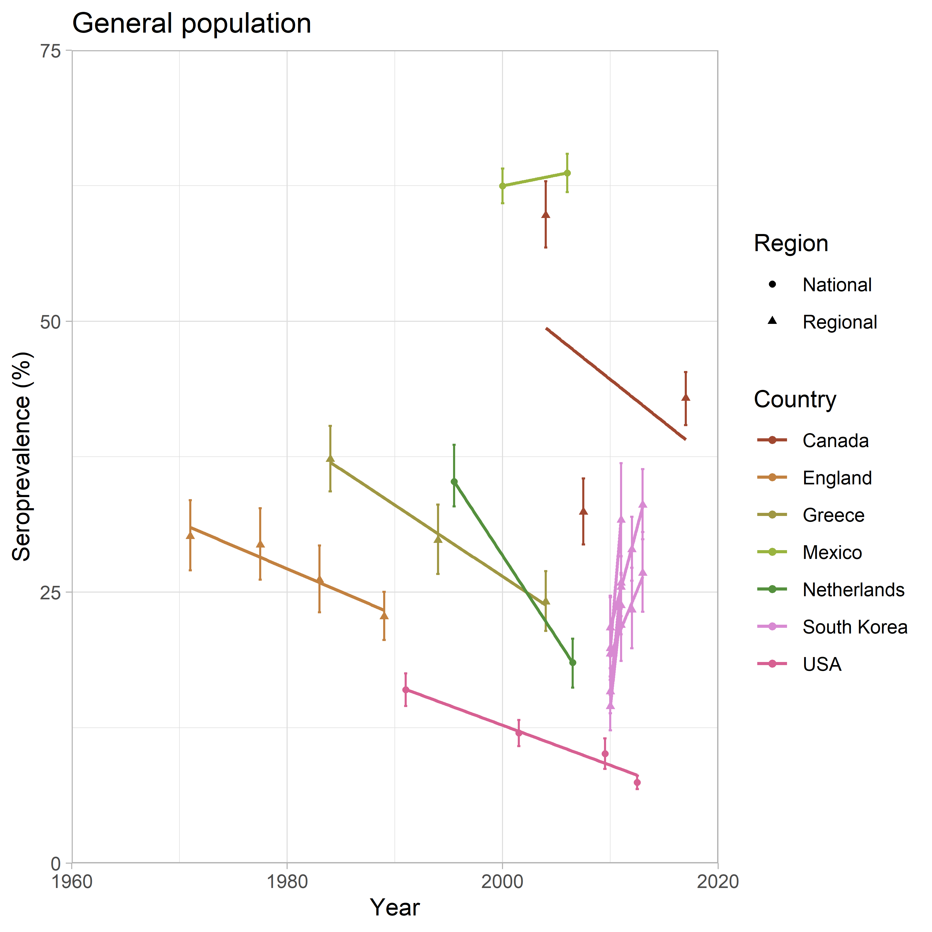
Background
Aim & methods
Results
Discussion
Results: seroprevalence
Milne, Webster & Walker 2022
~270,000 people, 39 studies (19 countries, 4 continents)
Notes:
Each line shows the linear change in seroprevalence for a given country
For countries where we had data for more than one population, these data are grouped so that lines correspond to the changes within each population
For brevity I have shown data on only 2 of the 6 collected populations. However the trends in seroprevalence are qualitatively similar, with most showing a trend of decreasing seroprevalence

Slide 7
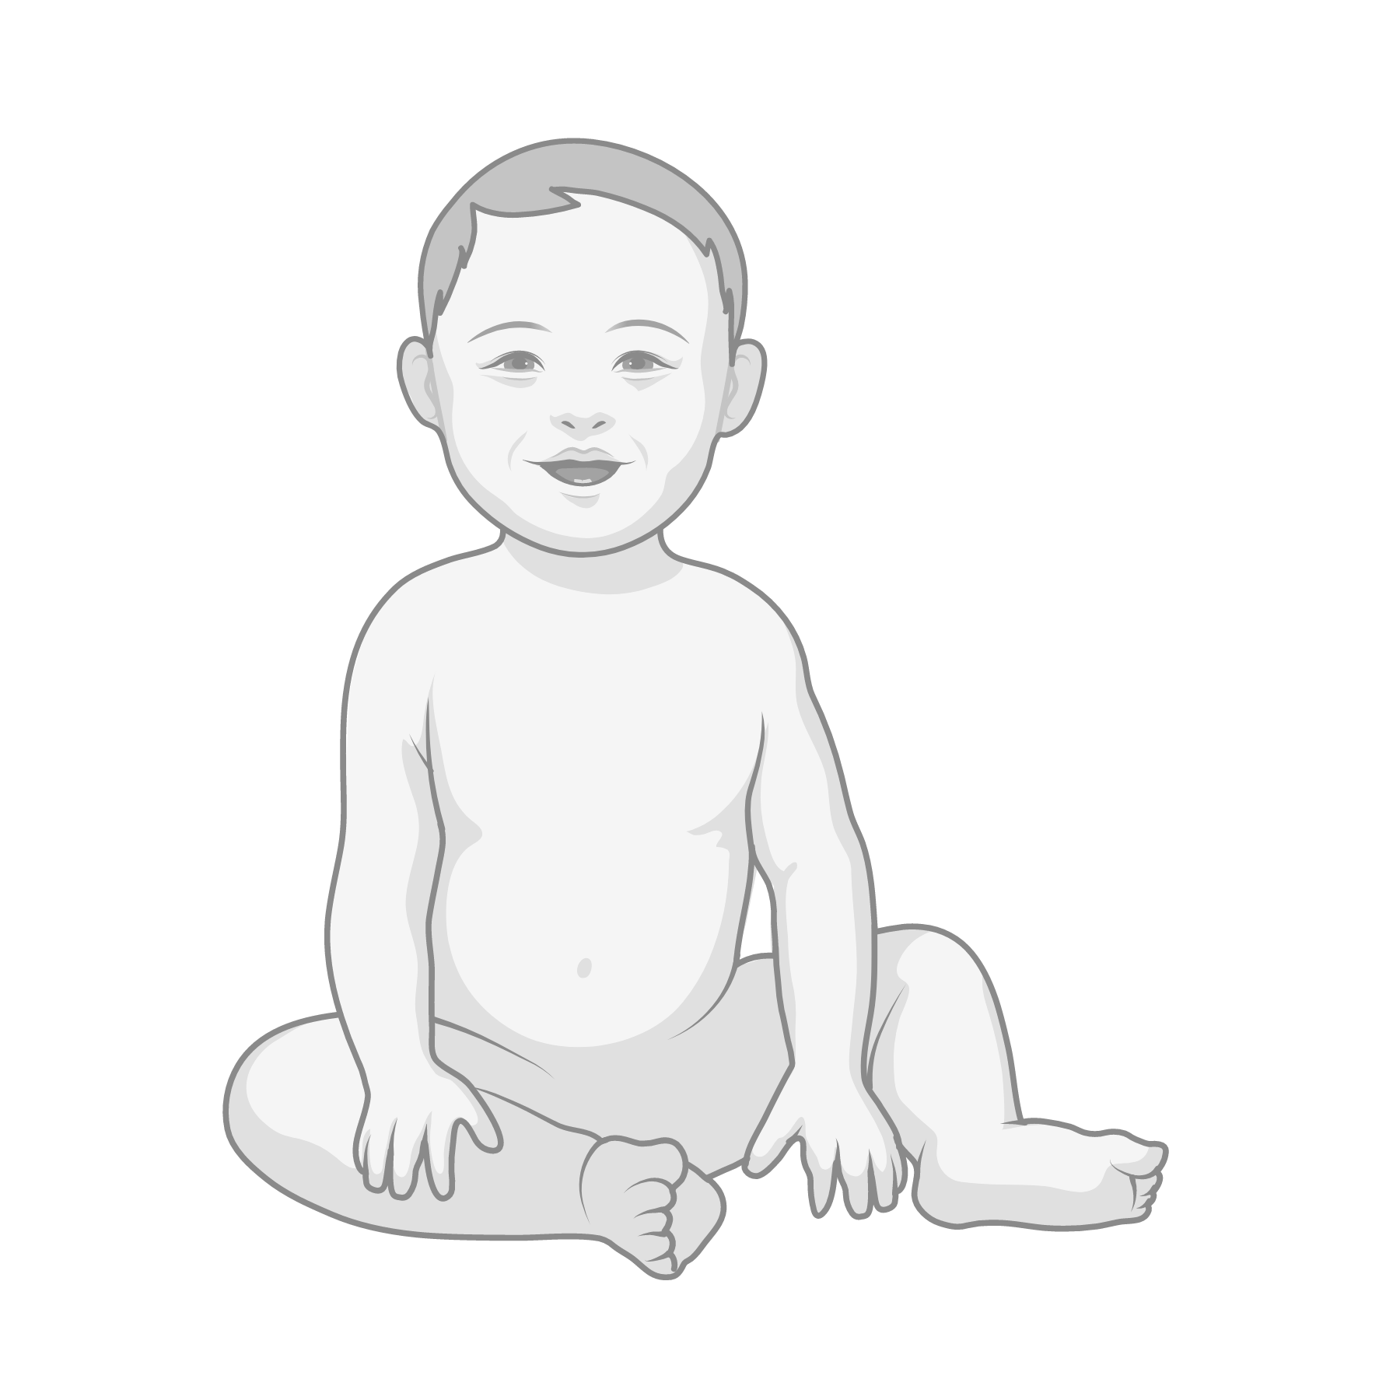
Background
Aim & methods
Results
Discussion
Discussion
Milne, Webster & Walker 2022
Evidence to support decreasing exposure in higher income countries
What about lower income?
This study not a systematic review
But data are less abundant in lower-income settings
Will (mostly) result in decreases in congenital toxoplasmosis incidence
Notes:
All countries in dataset were upper-middle to high income
Don’t have time to discuss the predictions of CT incidence but if you’re interested please do read our paper

Slide 8
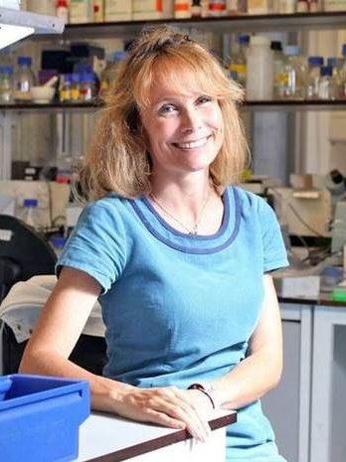
Acknowledgments
Dr. Martin Walker & Prof. Joanne Webster
@GC_Milne
gmilne@rvc.ac.uk

Slide 10
Supplement: estimating CT incidence
Milne, Webster & Walker 2022

Slide 11
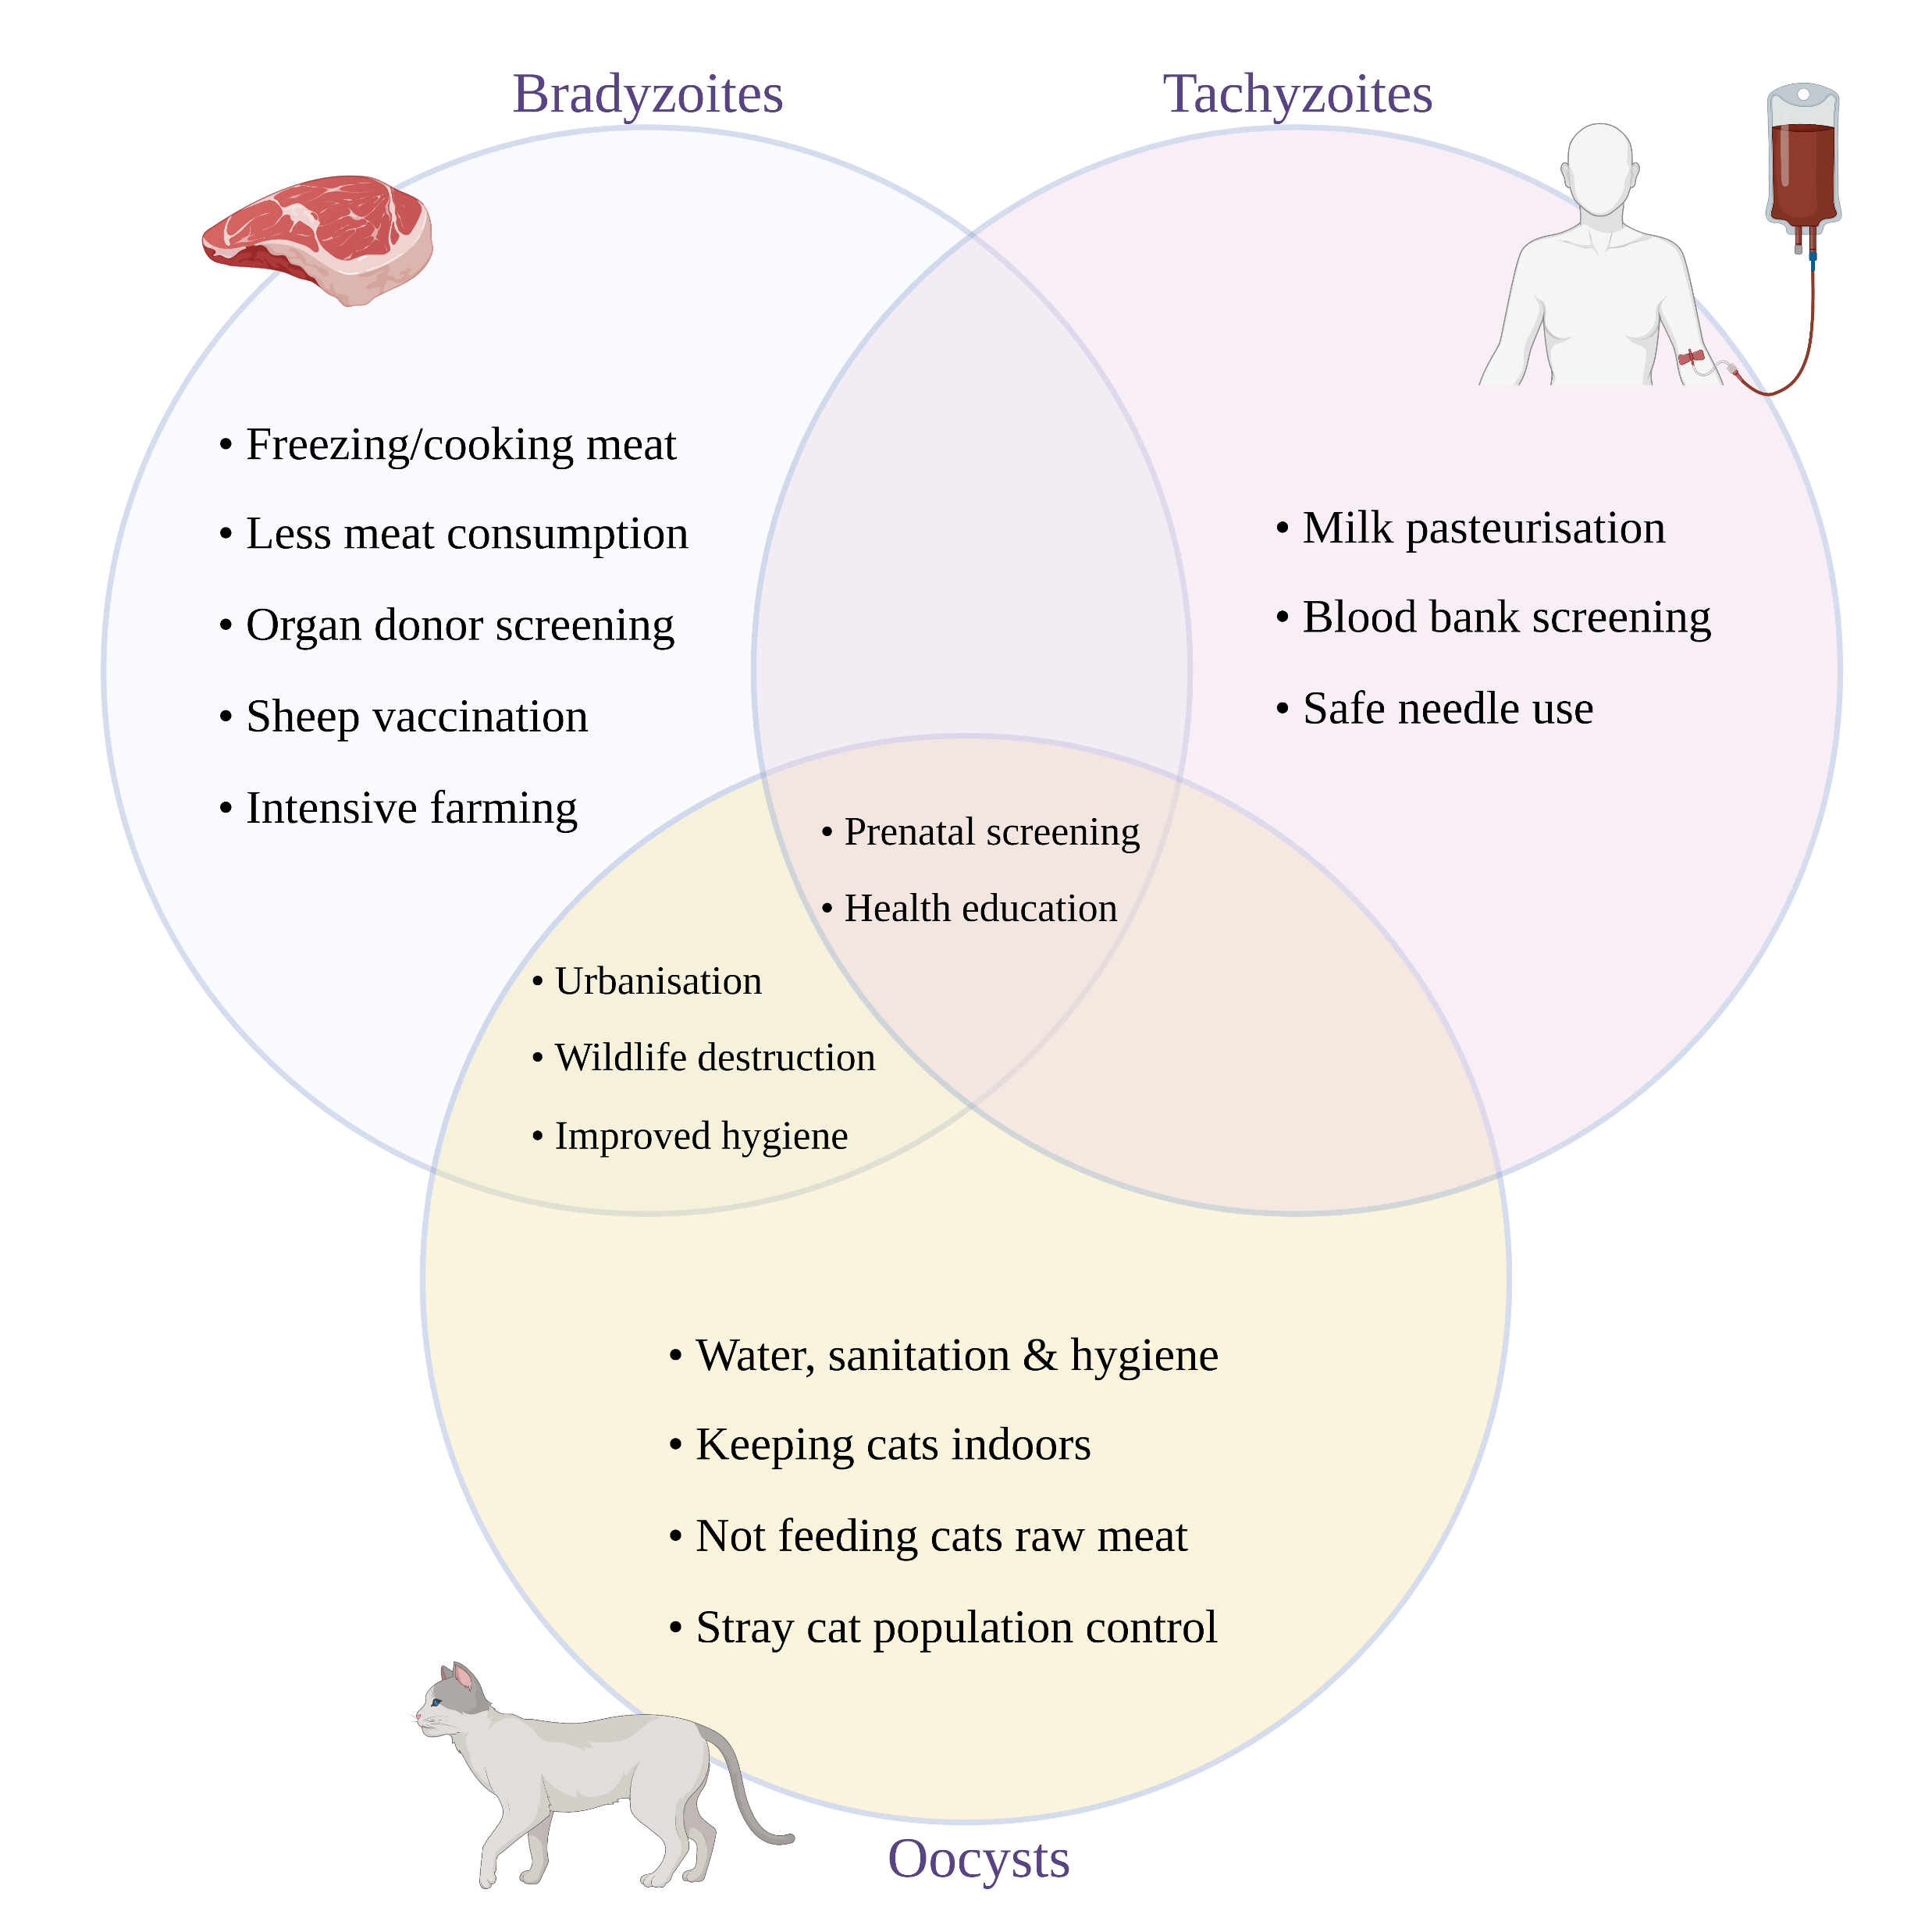
Supplement: possible causes of declines
Milne, Webster & Walker 2022

