Slide 1




The potential mechanistic pathways leading from parasite infection to childhood stunting
Isobel L. Gabain^{1,2}, Anouschka S. Ramsteijn³ and Joanne P. Webster^{1,2}
¹Department of Pathobiology and Population Sciences, Royal Veterinary College, University of London, Herts, AL9 7TA, UK
²London Centre for Neglected Tropical Diseases Research, Imperial College London Faculty of Medicine, St Mary’s Hospital Campus, London, W2 1NY, UK
³Rowett Institute, University of Aberdeen, Aberdeen, AB25 2ZD, UK

Slide 2
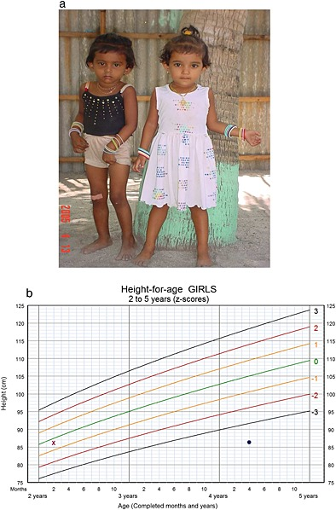
Childhood Stunting
A child is “stunted” if they are too short for their age, having a length/height-for-age Z-score that falls more than two standard deviations below the WHO Child Growth Standards Medium
WHO estimates stunting affects ~24 % or 161 mil children globally
Onis and Branca (2016)
Notes:
Stunting indicates a failure to achieve one’s own genetic potential for height
Physical stunting is accompanied by reduced and delayed neurocognitive development
Child on the left is twice the age of girl on the right, yet both same height

Slide 3


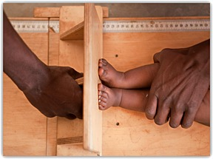

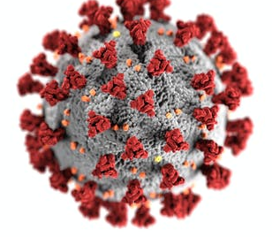
Stunting Targets
SDG 2.2.1: Reduce the number of stunted under 5s by 40% by 2025
Further challenges: Climate, Covid-19, conflict
Onis and Branca (2016)
Notes:
Sustainable development goal 2 is Zero Hunger

Slide 4

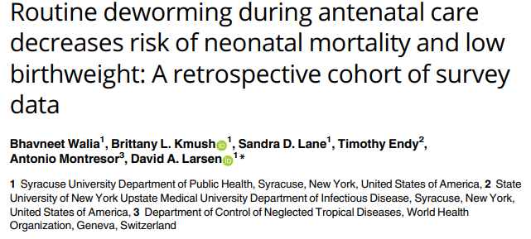
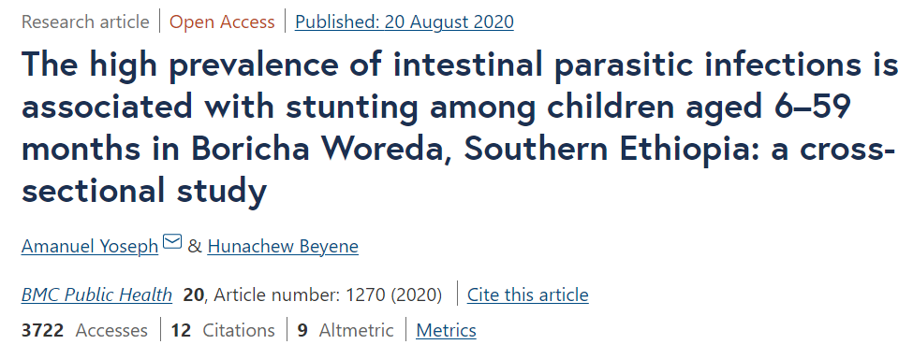
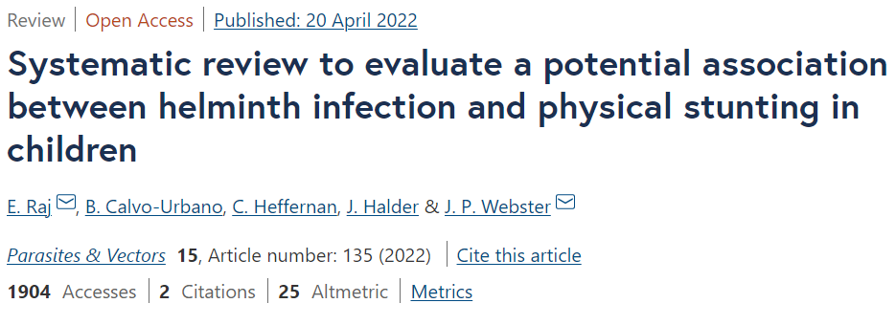
Parasites cause/contribute to stunting?
Parasites often cited as a causative
Data lacking from key demographic groups (pregnant and breastfeeding women and children under two)
Notes:
Aside from inadequate nutrition, there are other key drivers
Repeated and/or persistent parasitic infection
Studies shown that anthelmintics can increase height in SAC
First 1000 days
Stunting more difficult to salvage after
Crucial window of opportunity for intervention

Slide 5
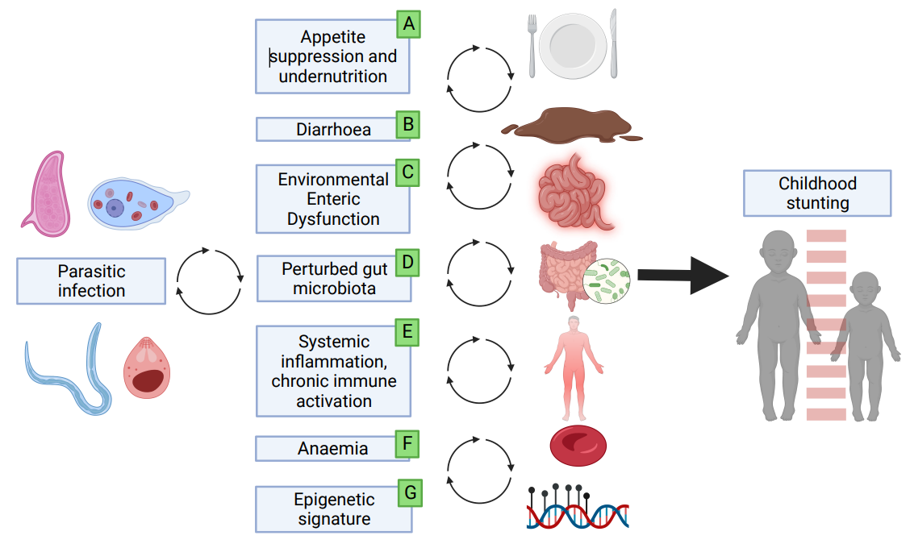
Mechanisms?
Notes:
Opinion article
Present and summarise potential mechanistic pathways
Evidence interactions between these pathways

Slide 6
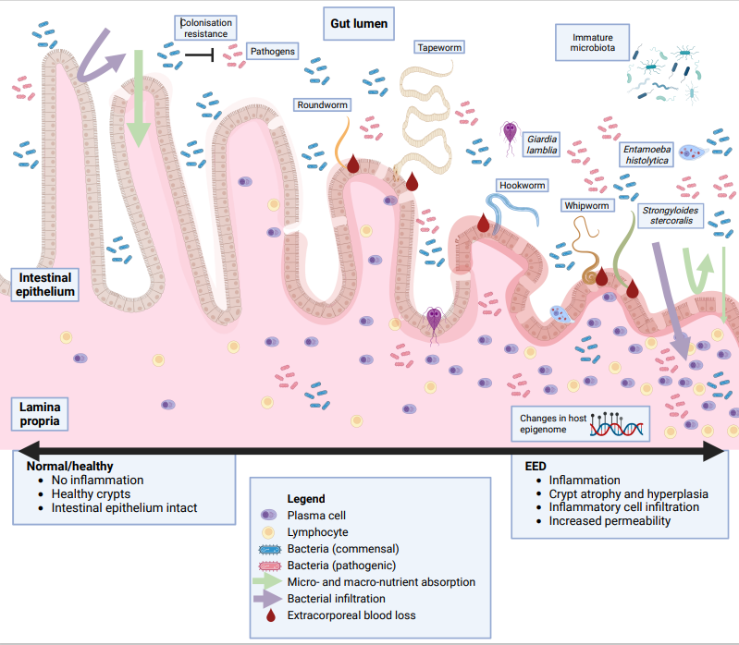
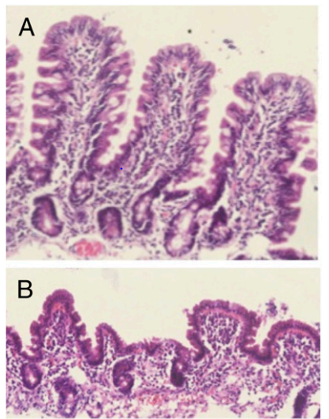
Environmental enteric dysfunction (EED)
Parasites → EED → stunting
Owino, Victor et al. “Environmental Enteric Dysfunction and Growth Failure/Stunting in Global Child Health.” Pediatrics vol. 138,6 (2016): e20160641. doi:10.1542/peds.2016-0641
Notes:
Incompletely defined syndrome - characterised by evidence of gut mucosal inflammation, altered intestinal architecture (villous atrophy and crypt hyperplasia) and dysbiosis → asymptomatic
A number of potential triggers →GI infections e.g. Giardia disrupt the epithelium (damage + inflammation)
Resulting intestinal leakiness, reduced gut SA, and destruction of catalytically active brush border enzymes → maldigestion and malabsorption → malnutrition
Anaemia → worms feed and anticoagulants cause continued bleeding at the feeding site

Slide 7
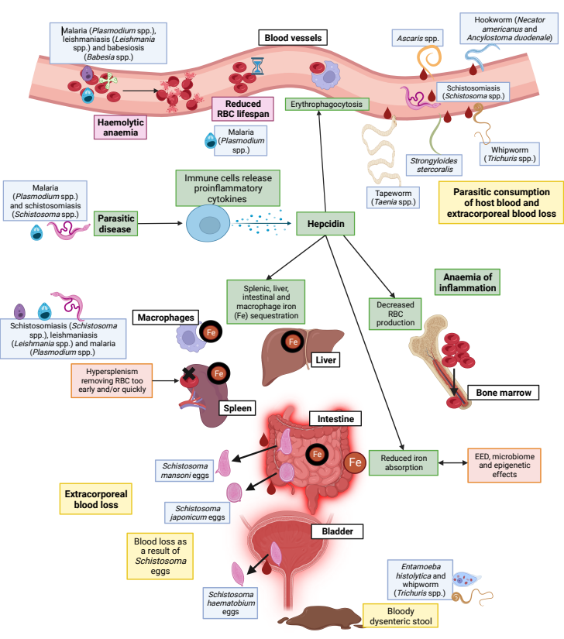
Anaemia
Parasites → anaemia → stunting
Hypoxia in cells
Interfere with insulin-like growth factor-1 (IGF-1) signalling
Notes:
Anaemia may inflict hypoxic conditions on cells – can interfere with insulin-like growth factor-1
Low maternal IGF-1 levels at birth have been associate with LBW (proxy for stunting at birth)

Slide 8
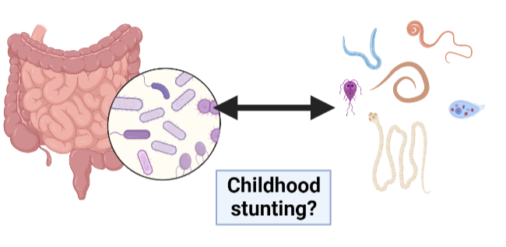
Gut microbiota
Refers to the collection of microorganisms in the gastrointestinal tract, which is dominated by bacteria
Parasites → microbiota changes → stunting
Notes:
Microbiota is established early in life – influenced by the mother (milk)
Parasites influence maturation (more strongly in the first 1000 days), causing profile changes (lower diversity in bacterial species + overgrowth of certain species), associated with stunting

Slide 9
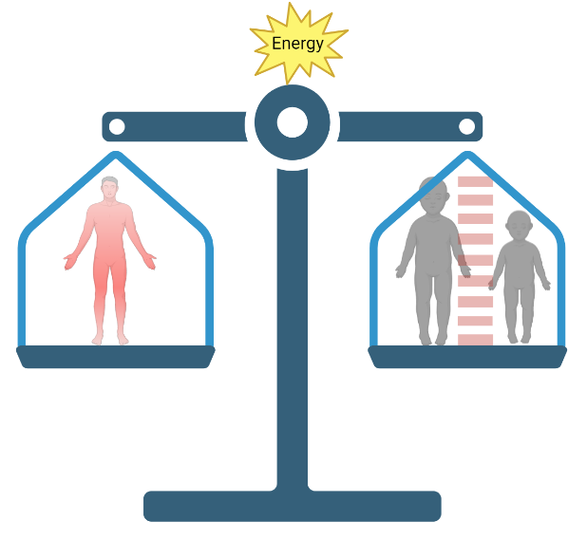
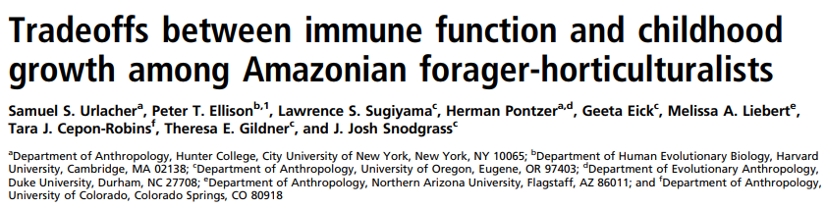
Energetic trade-off
EED and fever and systemic inflammation
Helminths vs parasitic protozoa
Notes:
EED - bacterial translocation into systemic circulation
Invasive protozoal infections are associated with fever
Immune function is nergetically costly - potentially diverts calories away from linear growth
Interestingly, helminths – potentially attenuate immune response

Slide 10
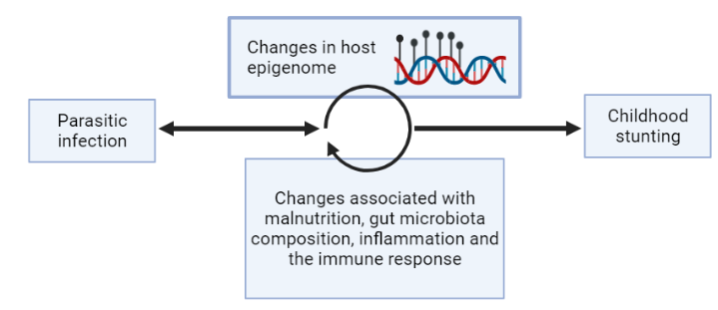
Epigenetics
Epigenetics – characteristics in or on the DNA that influence gene expression but do not involve the genetic sequence e.g. DNA methylation
Notes:
Parasites manipulate host cells through epigenetic mechanisms that alter host genome expression and signalling pathways (Sh - methylation that interrupts immune function)
Epigenetic signatures have been associated with stunting
Isn’t much evidence yet – but interesting area of research

Slide 11
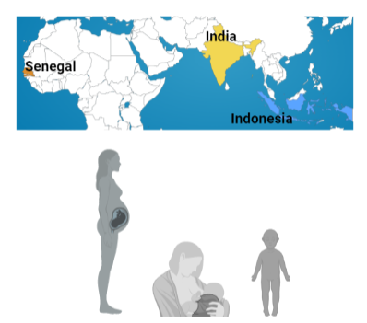
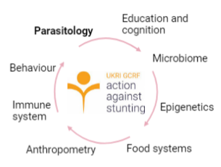
Action Against Stunting Hub
Longitudinal cohort study

Slide 12
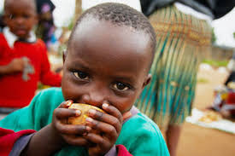


Thank you!
Prof. Joanne P. Webster
Dr Anouschka Ramsteijn
Action Against Stunting Hub (https://actionagainststunting.org/

