Slide 1
An economic evaluation of Wolbachia deployments for dengue control
Hugo C Turner
Lecturer: Health economics
MRC Centre for Global Infectious Disease Analysis
Imperial College London

Slide 2
Its BURDEN IS only going to get worse!!
Notes:
Dengue is a significant public health problem
It economic burden was estimated to be around 8 bliion per year from Study in around 2014
AND DUR TO climate change
Its only going to get worse!!

Slide 3
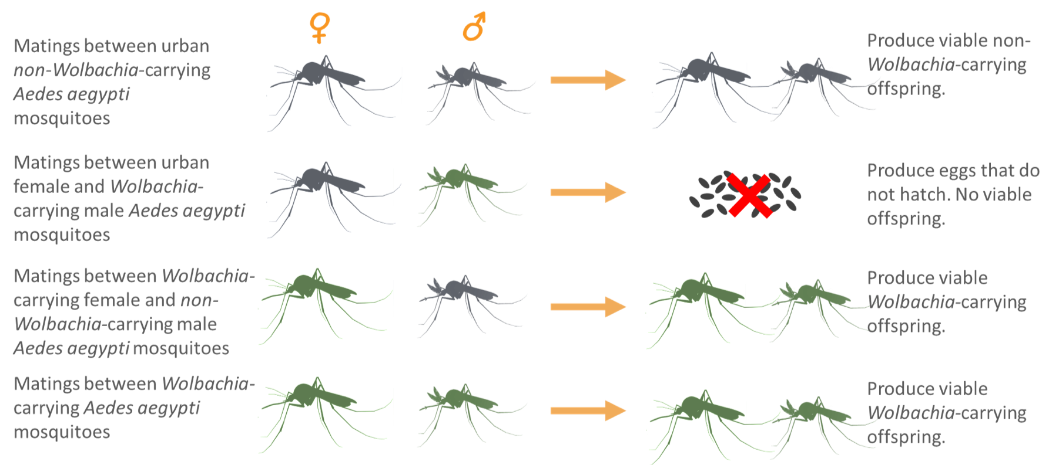
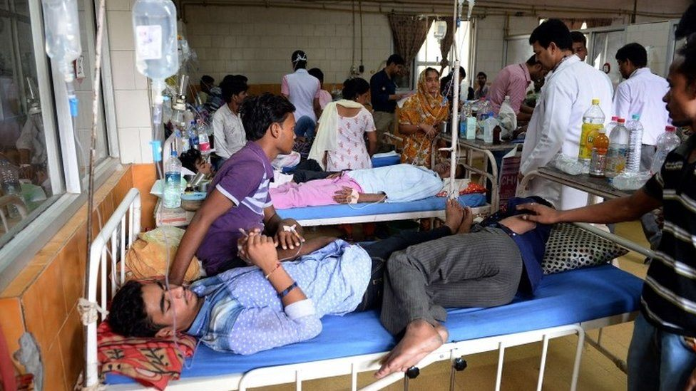
Background
https://www.sciencedirect.com/science/article/pii/S1931312821001347
https://www.nea.gov.sg/corporate-functions/resources/research/wolbachia-aedes-mosquito-suppression-strategy/wolbachia-aedes-mosquito-suppression-strategy-how-it-works/cytoplasmic-incompatibility
Currently, there is no specific therapeutic treatment for dengue
Standard vector control interventions generally unable to sustainably control it.
A range of novel technologies are under development.
Spread of Wolbachia-carrying mosquitoes mediates the reduction in arbovirus transmission and is self sustaining
BBC
Kaur et al 2021
Notes:
Currently, there is no specific therapeutic treatment for dengue, and therefore preventive interventions are vital
Wolbachia are extremely common bacteria that occur naturally in 50 per cent of insect species
Wolbachia live inside insect cells and are passed from one generation to the next through an insect’s eggs
Aedes aegypti mosquitoes (THE MAIN VECTOR FOR DENGUE) don’t normally carry it
METHODS to INTRODUCVE IT HAVE BEEN FOUND in a way that is self sustaining once it is reaslead
YOU USE THIS SHOULD OF TECHNOLOGY IN OTHER WAYs – such as suppring the mosquitoes population
What is Wolbachia?
Wolbachia are extremely common bacteria that occur naturally in 50 per cent of insect species, including some mosquitoes, fruit flies, moths, dragonflies and butterflies. Wolbachia are safe for humans and the environment. Independent risk analyses indicate that the release of Wolbachia-infected mosquitoes poses negligible risk to humans and the environment.
Wolbachia are extremely common bacteria that occur naturally in 50 per cent of insect species, including some mosquitoes, fruit flies, moths, dragonflies and butterflies. Wolbachia live inside insect cells and are passed from one generation to the next through an insect’s eggs. Aedes aegypti mosquitoes don’t normally carry Wolbachia, however many other mosquitoes do.
Our method does not suppress mosquito populations or involve genetic modification (GM), as the genetic material of the mosquito is not altered.
Long-term monitoring shows that our natural Wolbachia method is self-sustaining in almost all international project sites, with the first mosquitoes released in 2011.

Slide 4
Aim of this study
We evaluate the cost-effectiveness of scaled Wolbachia replacement strategy as a form of dengue control in Vietnam
Done in collaboration with the World Mosquito Program

Slide 5
Methods
Ten high burden urban settings were identified as priority locations
The effectiveness of Wolbachia deployments in reducing the incidence of symptomatic cases was assumed to be 75%
Assume it will have an effect for up to 20 years (varied this down to 10 years)
Notes:
was assumed to be 75% - based on a randomized control trail

Slide 6
Results: Baseline burden
Baseline annual economic burden (2020 US$ prices)
Cases that sought no formal treatment | Outpatient cases | Hospitalized cases | Fatal cases | Government’s current dengue prevention and control activities | Total economic burden
US$4,030,630 | US$5,839,849 | US$10,238,129 | US$3,590,929 | US$809,105 | US$24,508,641
Notes:
The economic burden inculds medical bills, non-medial costs, and valuing produvcintiuvt ylosses

Slide 7
Results: Costs
Cost around US$8.50 per person covered
US$171.3 million in total
Notes:
Costs are looked at for 4 different phases
Looking at ways to reduce these

Slide 8
Results: Economic evaluation
Cost-effectiveness | Cost per DALY averted
ICER - health sector perspective | 419.56
ICER - societal perspective | “Cost saving” (-716.26)
A threshold of around US$1,700 per DALY averted would be the cut off for cost-effective.
The results were most sensitive to assumptions related to the:
Duration of the impact of the intervention
The assumed growth in case numbers
Wolbachia deployment costs.
Notes:
Our outcome is the cost per DALY averted
DALY averted - one DALY is the equivalent of one year of heath being lost
Used a range of different perceptive only showing here
Perspective is the viewpoint from which the analysis is connected
These affect which cost offstes or savings are included which are deducted from the cost of the interventions within the calculation.
health sector perspective – we consider all the offsets associated with averted medical bills
DALY averted - one DALY is the equvi,ment of one year of heath being lost
ICER - societal perspective all savings associated with averted dengue cases (valued producinty gains )

Slide 9
Key messages
We found that targeting high burden cities with Wolbachia deployments to control dengue would be a cost-effective intervention in Vietnam
Further investigation of ways to reduce the cost and ensure the long term benefits of the intervention are needed.
Notes:
We found that targeting high burden cities with Wolbachia deployments to control dengue would be a cost-effective intervention in Vietnam
Generating considerable health and economic benefits from both a health sector and societal perspective.

Slide 10
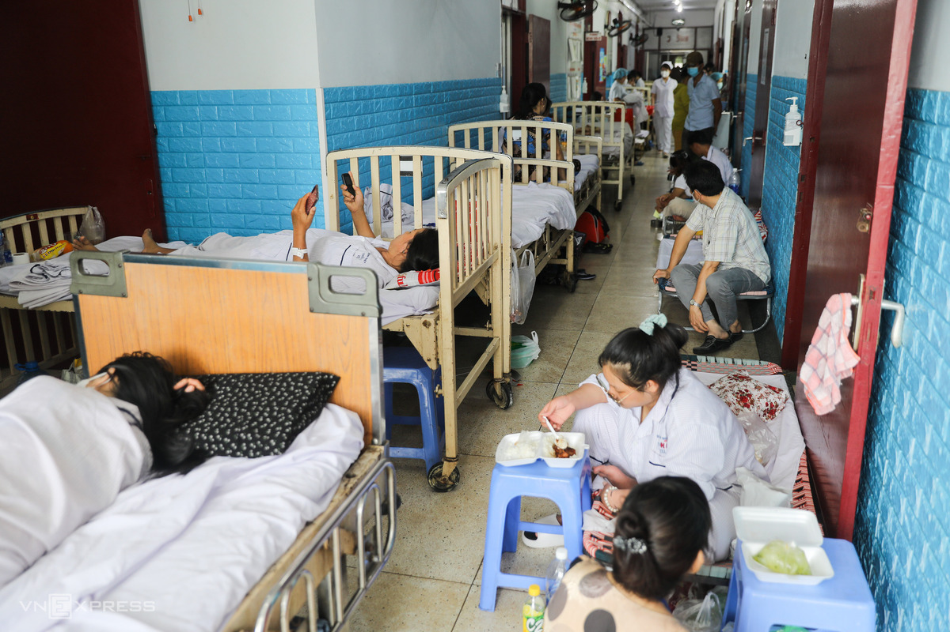
Future directions
Consideration of the broader benefits of dengue control – impact on ICU capacity
More advanced costing models
Comparison to other interventions (such as new vaccines)
Working more with policymakers for understanding their needs
We are keen to promote/support health economic research within the LCNTDR.
vnexpress.net

Slide 11
Acknowledgements
Duong Le Quyen,
Reynold Dias,
Cameron P. Simmons,
Katherine L Anders
Phan Thi Huong

