Slide 1



The journey of External Quality Assurance (EQA) specimens for diagnostic parasitology: from our hands to yours
Jaya Shrivastava
UK NEQAS Parasitology Scheme Manager

Slide 2
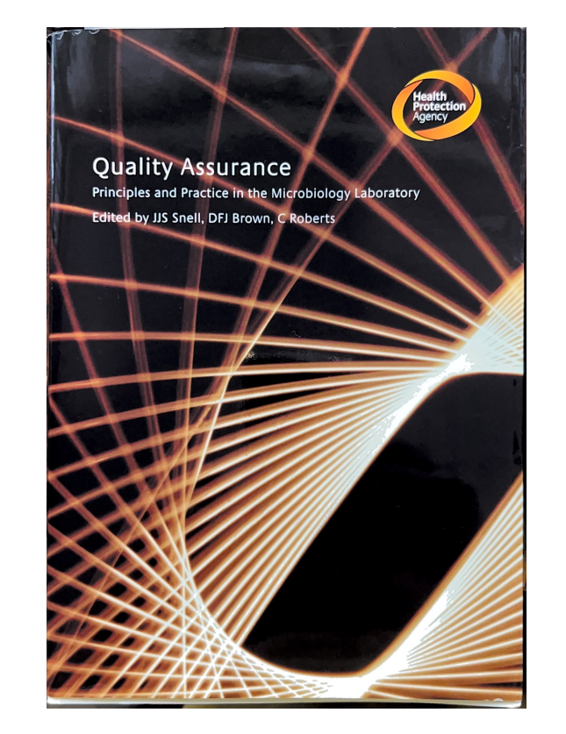
What is Quality Assurance?
Quality assurance in clinical diagnostics:
  “the right result at the right time on the right specimen from the right patient, with result interpretation based on correct reference data”
Should not be impacted by range of investigations undertaken or of the volume of the workload.
QA tells you that you may have a problem, it does not solve the problem.
Internal Quality assessment:
  Are today’s results the same as yesterday’s?
External quality assessment:
  Are my results the same as other laboratories?
  Does my method perform as well as others?

Slide 3
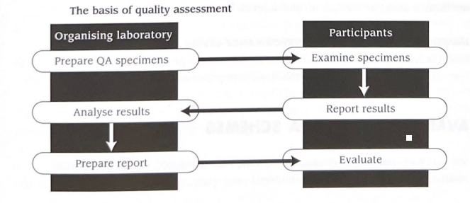

The role of EQA/Proficiency testing
External assessment of results from a group of laboratories, where each tests identical specimen of known but undisclosed content
A long term , retrospective and independent assessment of laboratory performance
Advantages:
  Comparability
  Educational
  Credibility/accreditation impacts
  Insight into national performance levels
  Improvement in national performance levels
  PATIENT BENEFIT
Essential part of Quality Management

Slide 4
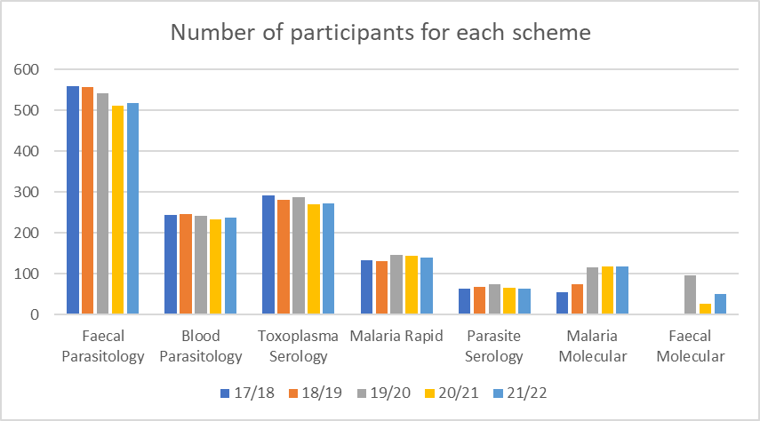
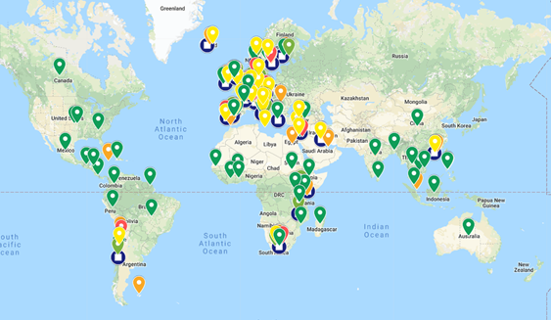
Quality Assurance in Parasitology
National External Quality Assessment Schemes for Parasitology- Operating since 1983
  Scheme Organiser: Professor Peter L Chiodini
  Scheme Manager: Dr Jaya Shrivastava
  Overseen by
    NEQAS Steering Committee
    National Quality Assessment Advisory Panel
  All schemes ISO 17043:2010 accredited
The techniques targeted are microscopy, serology, rapid tests and molecular.

Slide 5
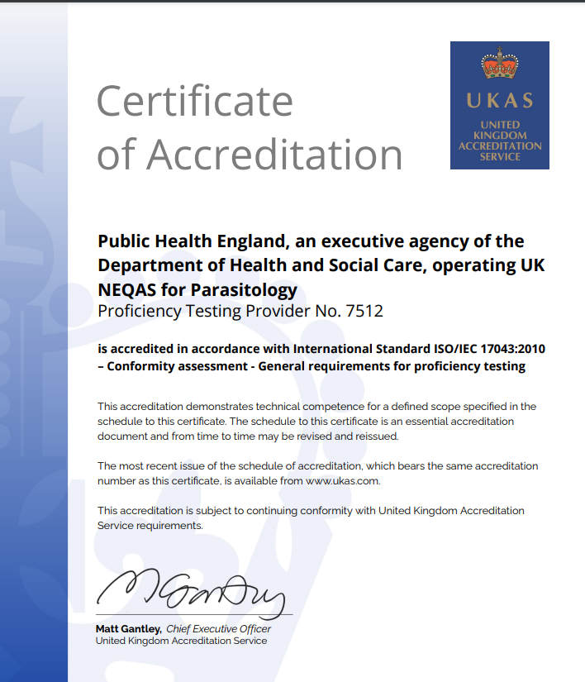
ISO 17043:2010 requirements for EQA specimens
EQA provider shall ensure that environmental conditions do not compromise the scheme. Conditions can include, for example, biological sterility, dust, electrical supply, and temperature.
Homogeneity and stability: inhomogeneity and instability have impact on participant’s performance.
  Each participant to receive comparable test items
  Test items remain stable throughout the testing period
Test to be performed pre- and post- distribution of schemes.
Storage and transport conditions should be optimal.
Procedures used to collect, produce, package and distribute the test items should be sufficient for the purpose of EQA testing.
Statistical analysis of variance to estimate the “sample-to-sample” variability and “within-sample” variability.

Slide 6
Considerations
Microscopy samples
  Need to be collected and processed ASAP.
  Morphological variation of malaria parasites and ex-flagellation of gametocytes occur on prolonged exposure of EDTA, and such changes can occur as early as 2-3 hours after blood collection.
  Faecal samples need to be formalized to prevent degradation of the morphological features.
Serological and Molecular samples
  For diagnostic procedures relying on antigen levels (serology or rapid tests), samples should be frozen after collection.
  Repeated freeze thaw cycles should be avoided, and it is recommended that no more than 2 cycles of freeze thaw are undertaken.
  Molecular samples require aseptic handling, and long-term storage at lower than minus 20 degrees in order to avoid degradation of genomic content.

Slide 7

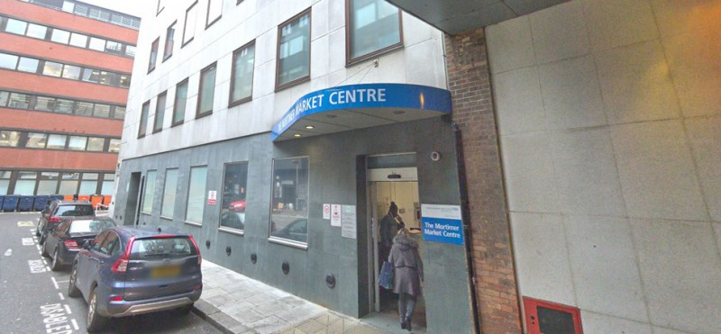



Where do the samples come from?

Slide 8
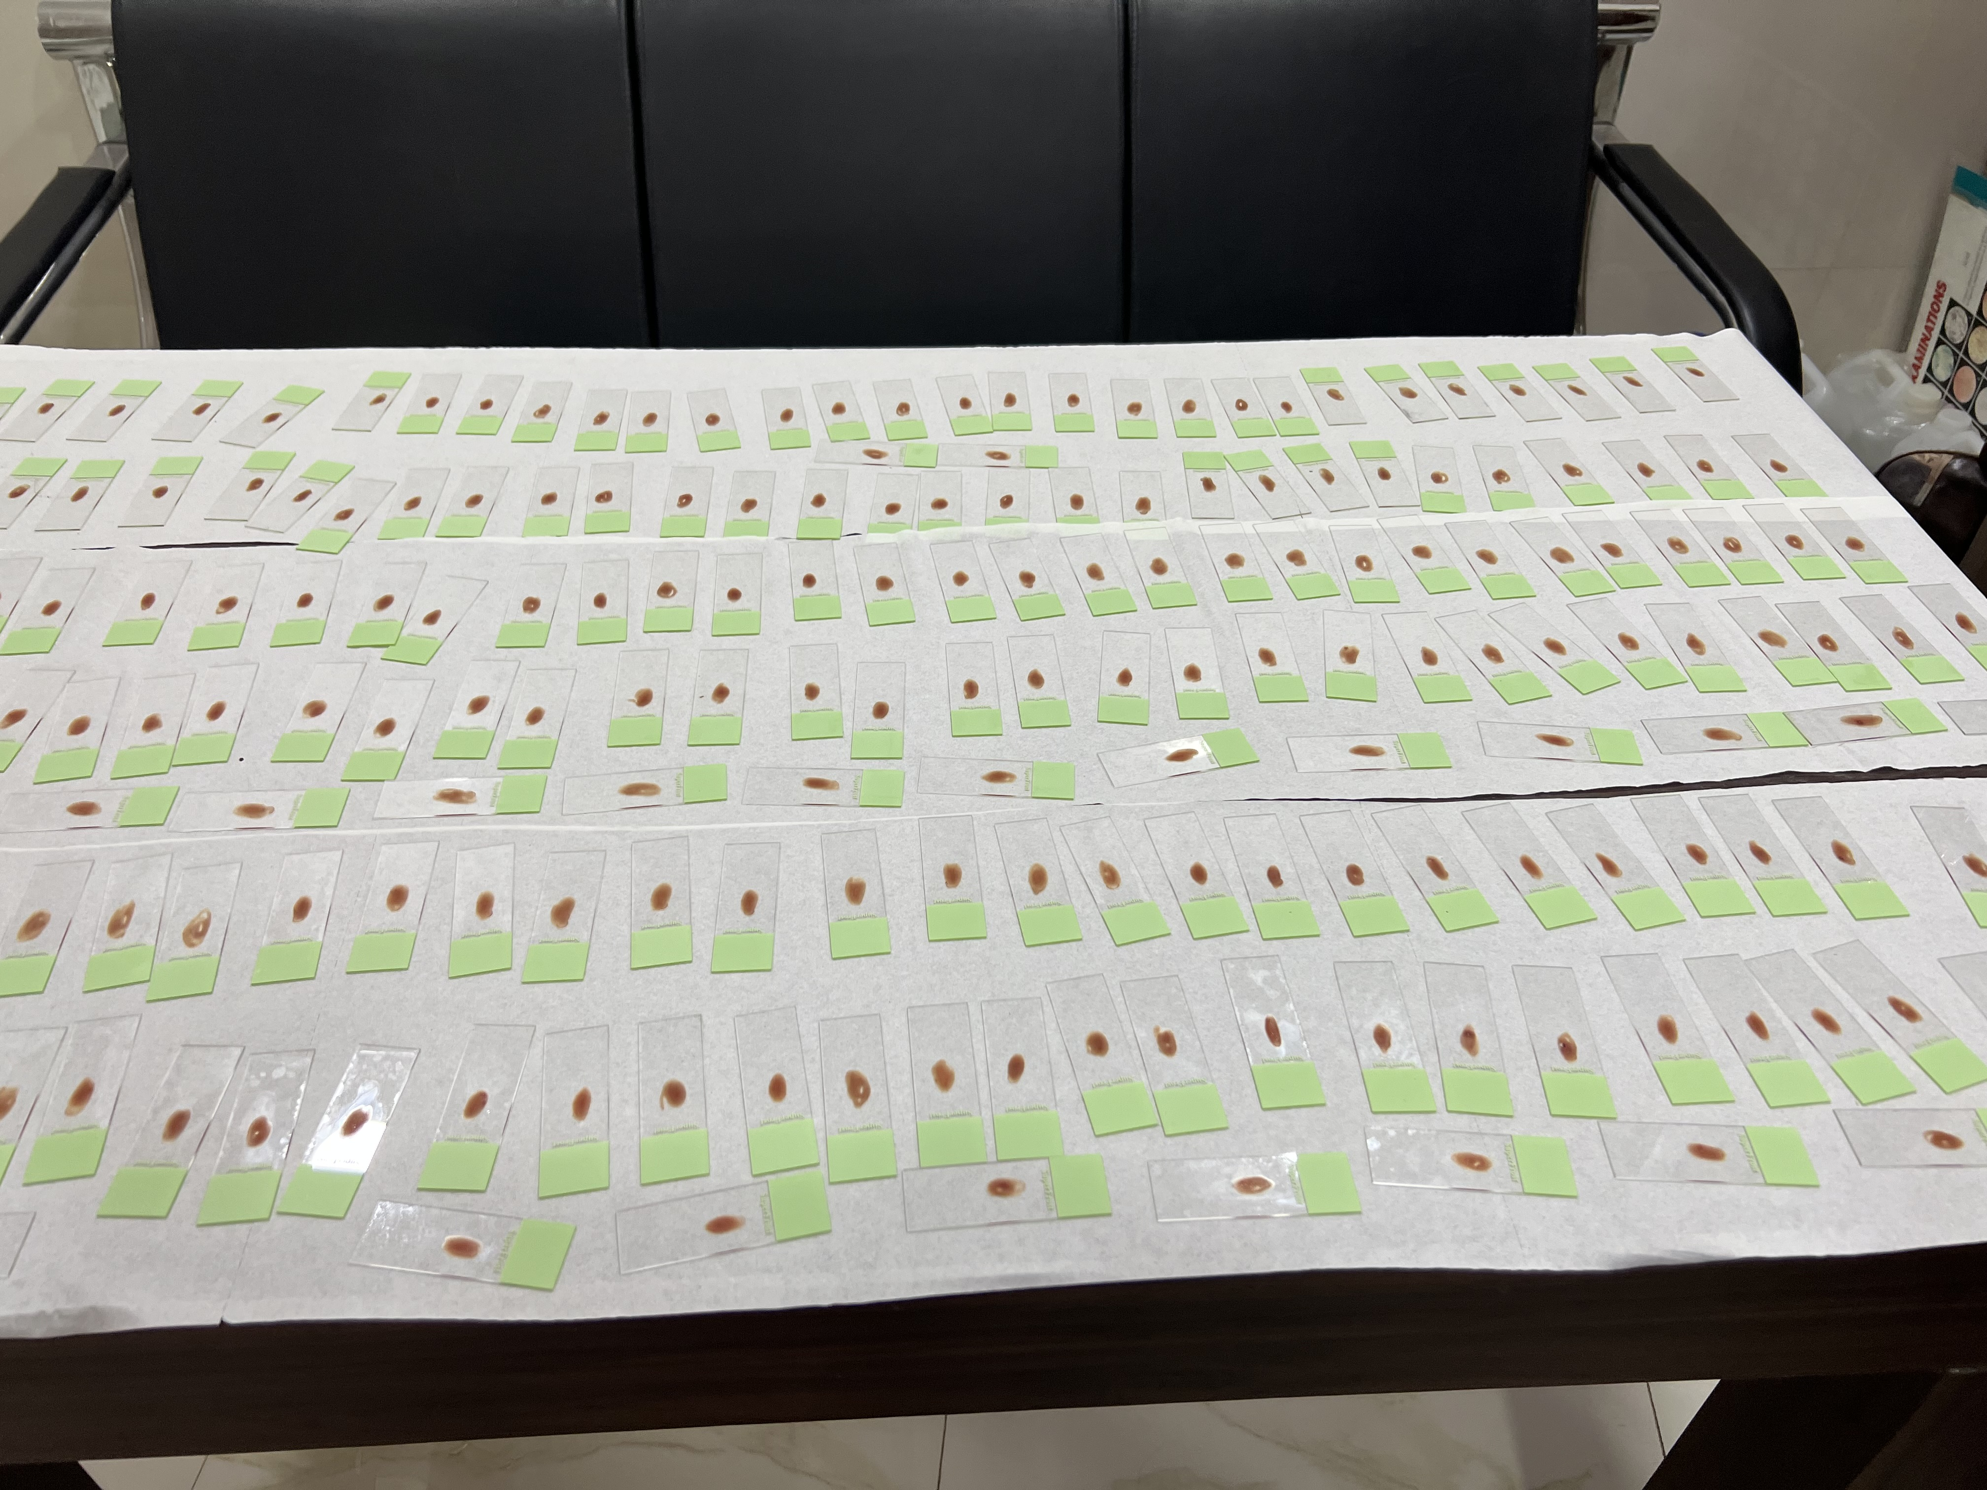
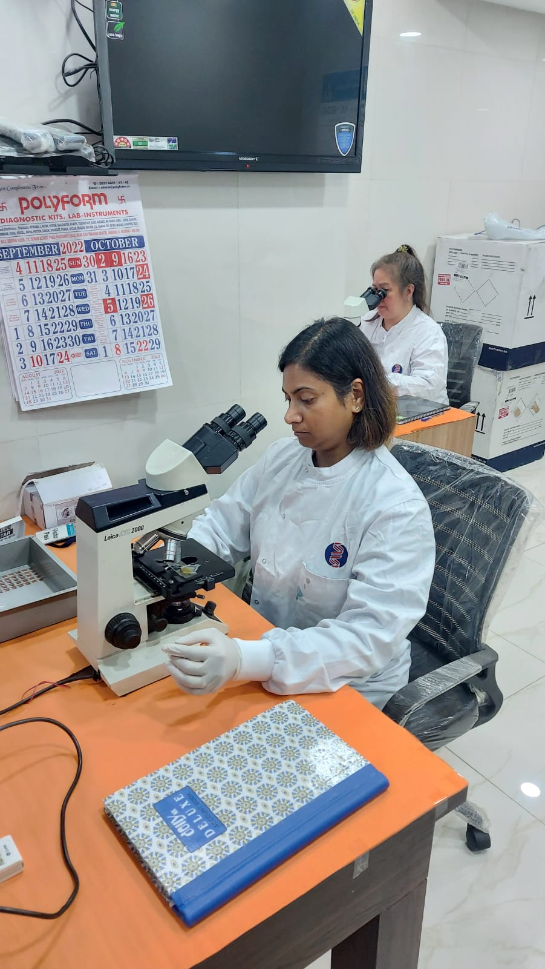
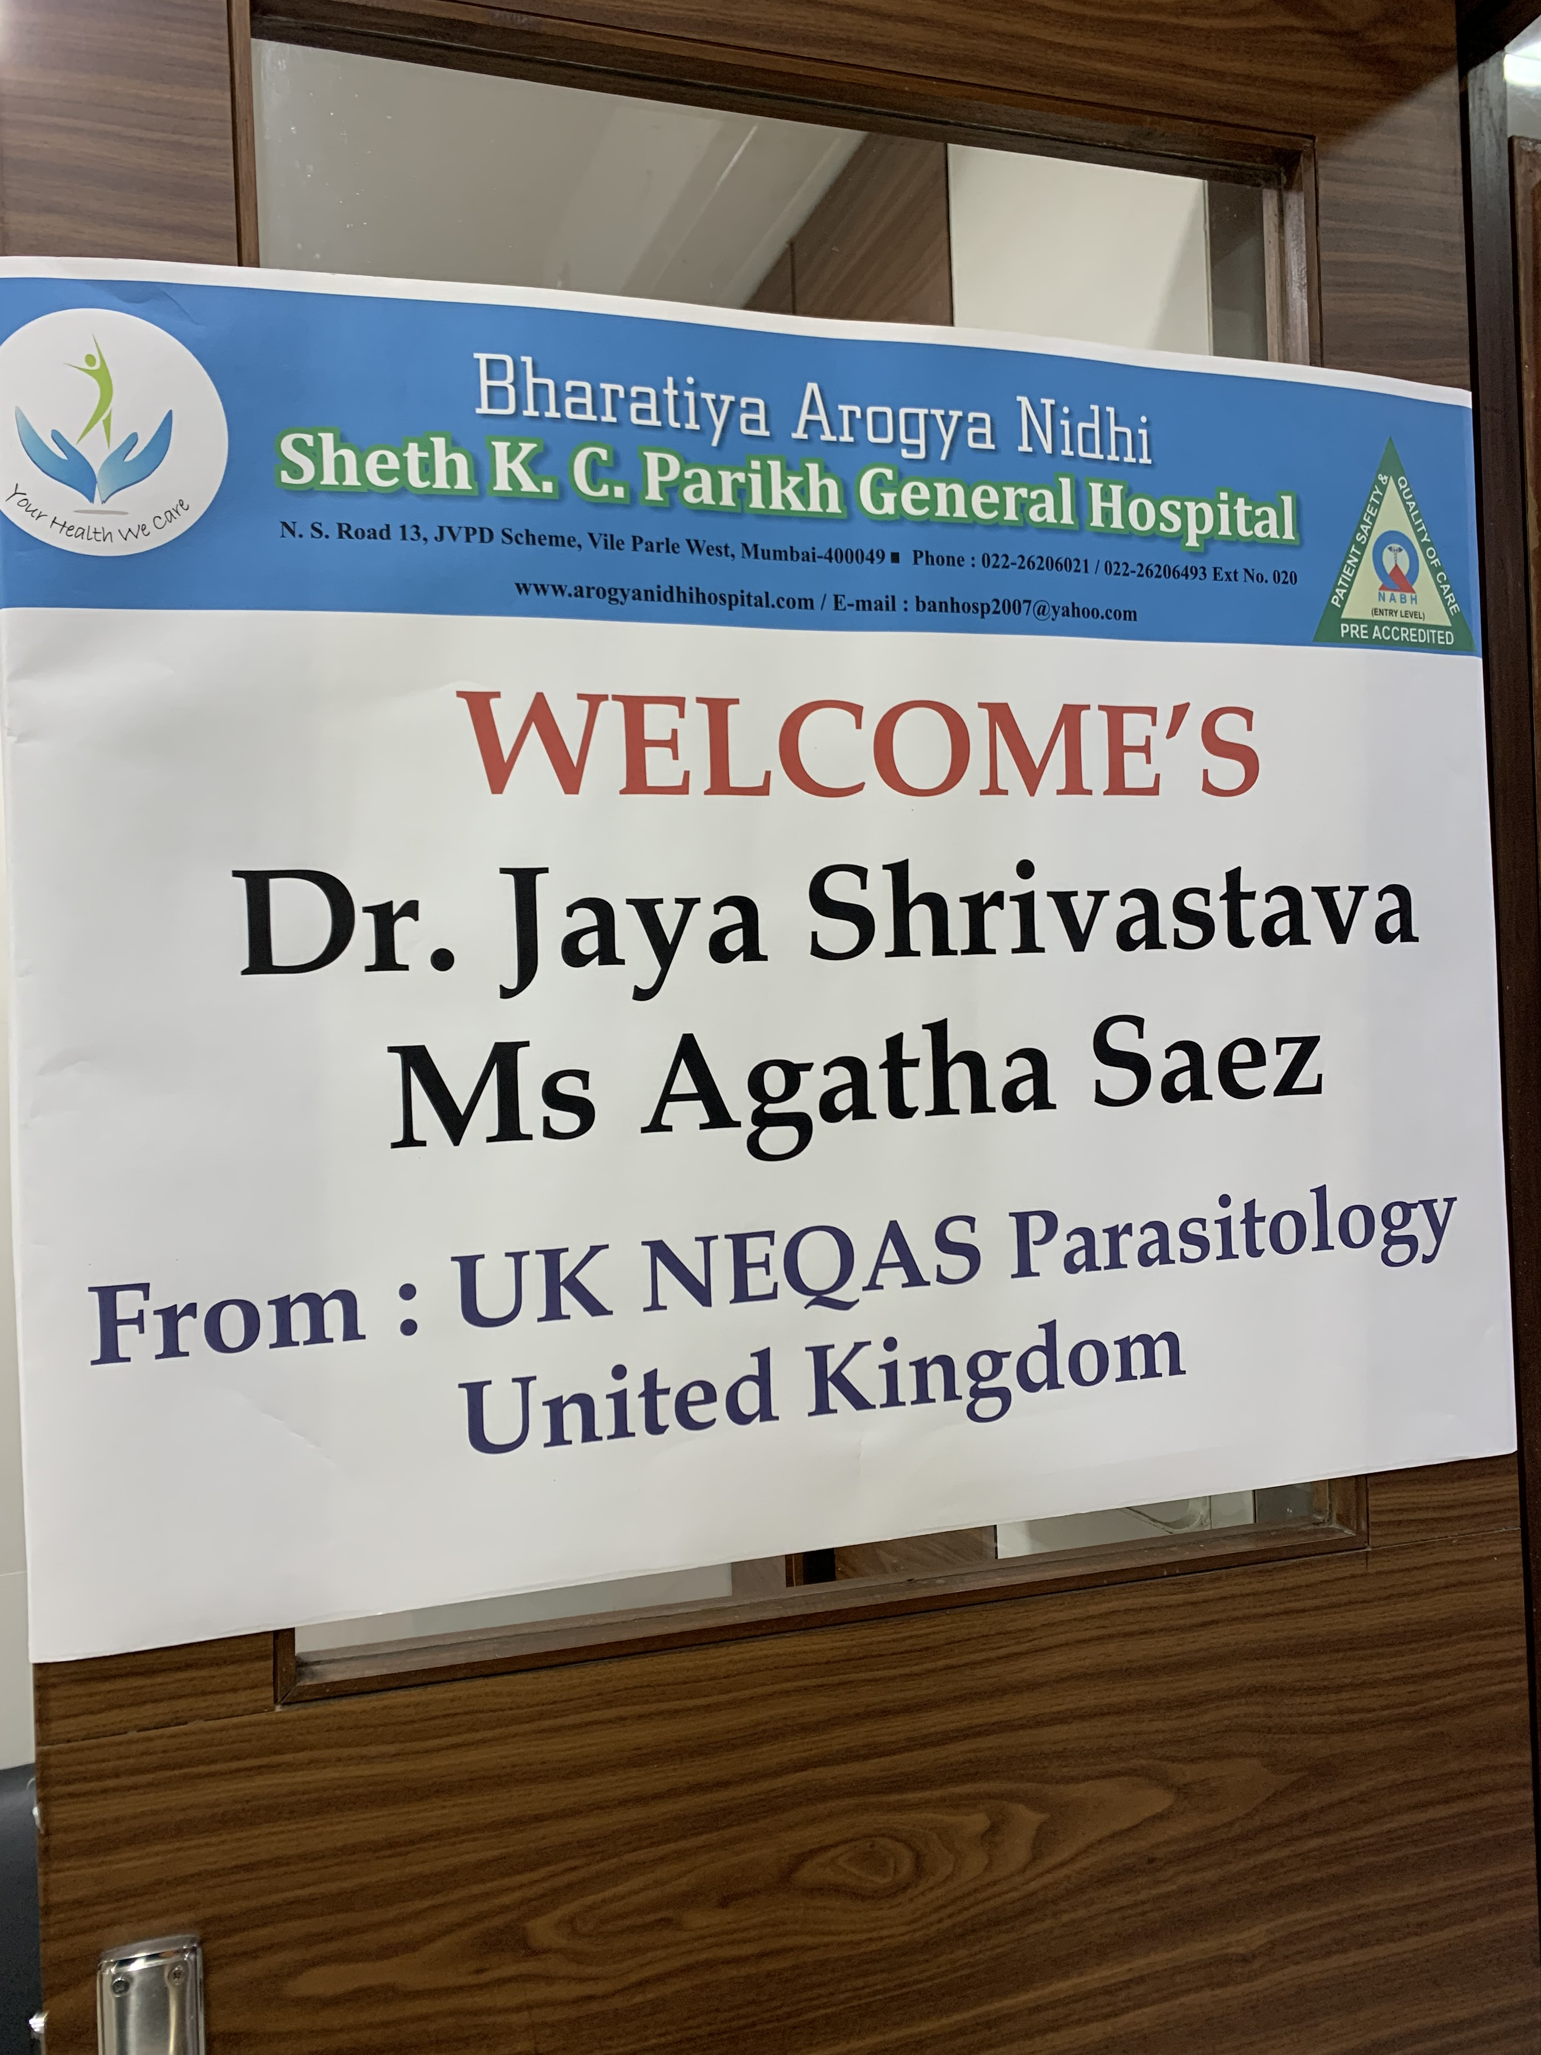
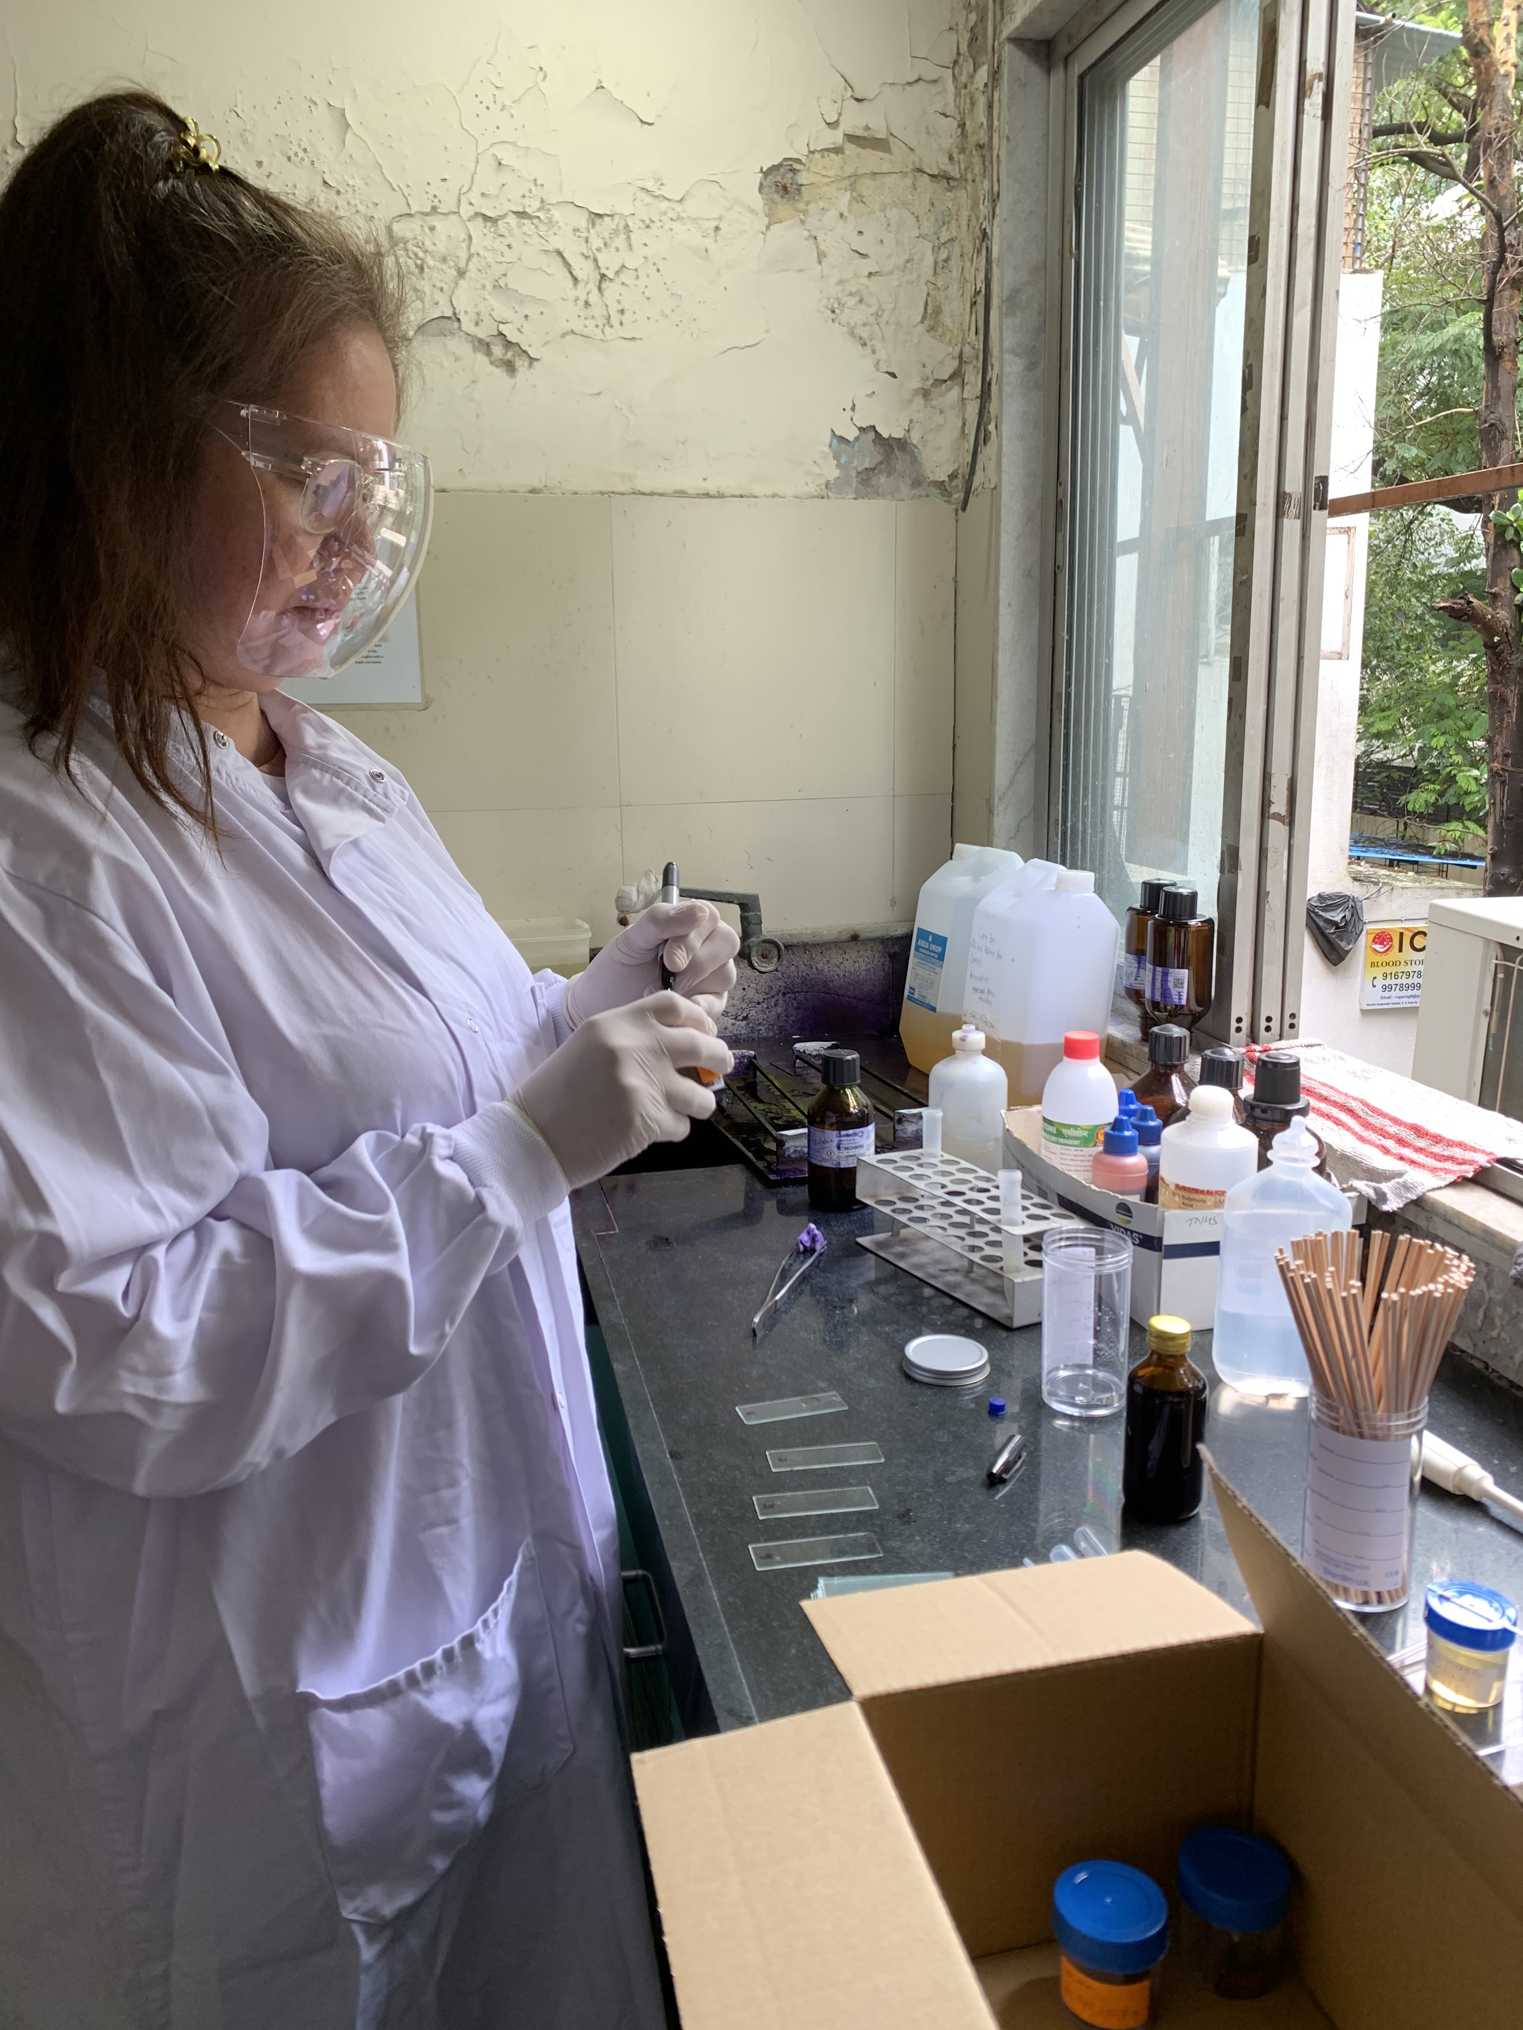
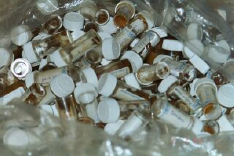
Field collections

Slide 9
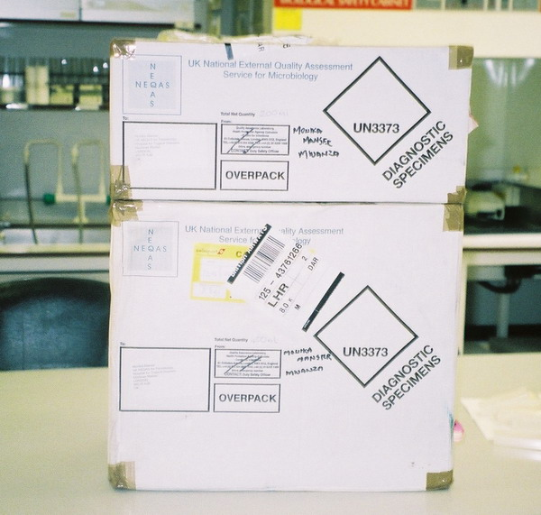
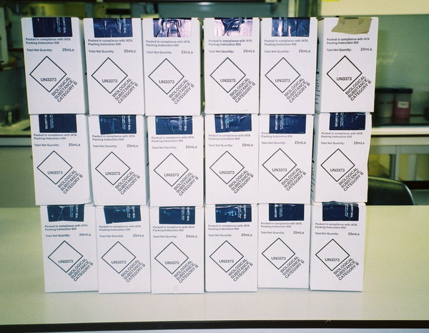

Transport under iata regulations, UN3373
Notes:
The International Air Transport Association (IATA) supports aviation with global standards for airline safety, security, efficiency and sustainability. Category B classifies an infectious substance as not in a form generally capable of causing permanent disability or life-threatening or fatal disease in otherwise healthy humans or animals when exposure to it occurs.

Slide 10
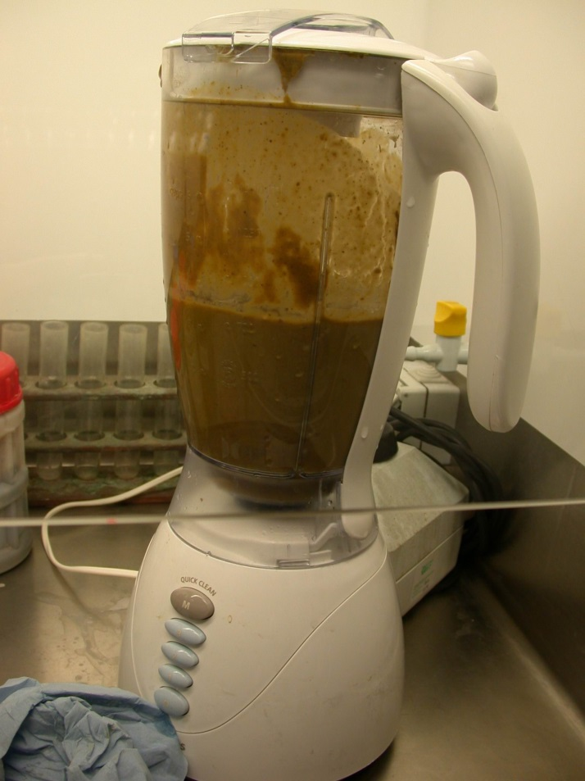
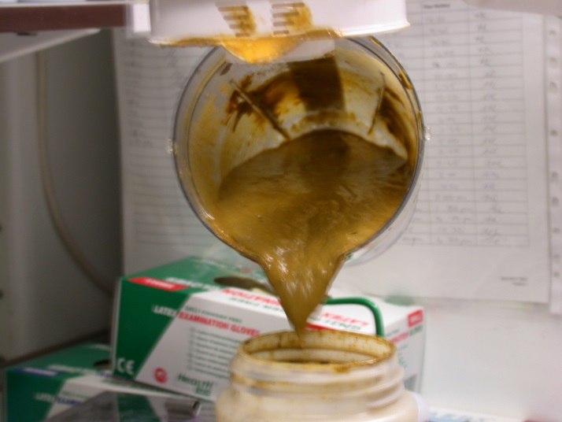
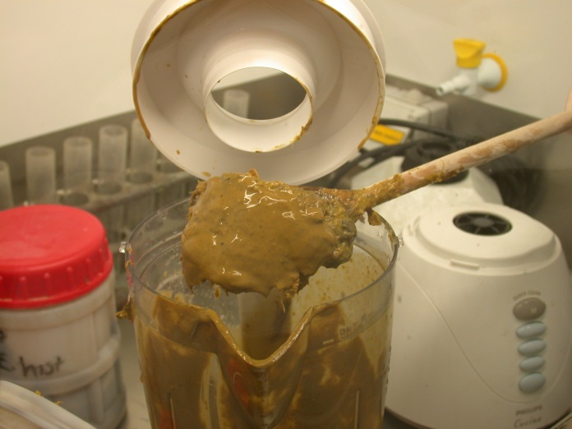
How are specimens processed: Faecal

Slide 11
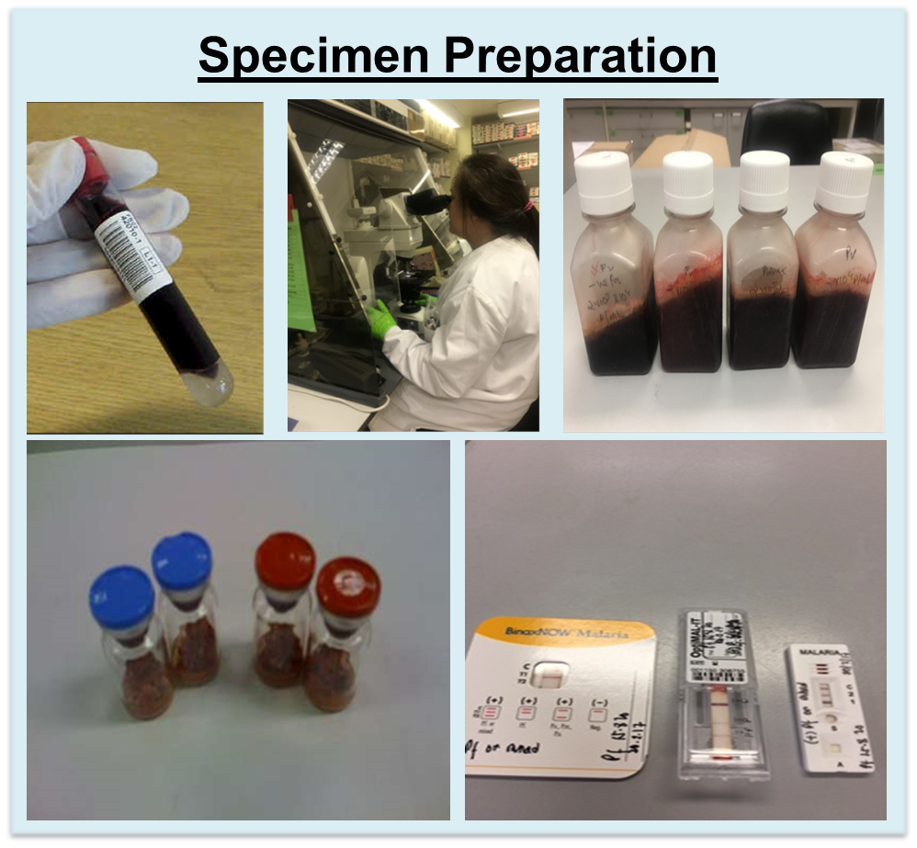

Slide 12
Acknowledgments
  NEQAS Parasitology team
  Department of Clinical Parasitology, HTD and Halo
  Reference labs
  LSHTM
  UK NEQAS consortium (Microbiology)
  Participants
For further information
parasite@ukneqas.org.uk

Slide 13
EXtras

Slide 14
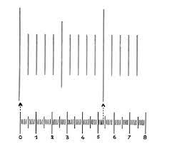
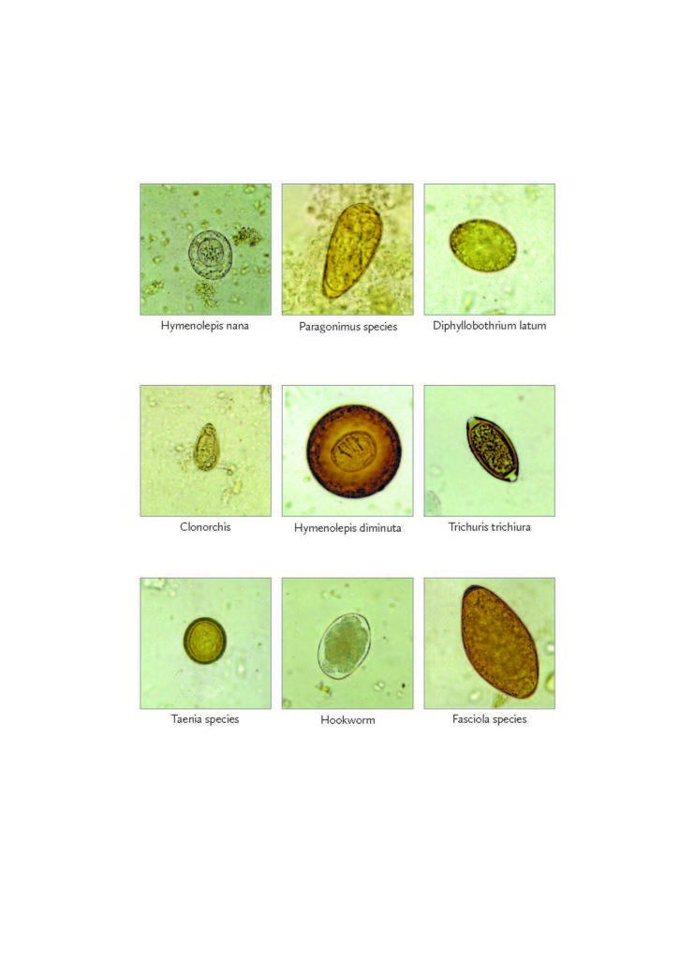
Faecal Parasitology scheme- microscopy based detection
Specimens distributed in UKNEQAS Faecal Parasitology Distributions consist of liquid specimens (i.e. faecal samples, urine samples and cyst fluid) and faecal smears.
The principal of the successful identification of faecal parasites:
  Measurement
  The use of an eyepiece graticule is of the utmost importance, especially for cyst identification
  Morphology and appearance
  Stains
  UK NEQAS Parasitology endeavours to send a range of specimens that are not only educational but also encourages participants to critically examine their routine method to take individual action to investigate and remedy any defects revealed from their score.
  The teaching sheets included in each distribution are designed for education purposes.

Slide 15
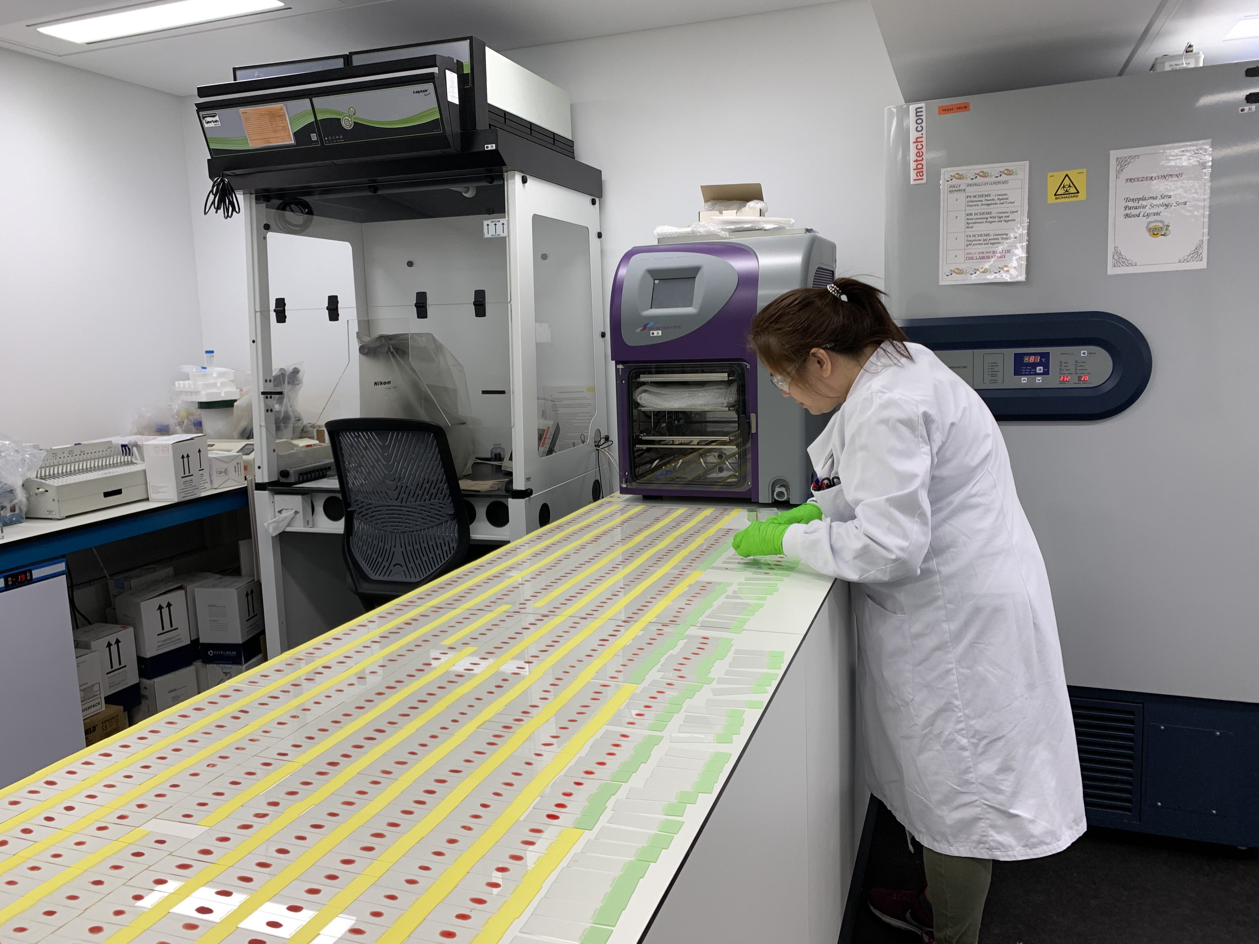
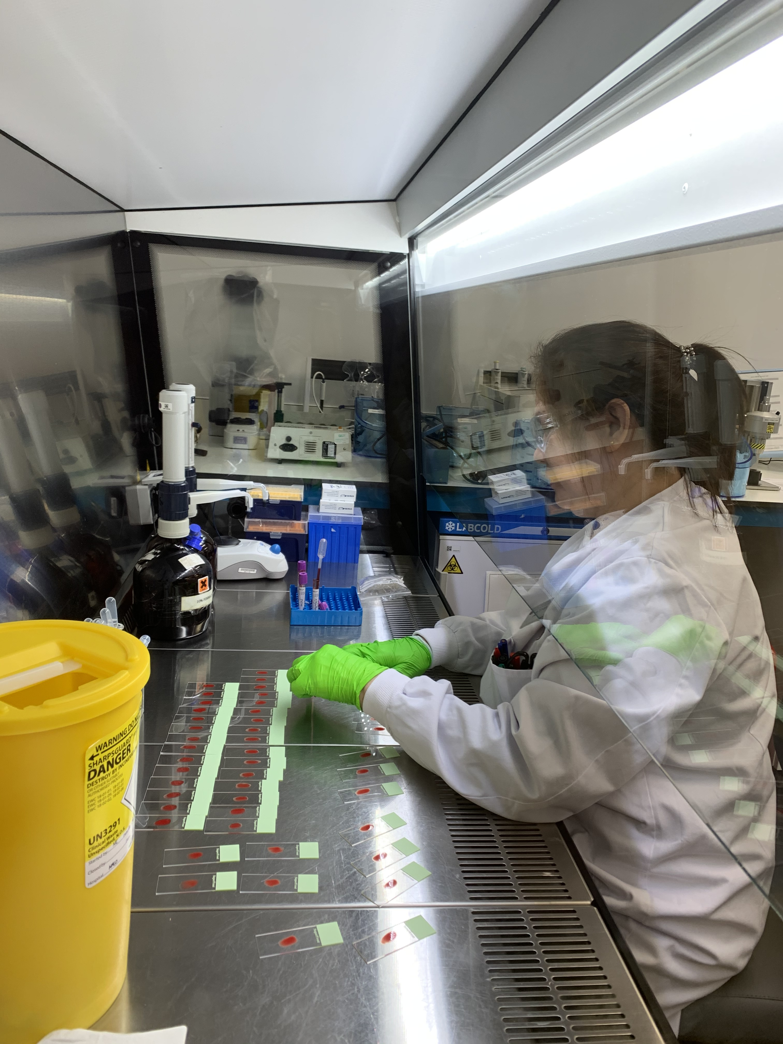
Blood Parasitology scheme- microscopy based detection
UKNEQAS Blood Parasitology Distributions consist of high-quality blood films.
UK NEQAS Parasitology distributes a wide range of specimens in order to challenge participants in their diagnostic techniques.
These specimens are pre-stained and the purpose is for identification of parasites.
Some specimens are also sent to test the participants’ parasitaemia calculation techniques as parasitaemia calculations can have potential clinical impact.
The principal of the successful identification of blood parasites:
      High-quality blood films
      Correct stain
      Morphology and appearance
      Percentage parasitaemia
The teaching sheets included in each distribution are designed for education purposes.

Slide 16
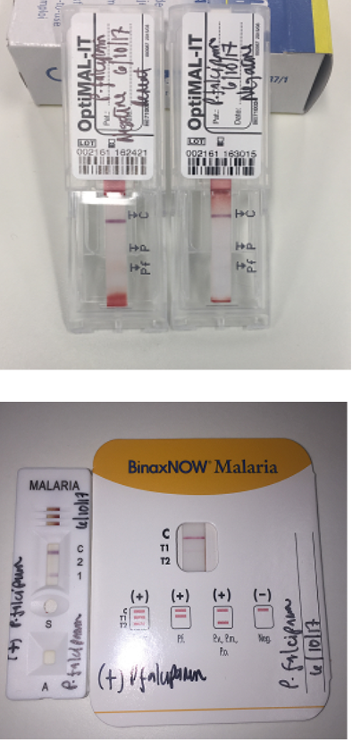


rapid diagnostic tests (RDTs) for Malaria
WHO recommendation

Slide 17
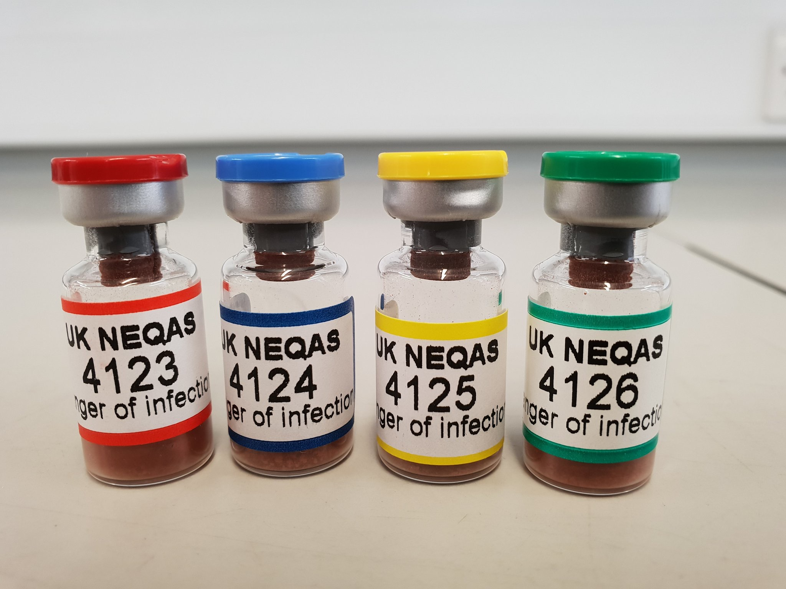
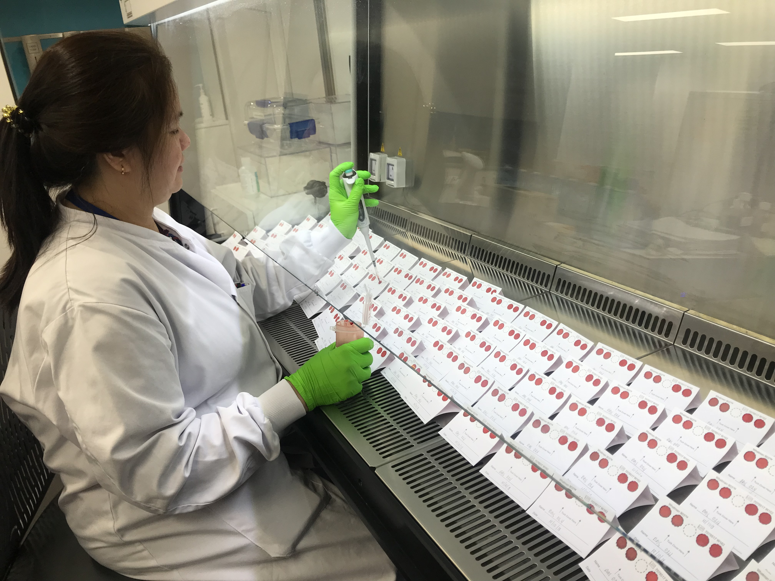
Scheme for molecular diagnostic methods for Malaria
Nucleic acid tests have become increasingly popular, particularly in Reference laboratories and specialised institutes.
UK NEQAS for Parasitology offers a scheme for the molecular detection of Malaria to Clinical Laboratories who undertake molecular methods to diagnose Malaria infections.
Scheme is comprised of 4 distributions per annum with 4 samples included in each distribution.
500 microlitre of freeze dried positive or negative blood samples are sent to participants of the scheme.
Varying parasite densities for all species of malaria are included.
The EQA scheme is qualitative only with the participants expected to use molecular detection methodologies to report presence or absence of Malaria parasite and identify the species.
NEQAS plus a WHO scheme

