Slide 1


Neglected Tropical Diseases in the era of global changes
10th Anniversary
January 26 2023
Giulio De Leo
deleo@stanford.edu
Stanford Doerr School of Sustainability
Notes:
Thanks for your nice words of introduction and for your invitation, it is real treat to speak in this magic environment that captured my imagination when I visited it the first time in 3th grade.
It is even a bigger honor to be here, at what I know to be a unique and tremendously important event, at the 10 year anniversary of the London Center for NTD Research.
And I cherish the opportunity to share a few thoughts with you who are on the front lines of the effort to make this world better, safer, and more healthy for future generations.
There is a tremendous amount of work that we still have to do, but a lot of progress has been made, in 2020, 600 million fewer people required interventions against NTDs than in 2010, and 42 countries eliminated at least one NTD.
Unfortunately the disruptions caused by the covid19 pandemic has caused also an unprecedented setback to the NTD agenda for nearly half of the countries where NTDs are endemic, with the fight against trachoma, schistosomiasis, and visceral leishmaniasis being most affected.
The climate change that we have been experiencing in the last few years is only adding a new layer of complexity, threats and challenges to progress toward NTD control and local elimination.

Slide 2
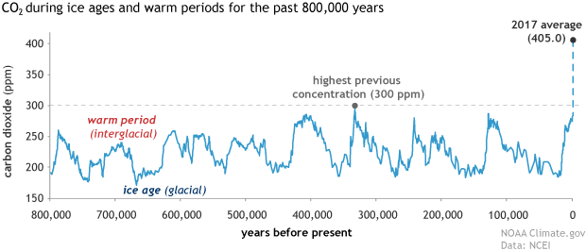
We are altering the Earth’s greenhouse effect
2022 average 421 ppm

Slide 3
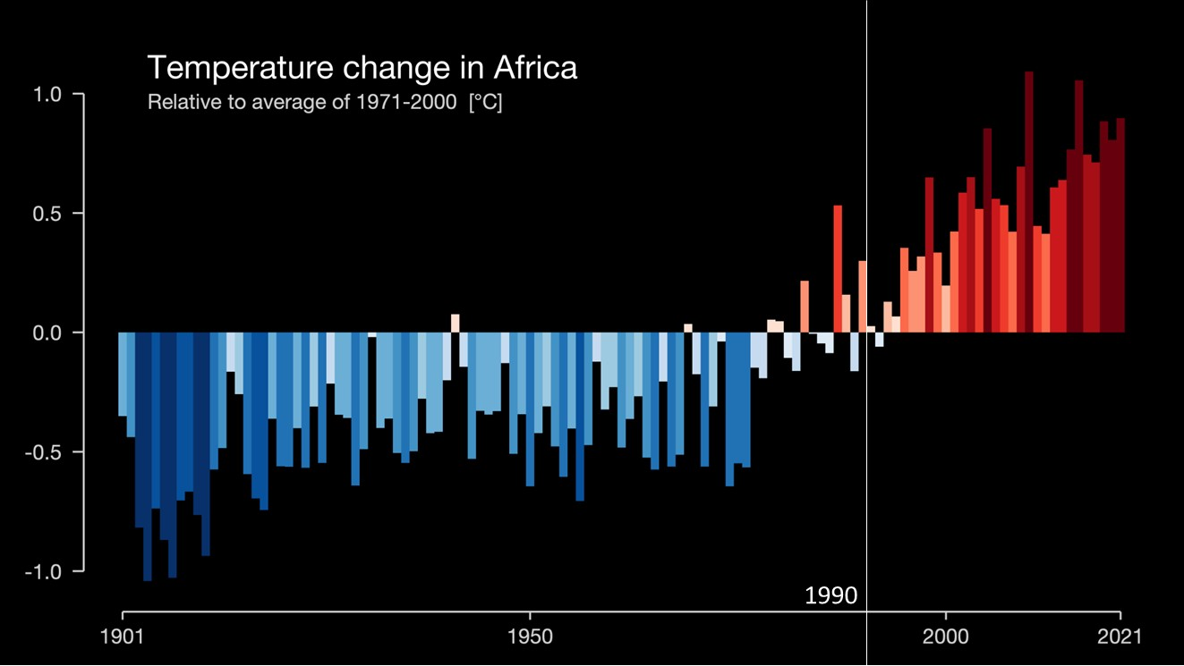
Since 1880,
global temp. on Earth
> +1.1° Celsius.
The majority of the warming has occurred since 1975
https://showyourstripes.info/
Notes:
https://showyourstripes.info/s/globe
https://earthobservatory.nasa.gov/world-of-change/global-temperatures
Since 1880,
global temp. on Earth
> +1.1° Celsius.
The majority of the warming has occurred since 1975
at a rate of roughly 0.15 to 0.20°C per decade

Slide 4
Does temperature matter for NTDs?

Slide 5
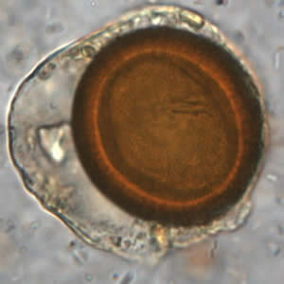
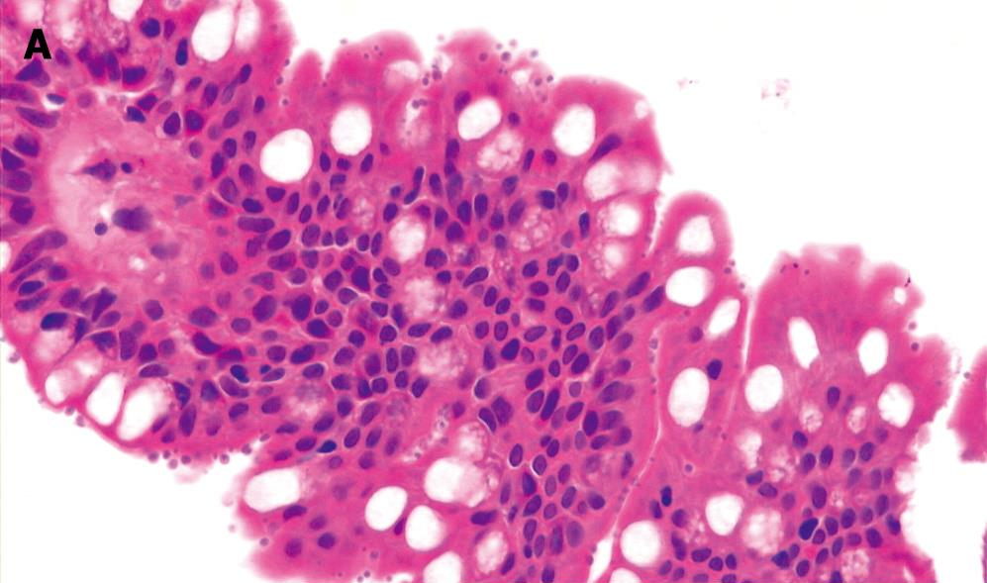
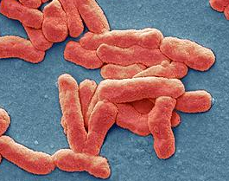
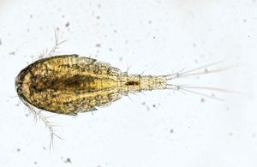
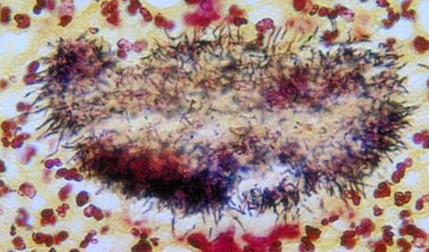
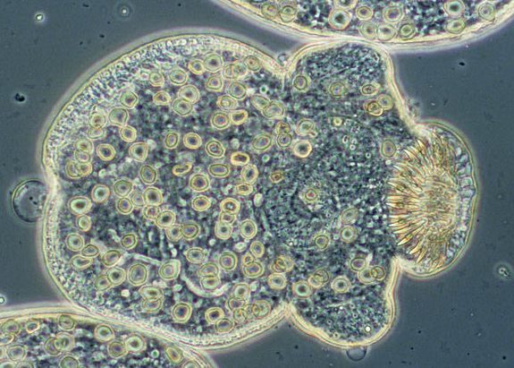
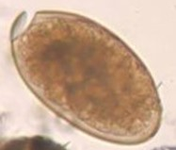
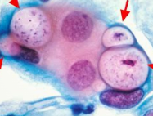
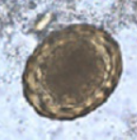
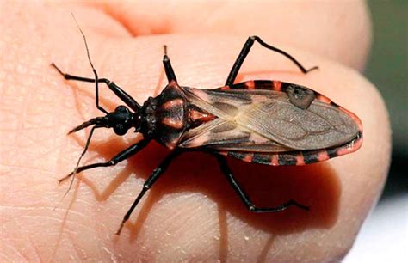
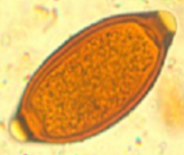
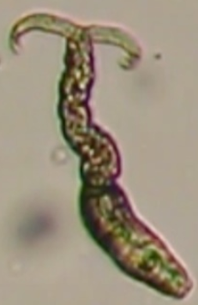
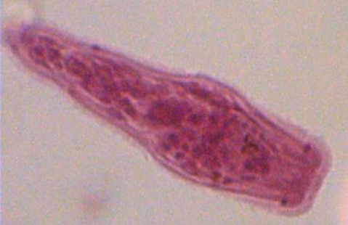
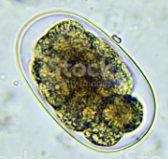
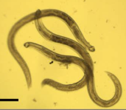

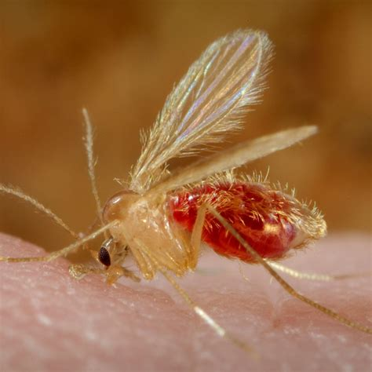
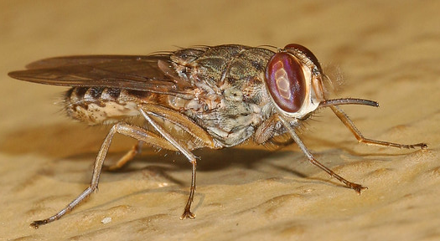

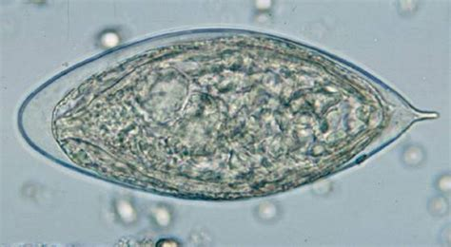
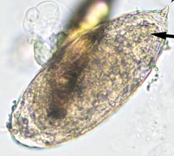
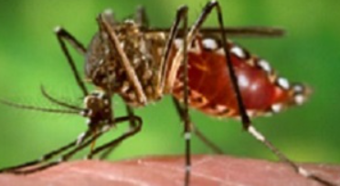
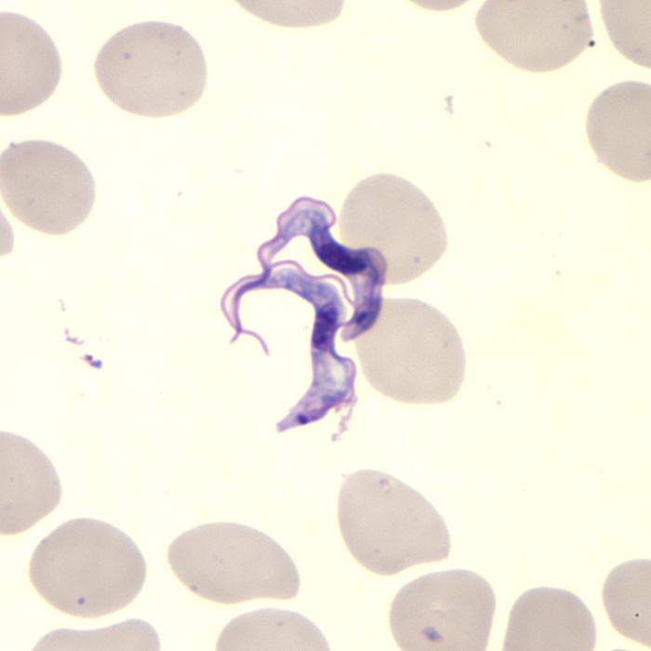
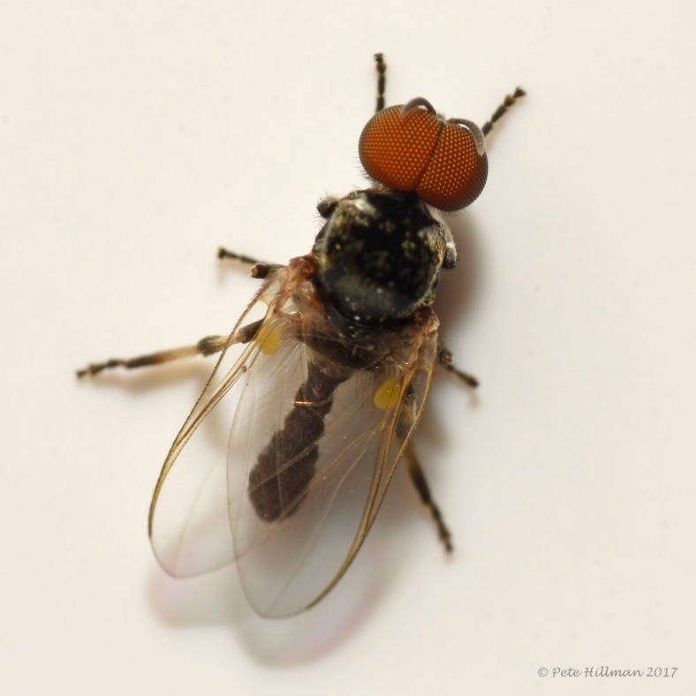

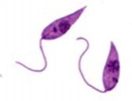
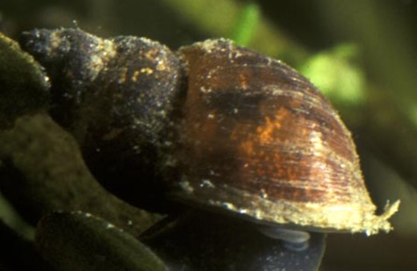
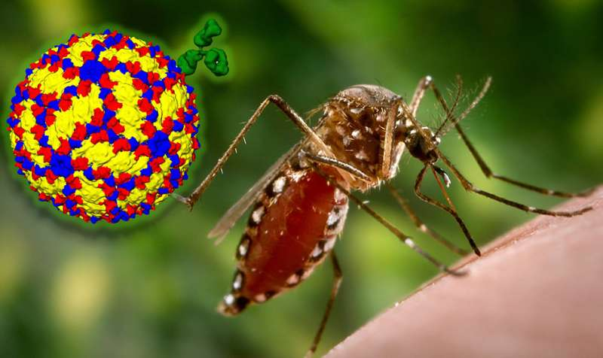
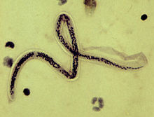
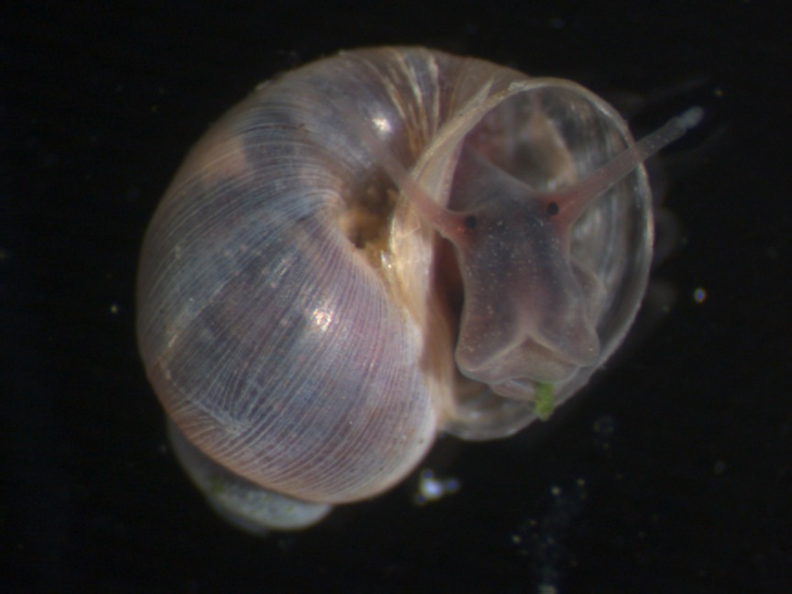

Armadillo, humidity, Mycobacterium Leprae
Water flea and D. medinensis larvae
Teniam solium egg
Mycobacterium ulcerans
Fasciola hepatica
egg, miracidium, cercariae, snail
actinomycetoma
Chlamydia trachomatis
Ech. Granulosuso larvae
A. lumbricoides
Triatoma spp. and Trypanosoma cruzi
Schistosoma free living stages,
snails
T. trichiuria
sand fly (Phlebotomus papatasi)
Leishmania promastigotes
Hookworm egg, larvae
Tstetse fly (Glossina) and T.b. gambiense)
Ae. Egypti,
Wuchereria bancrofti (filaria)
blackflies of the genus Simulium, Onchocerca volvulus
Ae. Albopictus, Dengue, Zika viruses

Slide 6
Temperature affects
free living stages of the parasites (eggs, larvae, free living forms) whether in the water or not
their invertebrate vectors/hosts (mosquitoes, ticks, flies, snails, ….etc.)
Parasites’ development time within the invertebrate hosts
(and yes, also their non-human vertebrate hosts, when applicable)

Slide 7
The answer is obviously yes.
Does temperature matter for NTDs?
The next question is
in what directions?
What is the potential impact of climate change of bugs, insects, pests and pathogens?

Slide 8
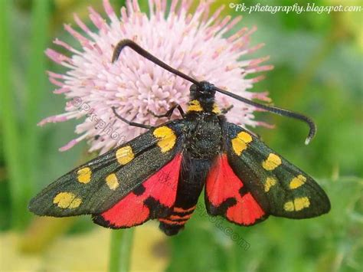
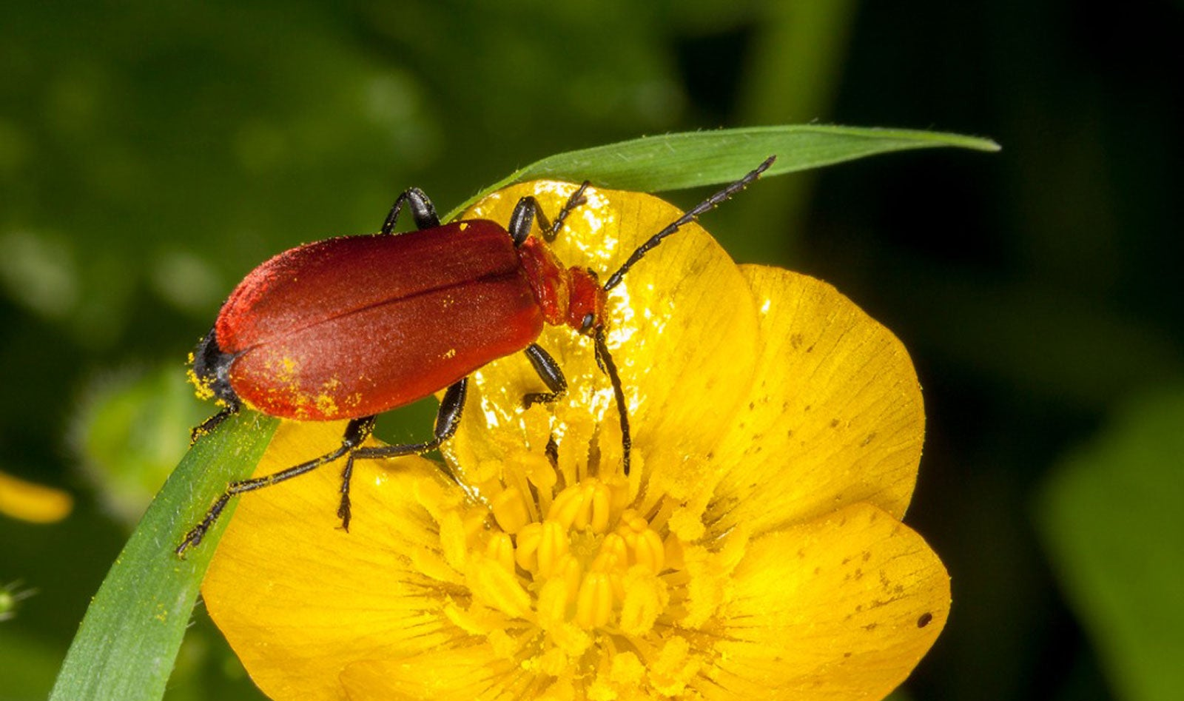
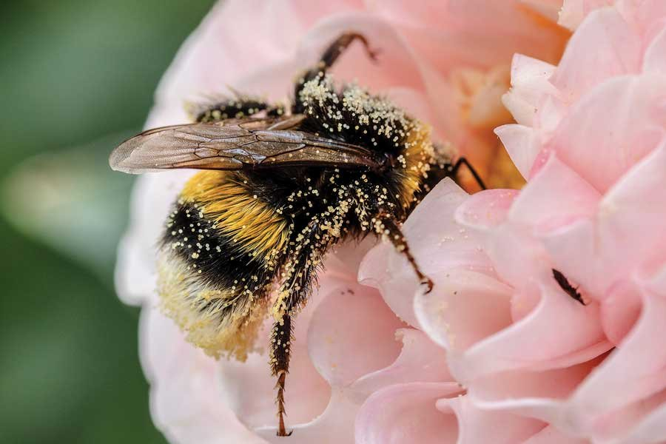
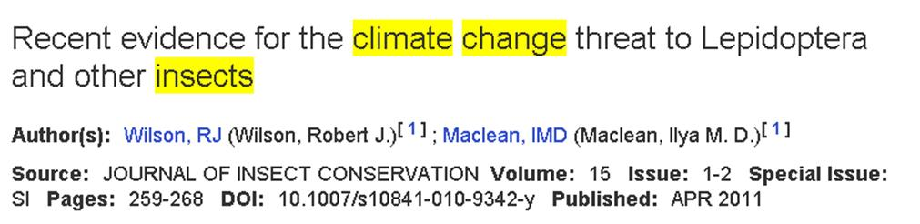
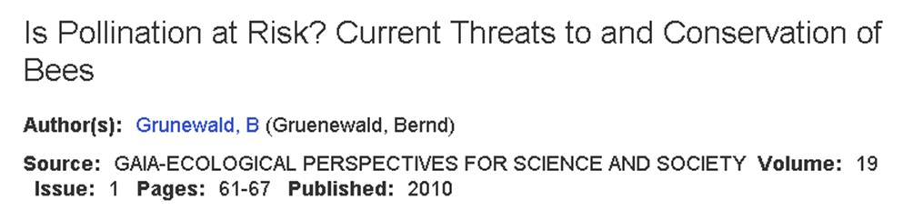
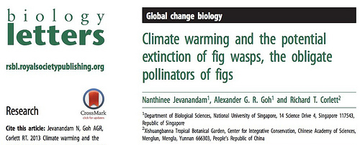
Climate Change is bad for “good bugs”
e.g., pollinators, natural pest enemies, doomed to extinction

Slide 9
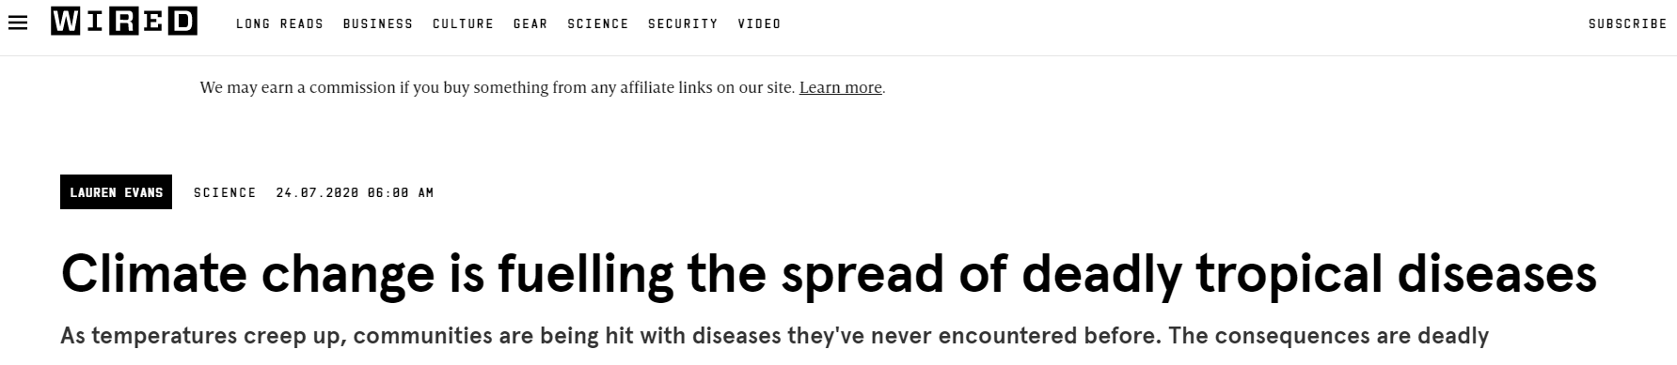
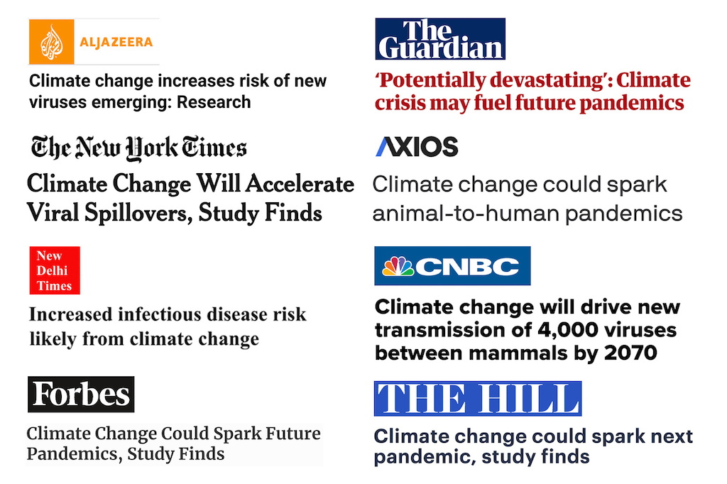
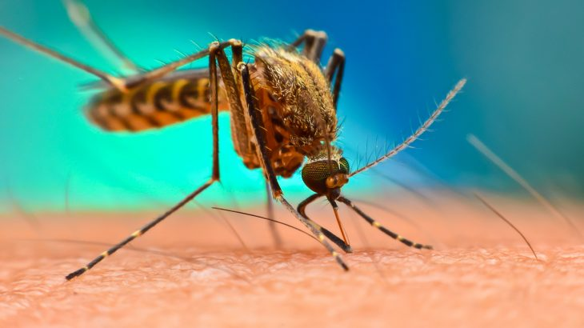
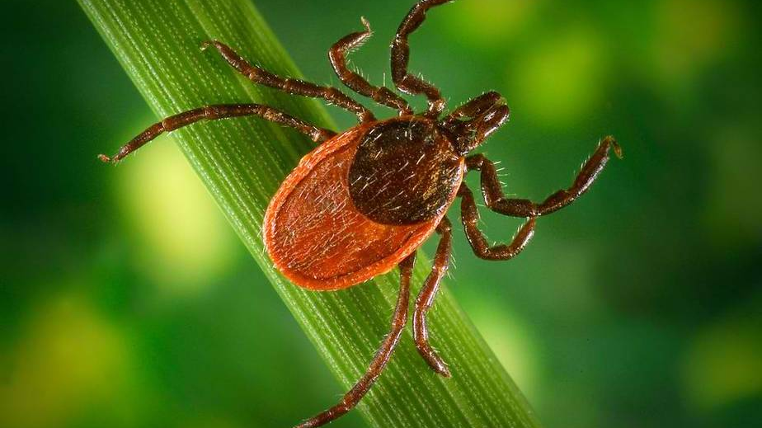
…but good for bad bugs
Source: https://www.carbonbrief.org/analysis-the-climate-papers-most-featured-in-the-media-in-2022/
Notes:
https://www.carbonbrief.org/analysis-the-climate-papers-most-featured-in-the-media-in-2022/
Yet, positive effects for bad bugs – typically mosquitoes and ticks acting as agents of vector-borne diseases - that will benefit from anthropogenic changes and will increase their geographical range and abundance

Slide 10
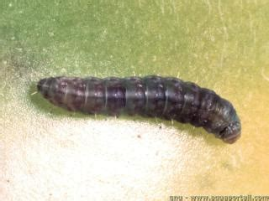
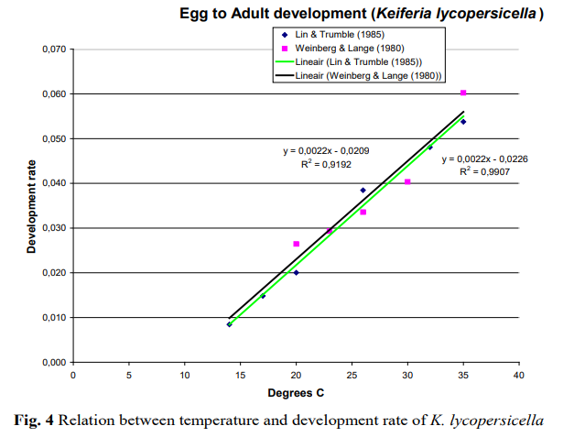
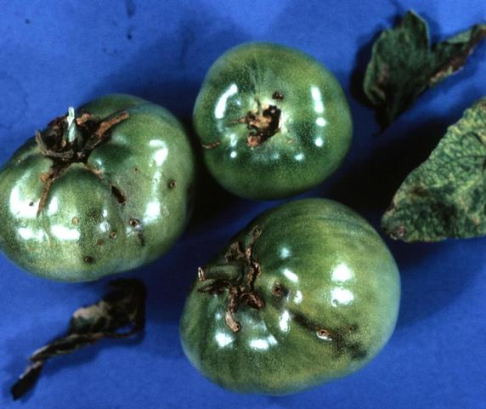
The legacy of the widespread use of “cumulated degree days” needed for pest development
Reference: Brahim et al. 2012. Pest Risk Analysis for Keiferia lycopersicella
Notes:
What is meant by growing degree days?
Growing Degree Days (GDD) are used to estimate the growth and development of plants and insects during the growing season. The basic concept is that development will only occur if the temperature exceeds some minimum development threshold, or base temperature
What is the benefit of using growing degree days as a measurement?
In the absence of extreme conditions such as drought, pests grow in a cumulative stepwise manner which is strongly influenced by the ambient temperature. The Growing Degree Days calculation allows producers to predict parasite development and modulate control.

Slide 11
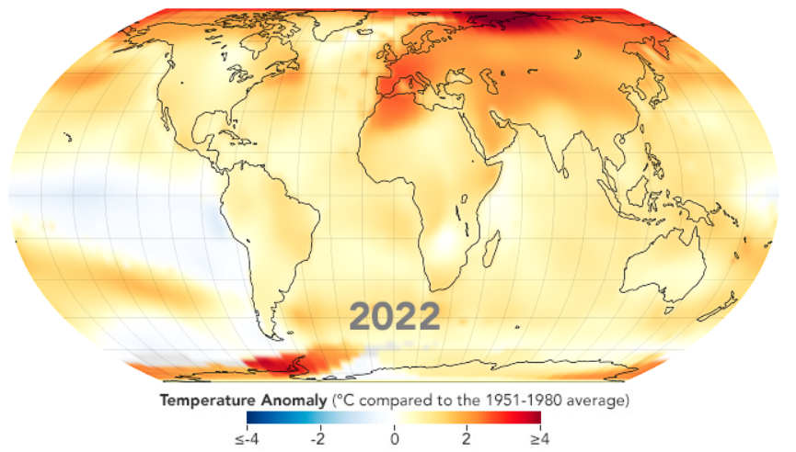
The old “climate change-pests” syllogisms
As bug’s development requires temperatures above a baseline, the higher the temperature, the faster the development
Climate change is about “global warming”
i.e., increasing temperature
--> A warmer world is also a more wormy world,
a world with more bugs, parasites and diseases
Notes:
https://earthobservatory.nasa.gov/world-of-change/global-temperatures
A syllogism is a kind of logical argument that applies deductive reasoning to arrive at a conclusion based on two propositions that are asserted or assumed to be true. In its earliest form, a syllogism arises when two true premises validly imply a conclusion, or the main point that the argument aims to get across

Slide 12
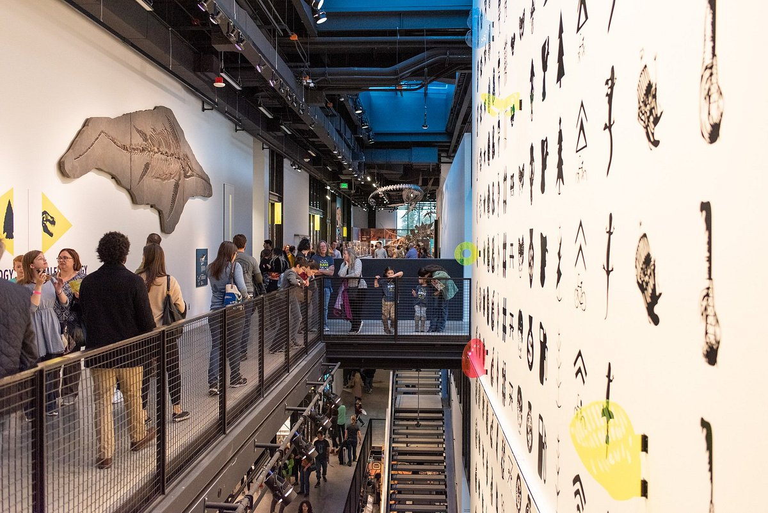
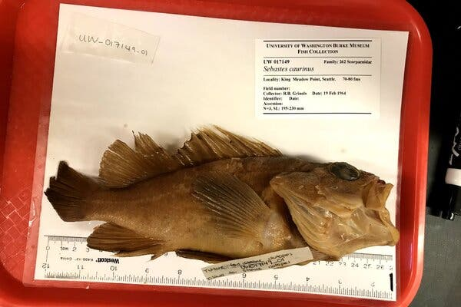
How do we test this hypothesis in practice?
Need for long time series of parasite mean burden or disease prevalence
A copper rockfish collected
from Puget Sound in 1964
Credit:Natalie Mastick/University of Washington
Notes:
Specimens held in natural history collections are often fixed and stored in such a way that both host and parasite tissues are maintained,
Parasitological dissection, visual detection, and morphological identification can therefore yield accurate counts of the number and identity of metazoan parasites infecting a host at the time of its death
reconstructed approximately one century (1880 to 2019, but the vast majority of data span 1920 to 2019) of change in parasite abundance (i.e., parasite counts per host individual) for eight fish hosts (SI Appendix, Tables S1 and S2) and 85 common parasite taxa (SI Appendix, Table S3) in Puget Sound,

Slide 13
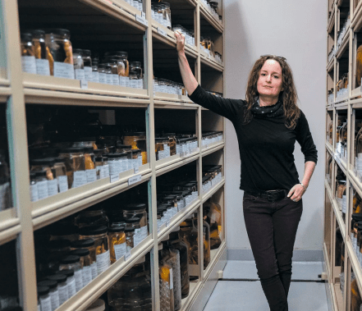
Historical ecology of parasites
Track change in parasite abundance (i.e., parasite counts per host individual) from NHM specimens
17,702 parasites
from 699 fish specimens
for 8 fish hosts and
85 marine taxa
nearly 140 years of data
(1880-2019)
Puget Sound (Seattle, UW)
Chelsea Wood, UW
Notes:
Specimens held in natural history collections are often fixed and stored in such a way that both host and parasite tissues are maintained,
Parasitological dissection, visual detection, and morphological identification can therefore yield accurate counts of the number and identity of metazoan parasites infecting a host at the time of its death
reconstructed approximately one century (1880 to 2019, but the vast majority of data span 1920 to 2019) of change in parasite abundance (i.e., parasite counts per host individual) for eight fish hosts (SI Appendix, Tables S1 and S2) and 85 common parasite taxa (SI Appendix, Table S3) in Puget Sound,

Slide 14
Wood et al. 2023 PNAS
parasites/host
1 host parasite count
2 host parasites
3+ host parasites
- 10%/decade
They found that:
parasite abundance negatively correlate with sea surface temperature
diminishing at a rate of 38%
for every 1 °C increase in temperature.
Notes:
found that parasite taxa using three or more obligately required host species—a group
that comprised 52% of the parasite taxa we detected—declined in abundance at a rate
of 10.9% per decade, whereas no change in abundance was detected for parasites using
one or two obligately required host species.

Slide 15
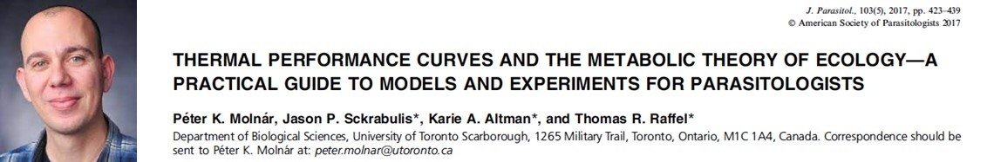
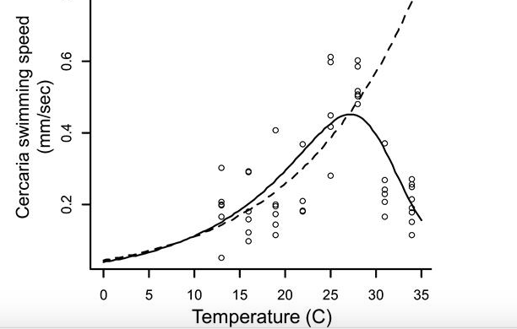

Thermal tolerance
T_{opt}
C_{Tmin}
C_{Tmax}
Notes:
Thermal performances curve have bene derived to described the metabolic, physiological and demographic response of both parasites and the snails to temperature. Theis type of data, such as this one about swimming speed of cercariae, allows to identify the thermal envelope, i.e., the range of temperature where parasite and or the snail is viable, where transmission occurs – and identify the critical thermal limits, temperatures that are too cold or too hot to ultimately sustain transmission
This information can be used to map where transmission can occur, as shown in the next slide
Peter Molnar, a Canadian parasitologist at University of Toronto, has published probably the most seminal work to understand the effect of temperature on the various life stages of wildlife and human parasites.
In his seminal 2017 work, Peter has presented an excellent practical guide to models and experiments to understand thermal performances curve in different development stages
In this graph, he present how cercariae swimming rate first increases with a power low with increasing tremperature, it reaches a peak and then drop off quite rapidly with temperatures increasing further.
This type of experiments allow to identify the thermal tolerance with viable performances between a critical temperature minimum and maximum

Slide 16
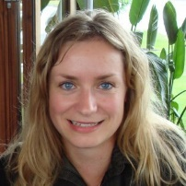
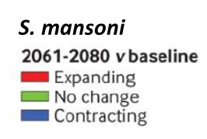
From: Stensgaard et al. Acta Tropica 2019
From: Stensgaard et al. Acta Tropica 2011
BIO10
C_{Tmin}
C_{Tmax}
S. haematobium
S. mansoni
BIO11
C_{Tmin} and C_{Tmax} from Pfluger (1980, 1981, 1984), Gordon et al. (1934), Foster (1964)
Notes:
This graph maps locations where schistosomiasis is endemic according to their location-specific mean temperatures, specifically the mean temperature of the coldest quarter in the horizontal axis, and the mean temperature of the warmest quarter in the vertical axes.
We can overlap them experimentally observed critical thermal thresholds for parasite intra-molluscan development for mansoni in orange and hametabium in gray.
We see that these critical thermal thresholds delimit the space where schistosomiasis is endemic pretty well, especially the upper one.
Now, for each location, danish scientist dr. Stensgaard, derived the projected temperature in 2070, and the result is this big shift up and right showing basically:
a potential expansion of schistosomiasis in areas where it is not present,
but also a potential range contraction, mostly in the lowland on the equatorial belt, where temperature is projected to become too high to support the intra snail development of the parasites
Anne Sofie Stensgaard, who published some of the most influential papers on how future climate change might affect the distribution of schistosomiasis, in his 2019 Acta Tropica review paper report this very compelling figure with mean temperature of the coldest quarter in the horizontal axis and mean temperature of the warmest quarter in the vertical axes. The light blue line corresponds to minimum critical temperature for schistosome parasites and the horizontal red line the temperature of the maximum critical temperature, as derived from lab experiments, and each dot in the figure corresponds correspond to a specific location where schistosomiasis is endemic and the coordinates are the mean temperature of the coldest quarter and mean temperature of the warmest quarter for that location. We can see that parasites my persist in places where winter is pretty cold and harsh, but the experiments are pretty good in providing the upper thermal limit.
The question is: what happen as a consequence of increasing temperatures associated to climate change?
On the right panel, you see that all the points tend to shift to right and up, with a remarkable number of locations whose climate will probably become more favorable to schisto transmission and other where temperatures will become too high for sustained transmission of schistosomiasis.
What are the implications of these projections in practice:?
Let’s see in the next slide a combination of empirical evidence and future projectsion

Slide 17
Published papers on schistosomiasis and CC present multiple (and sometime contradicting) results
Stensgaard et al. 2019
48
26
6

Slide 18
General finding for NTDs and other priority diseases
warmer temperatures increase transmission of vector-borne disease up to thermal optimum or “turn-over point,” above which transmission slows
Thermal optimum is species specific.
For example, malaria is most likely to spread at 25 degrees Celsius while the risk of zika is highest at 29 degrees Celsius
→ a few degrees of warming has a really different impact depending on where you start relative to the optimum
Accordingly:
  (fairly) good news: higher global temperatures will decrease the chance of most vector-borne disease spreading in places that are currently relatively warm.
  bad news: warming will increase the chance that all diseases spread in places that are currently relatively cold..
General and systematic reviews: Booth (2018), Tidman et al. (2021)

Slide 19




Not just temperatures…

Slide 20
Not just temperatures…
The multidimensional nature of climate change
Mora et al.2022. Nature Climate Change
Warming
Precipitation
Floods
Drought
Storms
Natural cover (habitat) change
Ocean Climate change
(e.g., El Niño, la Niña, PDO)
Fires
Heatwaves
Sea level
Mora et al. reviewed evidence of the impact of climate hazard for human diseases
Started from >77,000 published papers down to
830 references satisfying the eligibility criteria
3,213 empirical case examples for 375 diseases documented to have impacted humanity

Slide 21

Climatic Hazard
Transmission pathway
taxonomic diversity of
human pathogenic diseases
Mora et al.2022. Nature Climate Change See: https://camilo-mora.github.io/Diseases/

Slide 22
Main finding form Mora et al. 2022
58% (218 out of 375) of human infectious diseases
aggravated by climatic hazards
16% were at times diminished.
Empirical cases revealed 1,006 unique pathways in which climatic hazards, via different transmission types, led to pathogenic diseases.
Climatic hazards that…:
  directly strengthen or weaken parasites and pathogens (accelerate development)
  impair people (by weaking immune response, degrading nutrition, etc.)
  bring pathogens closer to people (range expansion for VBD, spillover, fecal cont.)
  bring people closer to pathogens and parasites (climatic refugees, land use change)
Notes:
Parts of Somalia hit by the driest season in 40 years as climate-fueled drought worsens
Nearly 90% of the country faces severe water shortages leaving 3.5 million people in extreme hunger
Climatic hazards bringing pathogens closer to people
range expansion of vectors such as mosquitoes, ticks, fleas, birds, snails implicated in outbreaks by viruses, bacteria, animals and protozoans, including dengue, chikungunya, plague, Lyme disease, West Nile virus, Zika, trypanosomiasis, echinococcosis and malaria
wastewater overflow, leading to the direct and foodborne transmission of noroviruses, hantavirus, hepatitis and Cryptosporidium.
Climatic hazards bringing people closer to pathogens and parasites
displacements of people and livestock leading to outbreak of leptospirosis, cryptosporidiosis, Lassa fever, giardiasis, gastroenteritis,Legionnaires’ diseases, cholera, salmonellosis, shigellosis, pneumonia, typhoid, hepatitis, respiratory disease and skin diseases
Climatic hazards directly strengthening parasites and pathogens or impairing people by altering body conditions, immune response,

Slide 23



Climatic hazards that bring people and parasites closer to each other
Climate migration and crowding around dwindling water
Dams and
water management
infrastructures
Notes:
and, although there is a lot to be said, here I want to focus on two specific aspects, i.e., construction of dams, and crowding around dwindling water

Slide 24

Climate change
Population growth
persistent poverty
Development of
artificial reservoirs
Agricultural expansion
Notes:
As for as the first point, there is no doubt that expected agricultural expansion and intensification to feed a growing human population while fighting increasing frequency and intensity of draughts in a wormer World, the most logical response is to build dams.
Agriculture expansion and intensification is needed to feed a growing humanity that will peak at about 10 billions by the end of the century.
(Food insecurity is non the rise with 27% of the world population facing food insecurity, 144 of children suffering stunting, 47 million affected by wasting.)
Increasing food security is good for health
And yet, agricultural expansion and intensification will lead to increase use of fertilizer and pesticides, potentially polluting water and aquifer, the loss of biodiversity because of deforestation with the associated risk of disease spillover,
Well, agricultural expansion need water and water can be provided by the construction of dams,
and schistosomiasis is a text book case of a disease that not only is associated with water, but whose transmission risk increases invariably following the construction of water management infrastructure, typically artificial reservoir for power production or agriculture.

Slide 25



+ agriculture → + Dams → + schistosomiasis
Masinga dam, Kenya
Notes:
Well, agricultural expansion need water and water can be provided by the construction of dams,
and schistosomiasis is a text book case of a disease that not only is associated with water, but whose transmission risk increases invariably following the construction of water management infrastructure, typically artificial reservoir for power production or agriculture.

Slide 26




THE DIAMA DAM, SENEGAL 1986
of schistosomiasis
Notes:
I will show you a specific example, the Diama dam in Senegal. The dam was built in 1986 on the mouth of the Senegal river at the border with Mauritania to support agricultural expansion and prevent saltwater intrusion.
It worked incredibly well, but unfortunately the construction of the dam was immediately followed by what was probably one of the most spectacular outbreak of schistosomiasis, as clearly document by several peer reviewed studies.
The question is WHY?

Slide 27
more water
more vegetation
more snails
Dam
Less or no prawns
+
more disease
more agrochemicals
more agriculture
more people
Notes:
Further studies have provided more nuances on the web of events leading to increase in schistosomiasis, including the use of agrochemicals , extirpation of migratory freshwater species that feeds on the snails , increase in the human populations gathering around water reservoirs.

Slide 29
Reality is so much more complex than simple conceptual disease models…
Multiple parasite competing for the same hosts (Laidemitt et al. 2019)
Parasites hybridization (Webster et al.2013, 2017, Leger & Webster 2016)
Multiple Biompahalaria spp in South America (Caldeira et al.)
Multiple non-human vertebrate hosts for S. mansoni (Catalano et al. 2018) and S. japanicum (Wang et al. 2006)
~70 Triatominae species involved in Chagas diseases, 11 in the US (Gerogieva et al. 2017)
Role of intra and interspecific competition for resources,
top-down predators, hyper-parasites
Notes:
\this allow me to transition to the third pointm,

Slide 30
Conclusions
Over large geographical scales, range shift/expansion/contraction as a consequence of climatic change.
“The devil is in the details” when we need to zoom in specific areas, and other socio-economic, ecological and environmental determinants, and a wider variety of climatic hazards are at play
We need to:
  ramp up monitoring and surveillance
  to go back to the lab to derive thermal performance curves for so many parasites and their hosts
  acknowledge complexity via a System Thinking approach

Slide 31




The time is now!
An unprecedented amount of new data and online repositories
  GEE, ESPEN, GBIF, genomics, etc.
Promises of a new generation of low cost, point of care diagnostic tools that can improve monitoring and surveillance,
including frugal science
Citizen science (Jeff Brees, Tine Huyse et al. 2021)
Manu Praksh
ATRAP,
HARISSA
D-SIRE
SWAMP
Notes:
I can feel the possibility and the potential right here in this room -- the coming together of ideas and innovations -- along with the sense that someday we will be able to look back on what LCNTDR has accomplished in this 10 years and the next one, as key stepping stones in the fight against NTD.

Slide 32
Thank you!

Slide 33














































Fiona Allan
Notes:
First of all, I want to acknowledge the contribution of my large group of amazing collaborators who, at different times and different role contributed to formulate some of the concepts and considerations I am goingt o share today.
There are too many to cite them all, but I want to call out in particular dr. Sokolow and dr. Wood, with whom I have developed the entire program, Andy Chamberlin, our lab and field manager who assists us on all activities and, because it is relevant in the specific context of this conference, our collaborators fantastic collaborators from Brazil, that is,
Roseli Tuan, senior scientific researcher at Secretariat of Health in Sao Paulo
Roberta Caldeira, Research associate at FioCruz, Berlo Horizonte, Brazil
Miguel Monteira, National Institute for Space Research in São José dos Campos,
Thiago Pereira research scientist at the Stem cell institute of Stanford university)

Slide 34







Notes:
Better slides to clarify that with free living stages, and invertebrate hosts that are ectotherms, it is inevitable that changes in temperature will affect a whole wide range of biological, behavioral and ecological processes. Maybe slides

Slide 35





https://showyourstripes.info/
Yap, this is me
1990
Notes:
Media press about CC being detrimental to good bugs (i.e., pollinators) and beneficial for bad bugs (pests, parasites and pathogens).
The latter is partially a legacy of the body of work on the bioenergetic of insect development in the context of pests control in agriculture, according to which, the hotter, the faster pests develop
For long we have heard about range expansion for vector born diseases, for instance, is that the case

Slide 36
Nguyen et al. 2021

Slide 37
Nguyen et al. 2021
21.7°C

Slide 38



Notes:
Parts of Somalia hit by the driest season in 40 years as climate-fueled drought worsens
Nearly 90% of the country faces severe water shortages leaving 3.5 million people in extreme hunger

