Slide 1
Economic evaluations of trachoma interventions
Joseph P Mensah
MPH Dissertation
Supervisors: Dr Hugo C Turner
Dr Sayem Ahmed

Slide 2
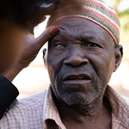
What is trachoma?
Neglected tropical disease
Leading infectious cause of blindness globally
Caused by bacterium Chlamydia trachomatis
Exists in the most deprived and ruralised areas of the world
Clinical features:
repeated infections scar the eyelids
trachomatous trichiasis
can lead to corneal opacification and irreversible blindness usually occurring into adulthood
Photo: RTI / Damien Schumann

Slide 3
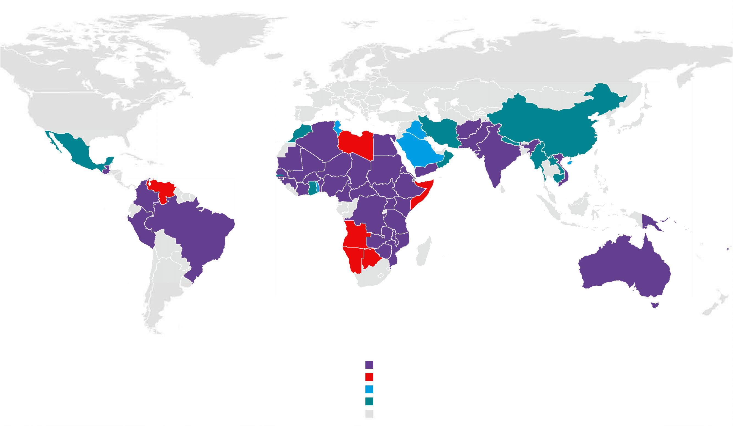
Global status of endemicity of trachoma
136.2 million people are known to be at risk of trachoma globally
1.8 million people require surgery for trachomatous trichiasis
67.2 million people at risk in Ethiopia, the world’s most affected country
44 countries are known to require interventions for trachoma
12 countries have been validated as having eliminated trachoma as a public health problem
Known to require interventions to eliminate trachoma
May require interventions, further investigation needed
Claims to have eliminated, but not validated
Validated as having eliminated trachoma as a public health problem
Thought to not require interventions
Adapted from: GET2020 database, 21 June 2021
Notes:
On 26 January 2022, the World Health Organization (WHO) validated Saudi Arabia for having eliminated trachoma as a public health problem
(Cambodia, China, Gambia, Ghana, Islamic Republic of Iran, Lao People’s Democratic Republic, Mexico, Morocco, Myanmar, Nepal, Saudi Arabia and Oman)

Slide 4
GET2020 and the SAFE strategy
WHO Alliance for the Global Elimination of Trachoma by 2020
“SAFE” strategy:
Surgery to correct trachomatous trichiasis
Antibiotics for C. trachomatis infection
Facial cleanliness to reduce transmission
Environmental improvement
WHO 2021-2030 road map for neglected tropical diseases (NTDs)
2030 target for global elimination of trachoma as a public health problem
Photo: ITI/ Mark Tuschman
Photo: CBM
Photo: Pfizer/William Vasquez

Slide 5
Aim and Objectives
Photo: ITI/ Mark Tuschman
I will give an overview of the costs and economic evaluation estimates of trachoma interventions.
Assess the reporting and methodological quality, and investigate the uncertainty surrounding the estimates.
Photo: CBM
Photo: Pfizer/William Vasquez

Slide 6
Search results
Identification
Records identified through PubMed search (n=238)
Records identified through EMBASE search (n=286)
Additional records found from other sources (n=81)
16 studies met the inclusion criteria for the review.
82 estimates of the cost of trachoma interventions and
76 ICER values were extracted in four categories of interventions:
MDA of azithromycin
Targeted (household) treatment with azithromycin
MDA of tetracycline
Trichiasis surgery
Screening
Total records screened after duplicates removed (n=462)
Records excluded after initial screening of titles and abstracts (n=420)
Records excluded based on their full-text assessment (n=26):
Cost-analysis of conducting prevalence surveys / mapping (n=6)
Article not in English (n=1)
Willingness-to-pay study (n=1)
Not economic evaluations (n=14)
Not SAFE interventions (n=2)
Conference abstract (n=2)
Eligibility
Full-text articles assessed for eligibility (n=42)
Inclusion
Relevant studies included for data extraction and synthesis (n=16)
MDA: mass drug administration; ICER: incremental cost-effectiveness ratio

Slide 7
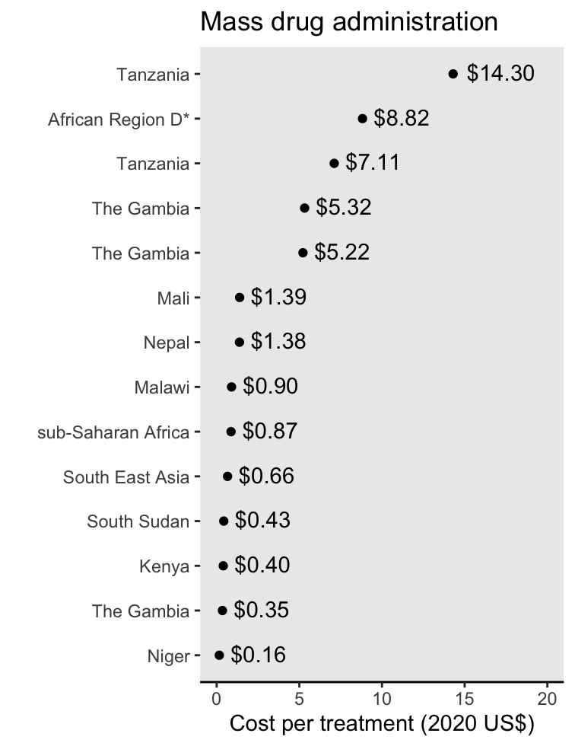
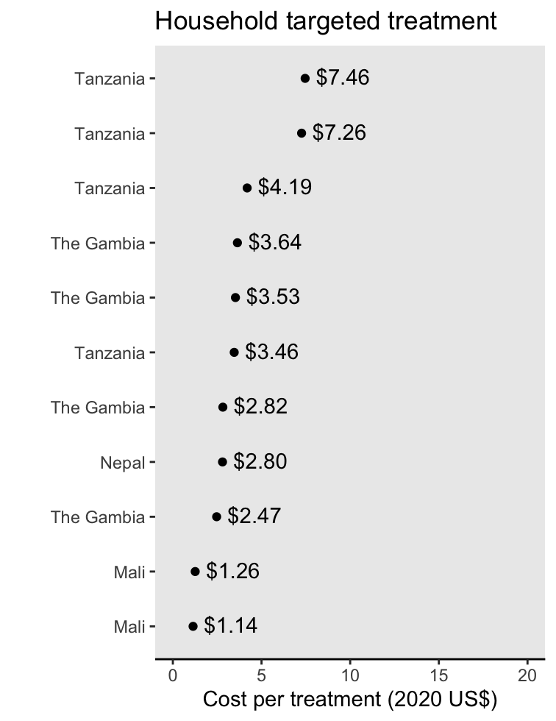
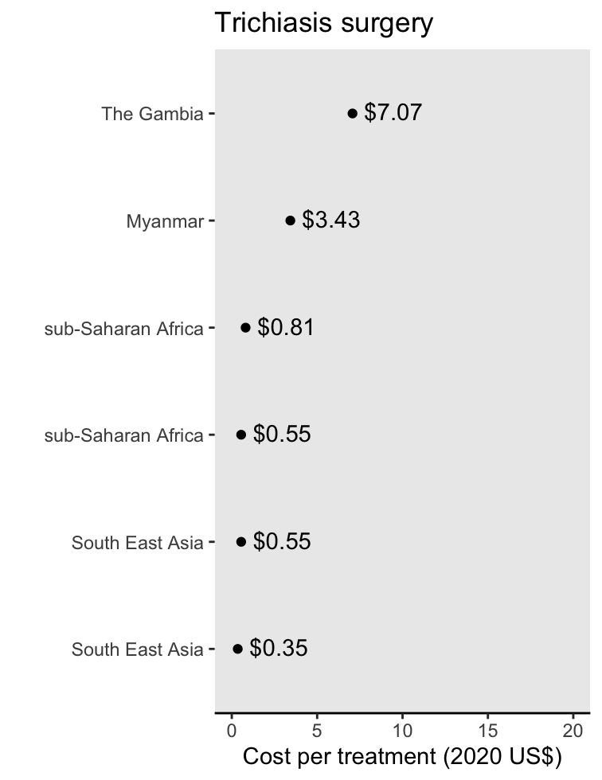
Cost of trachoma control interventions
Median = $1.14
Median = $3.46
Median = $0.68

Slide 8
Summary of the cost per disability-adjusted life year (DALY) averted estimates
MDA of azithromycin: I$9,000 to I$65,000 per DALY averted.
can be considered cost effective in the African but not the South East Asian sub-region.
Trichiasis surgery: I$13 to I$78 per DALY averted.
Mass treatment of all children with tetracycline and targeted treatment with azithromycin have the potential to be cost-effective trachoma control interventions.

Slide 9
Economic benefits
Countries with known or suspected blinding trachoma have a potential productivity loss of $2.9 billion (1995 US $) and using 1998 productivity measures¹ – may even be an underestimate of the total economic impact.
The potential economic benefit from productivity loss averted if NTD control/elimination was achieved by 2020 was estimated to be $0.71 billion in 2011-2020, and $3.6 billion in 2021-2030².
Estimates useful for policymakers and advocacy groups in justifying continued investment in trachoma control (and integrated strategies for NTD prevention and elimination).
Frick, Kevin D et al. “Estimating the burden and economic impact of trachomatous visual loss.” Ophthalmic Epidemiol vol. 10,2 (2003): 121-32.
Redekop, William K et al. “The Socioeconomic Benefit to Individuals of Achieving the 2020 Targets for Five Preventive Chemotherapy Neglected Tropical Diseases.” PLoS Negl Trop Dis vol. 11,1 e0005289. (2017)

Slide 10
Key messages
Trachoma interventions have potential to be very cost-effective.
Significant economic benefits.
Equity impact: benefits the poorer populations.
Economic analyses need to carefully evaluate the SAFE strategy comprehensively, using consistent methodological approaches, while adhering to detailed reporting.
Optimise elimination programmes to reduce NTD burden.

Slide 11
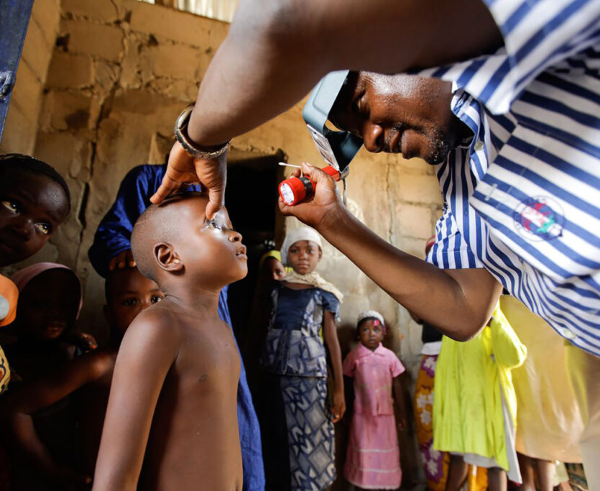
Thanks for listening!
Presentation by Joseph P Mensah
Wellcome Trust PhD Student
Public Health Economics and Decision Science
School of Health and Related Research (ScHARR)
University of Sheffield
jpmensah1@sheffield.ac.uk
Source: https://unitingtocombatntds.org/ntds/trachoma/

