Slide 1
Anniversary Event, March 2022
Secular changes in exposure to Toxoplasma gondii: Implications for congenital disease in human populations
Gregory Milne
@GC_Milne
gmilne@rvc.ac.uk

Slide 2
Background
Research questions
Methods
Results
Discussion
Toxoplasma: an NTD?
Disproportionately affects lower income, minority & indigenous populations
Often chronic condition, exacerbated by immunosuppression
Interventions largely in high-income countries
“Toxoplasmosis is considered one of the neglected parasitic infections of the United States”

Slide 3
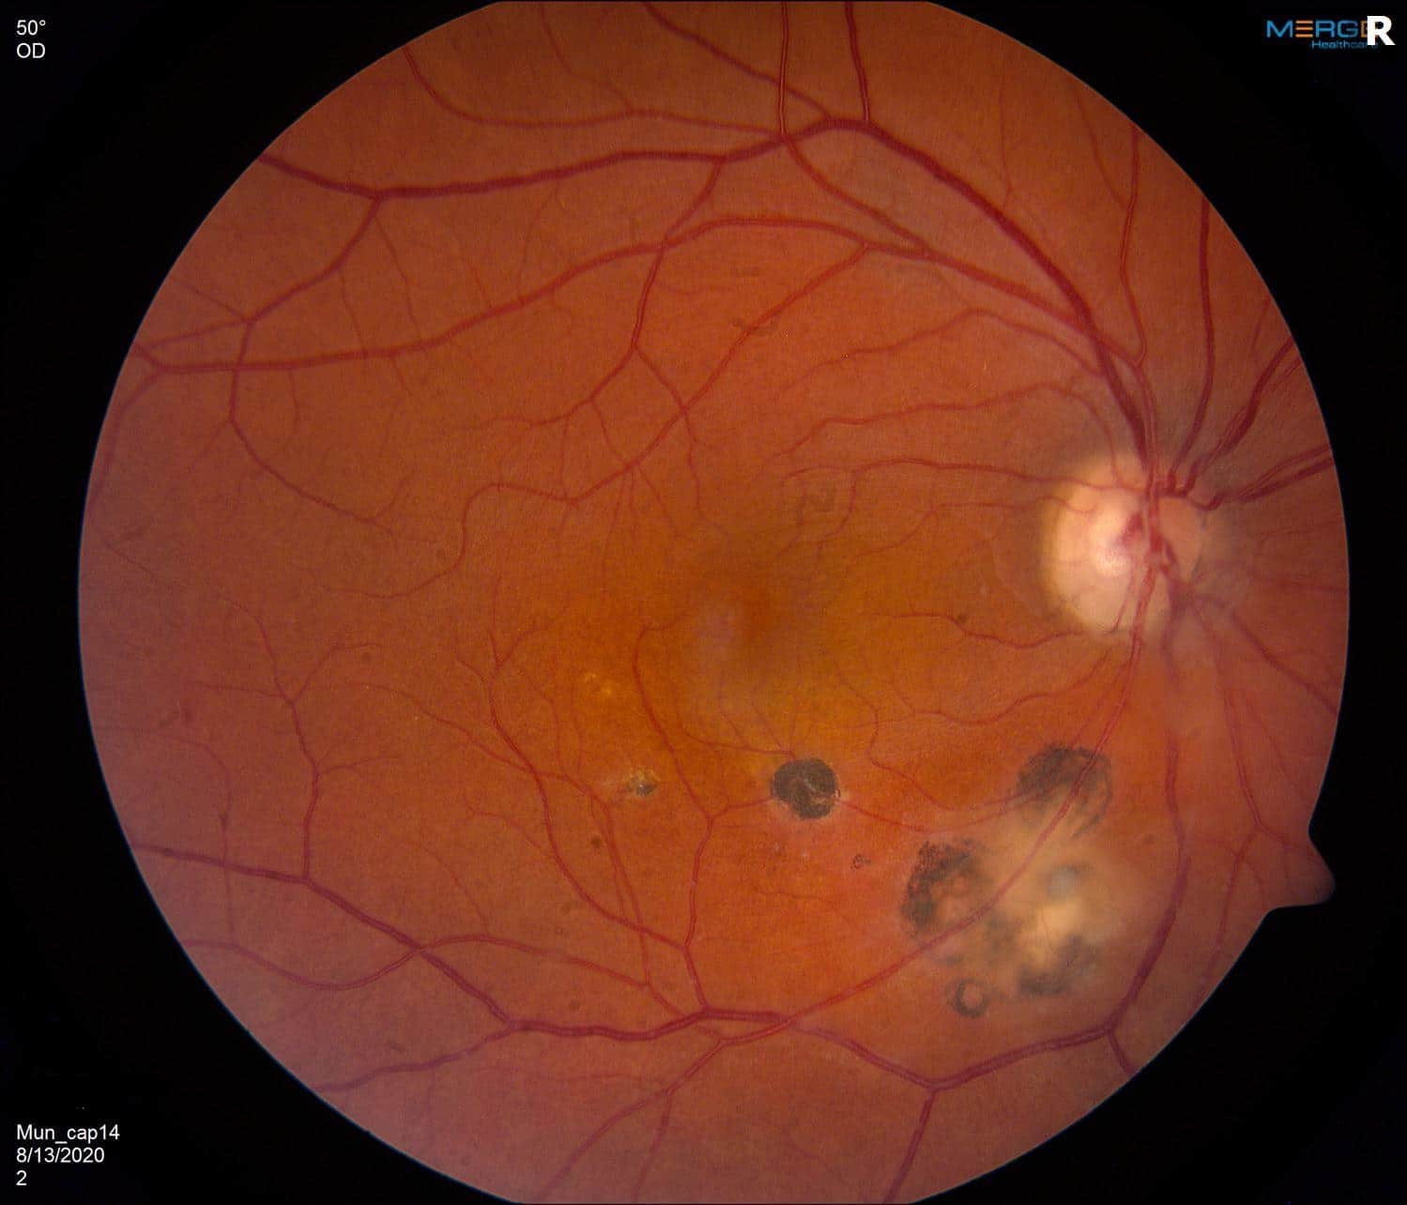
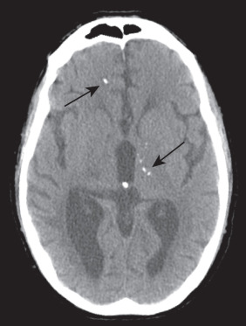
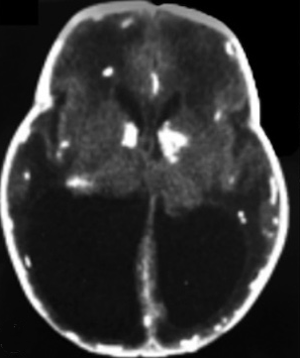
Background
Research questions
Methods
Results
Discussion
Human congenital toxoplasmosis
First-time exposure in pregnancy (transplacental passage of asexual ‘tachyzoites’)
190,000 cases/year (temporal component?)
Significant clinical consequences
Few countries offer prenatal or neonatal screening
Chorioretinitis
Intracranial calcifications
Hydrocephalus

Slide 4
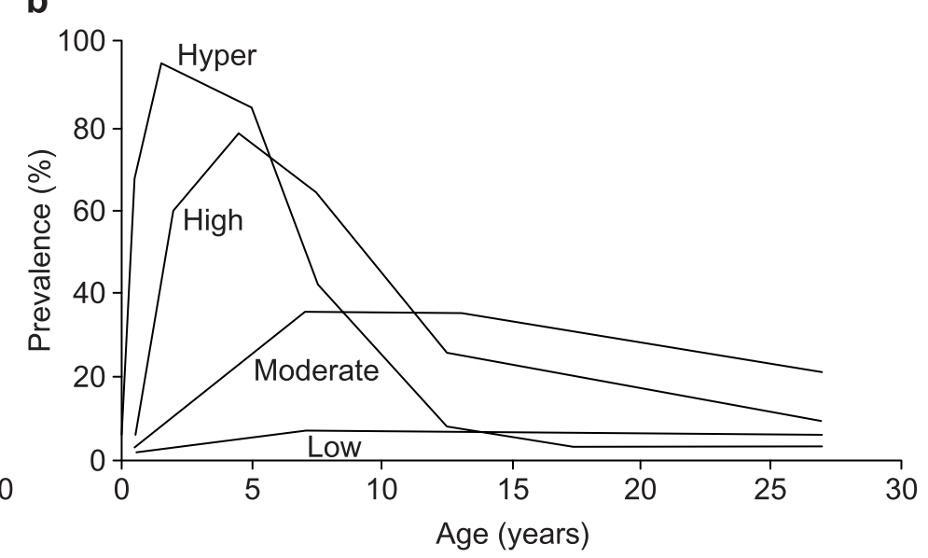
Background
Research question
Methods
Results
Discussion
Research question
Milne, Webster & Walker (under review)
How do secular changes in exposure translate into congenital toxoplasmosis (CT) incidence?
In high-transmission settings, could declines translate into paradoxical increases in CT cases?
‘Peak shift’ dynamics
Probability of infection (%)
Woolhouse M, 1998. Parasitology Today, 14(10)

Slide 5
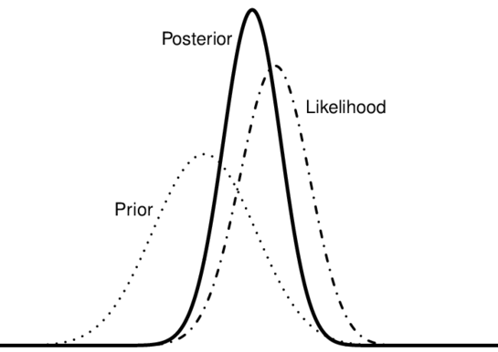
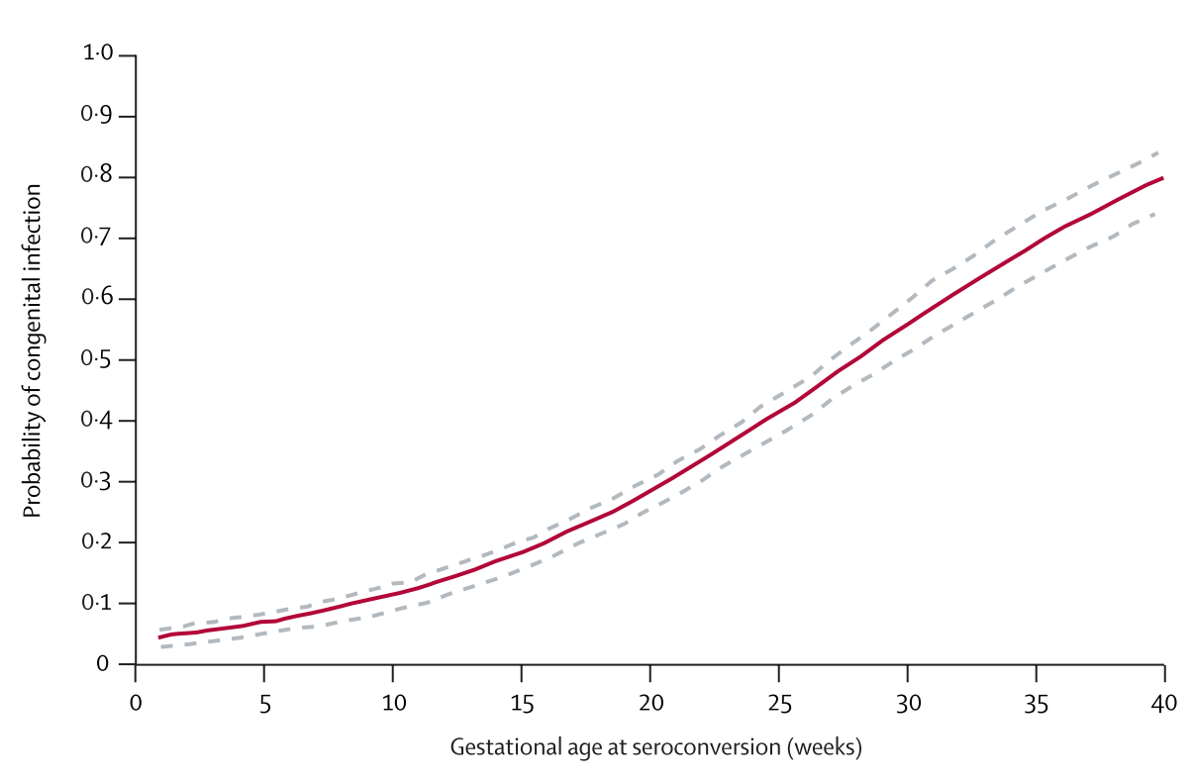
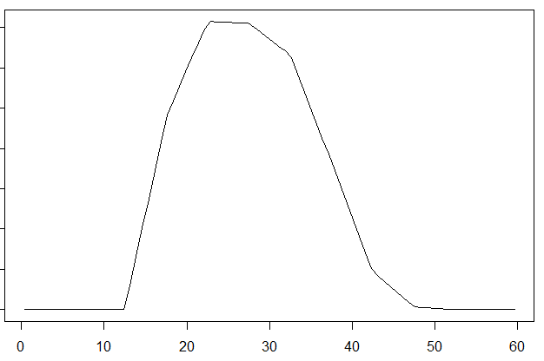
Background
Research questions
Methods
Results
Discussion
Methods: mathematical model
Milne, Webster & Walker (under review)
Tracks change in seroprevalence over age and time
Fit to longitudinal country-specific seroprevalence data (accounting for demographics)
Estimate the CT incidence by
Age-seroprevalence
No. pregnant women
Mother-child transmission rate
i
i+1
Age (years)
Gestational age (weeks)
Age (years)

Slide 6
Background
Research questions
Methods
Results
Discussion
Results: congenital toxoplasmosis incidence
Milne, Webster & Walker (under review)
No/marginal change in seroprevalence
Declines from low (<30%) seroprevalence
y-axis: Incidence per 10,000 live births
Declines from medium (30-60%) seroprevalence
Declines from high (>60%) seroprevalence

Slide 7
Background
Research questions
Methods
Results
Discussion
Discussion: public health implications
Milne, Webster & Walker (under review)
Secular declines in exposure may warrant revision of screening policies in some countries - cost effectiveness will improve with rising CT incidence
Austria: declines from 50% (late ‘70s) -> 35% (early ‘90s) led to doubling of acute infections in pregnancy
Highlights utility of models in forecasting future CT incidence & therefore preparing ahead of time via policy change

Slide 8
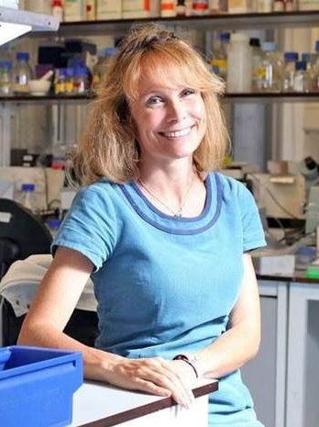
Acknowledgments
Supervision
Funding
Dr. Martin Walker
Prof. Joanne Webster
@GC_Milne
gmilne@rvc.ac.uk

