Slide 1



Ex vivo analysis of Leishmania infection in human blood cells over
24 hours
Dr Medhavi Ranatunga
Postdoctoral Academic in the Biosciences
M.Ranatunga@greenwich.ac.uk

Slide 2
Introduction
A number of human cells are thought to be able to host Leishmania parasites but their effect/participation on establishment of infection remains widely uncharacterized.
Neutrophil
Monocyte
Macrophage
Dendritic cell
B lymphocyte

Slide 3
Aims
To investigate how whole blood cell populations participate and interact with Leishmania parasites to allow establishment of infection in humans.

Slide 4
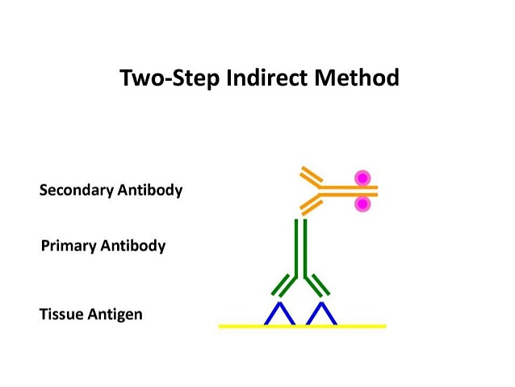
Material and Methods
Red Blood cell lysed Whole Blood
Immunophenotyping
Neutrophil
Macrophage
Anti- CD16b
Anti- CD14
Anti-CD20
4h & 24h
PE CD16b
Alexa Fluor CD14
PE-Cy CD20
CD16b
CD14
CD20
Monocyte
Dendritic cell
Lymphocytes
GFP expressing Metacyclic Promastigotes
Flow cytometry

Slide 5
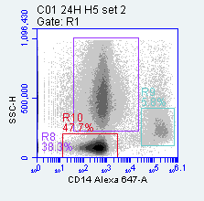
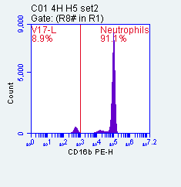
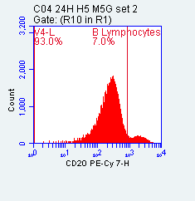
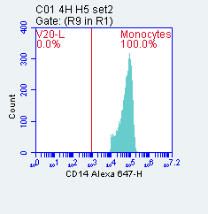
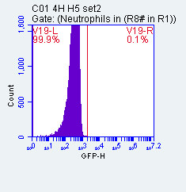
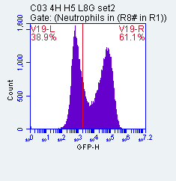
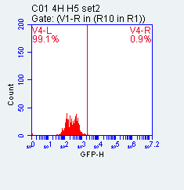
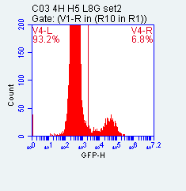
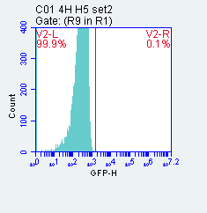
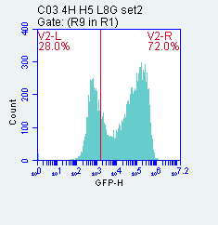
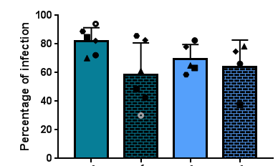
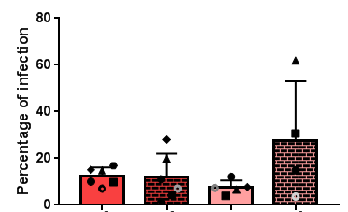
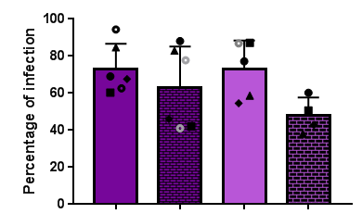
Results and Discussion
(Percentage of infection)
Neutrophil (PMN)
B Lymphocyte (B cells)
Monocyte (Mφ)
Neutrophil (PMN)
B Lymphocyte (B cells)
Monocyte (Mφ)
CD16B -
CD16B +
CD20 -
CD20 +
CD14 -
CD14 +
Notes:
All cell types are infected
Higer infection of 40-90 get infected….

Slide 6
Conclusion
During whole blood infection both L. aethiopica and L. mexicana infect Neutrophils, Monocytes and B cells over 24 hours.
As expected higher percentage of Neutrophils and Monocytes get infected when comparing to B cells during whole blood infection.

Slide 7
Reference
Getti, G. T et al. (2008). Induction of apoptosis in host cells: a survival mechanism for Leishmania parasites?. Parasitology. 135, 1391-1399.
Ruben, E et al. (2012). In Vitro and In Vivo Efficacy of Ether Lipid Edelfosine against Leishmania spp. and SbV-Resistant Parasites. PLos Neglected Tropical Diseases. 6 (4), 1-14.
Liu D, Uzonna JE. The early interaction of Leishmania with macrophages and dendritic cells and its influence on the host immune response. Front Cell Infect Microbiol [Internet]. 2012;2(June):83. Available from: http://journal.frontiersin.org/article/10.3389/fcimb.2012.00083/abstract
DaMata JP, Mendes BP, Maciel-Lima K, Menezes CAS, Dutra WO, Sousa LP, et al. Distinct macrophage fates after in vitro infection with different species of Leishmania: Induction of apoptosis by Leishmania (Leishmania) amazonensis, but not by Leishmania (Viannia) guyanensis. PLoS One [Internet]. 2015;10(10). Available from: http://dx.doi.org/10.1371/journal.pone.0141196

Slide 8
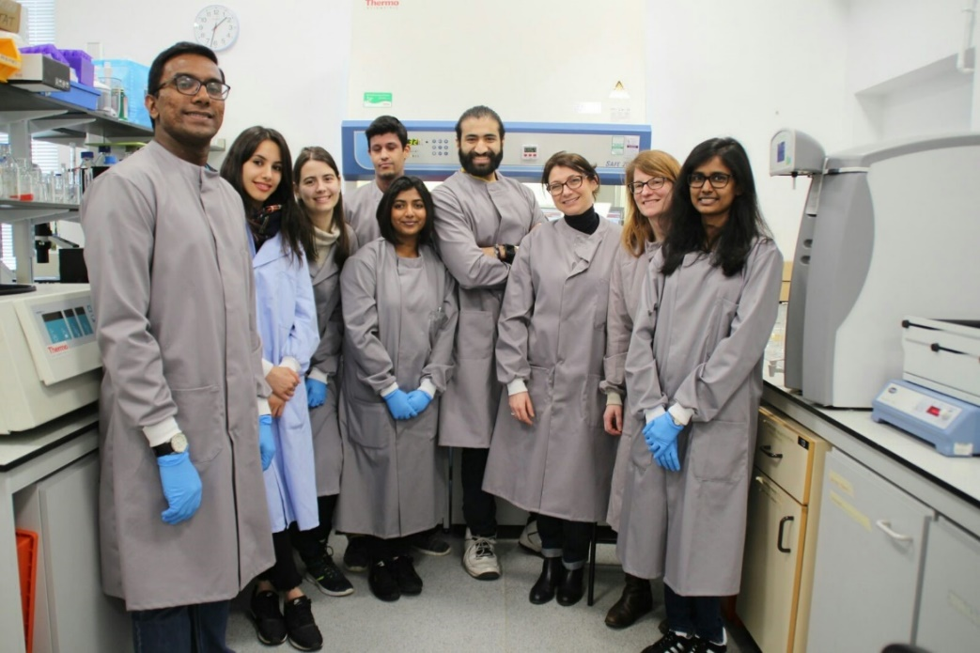
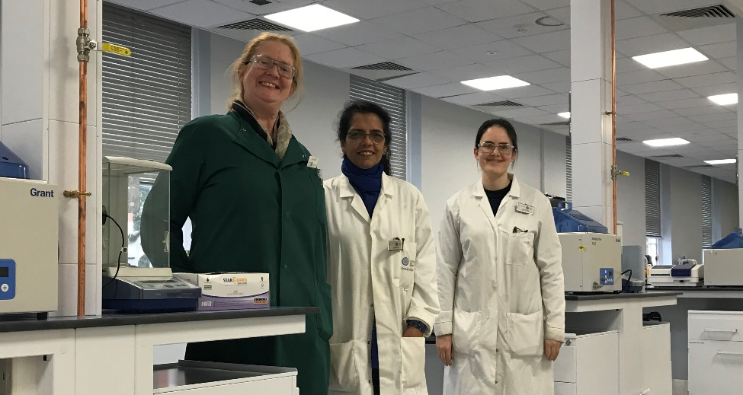

Thank you !
Dr. Giulia Getti
Dr. Paul Dyer
Rachel Nice
Atiya Raza
Samantha Lewis
Samantha Ingram

