Slide 1
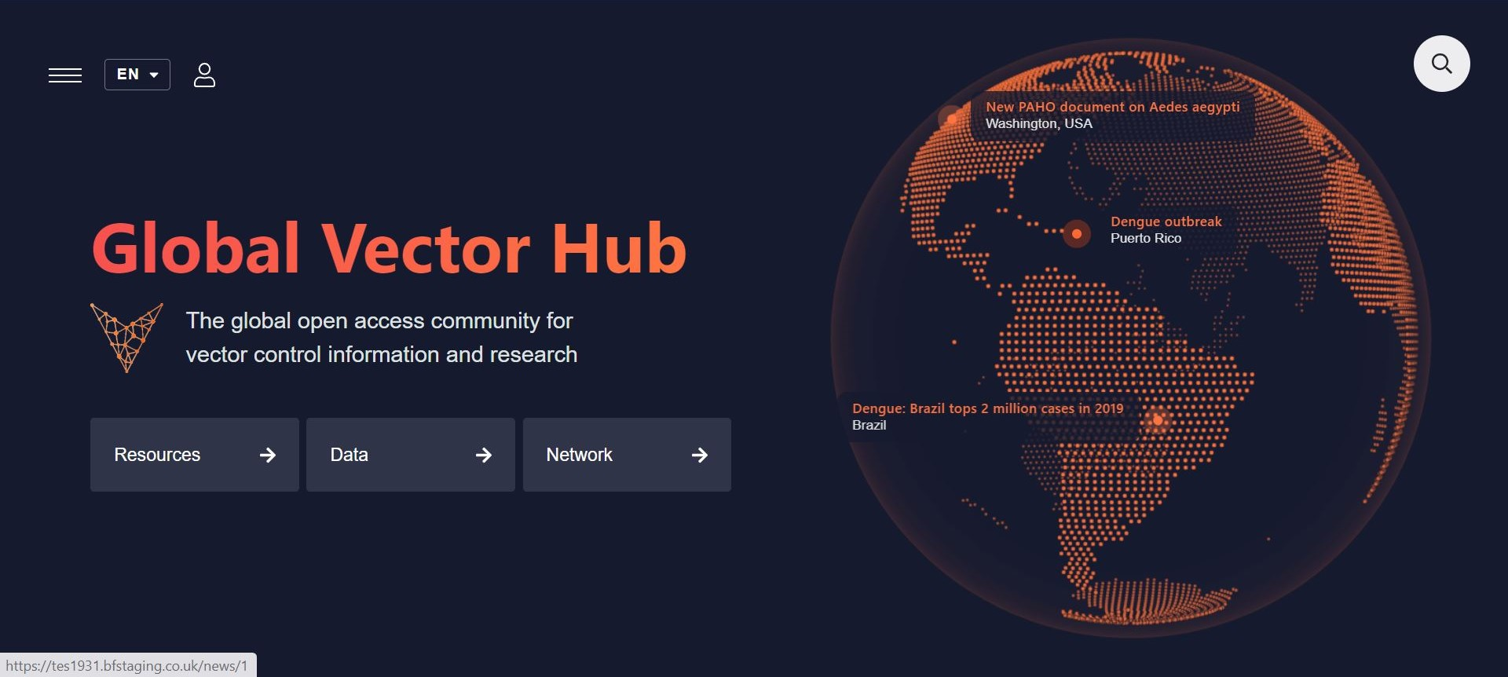
Building entomological capacity worldwide and
improving epidemic preparedness
Making vector-borne diseases history
Dr Frederik Seelig
frederik.seelig@lshtm.ac.uk

Slide 2
The Global Problem
Vector-borne NTDs:
Chagas disease
dengue and chikungunya
human African trypanosomiasis (sleeping sickness)
leishmaniasis
lymphatic filariasis
onchocerciasis (river blindness)
scabies and other ectoparasitoses
80% of World’s population at risk of vector-borne diseases (VBDs)
17% of global disease burden of communicable diseases due to VBDs
241 million malaria cases and 627,000 malaria deaths worldwide in 2020
390 million dengue infections per year, 3.9 billion people at risk

Slide 3
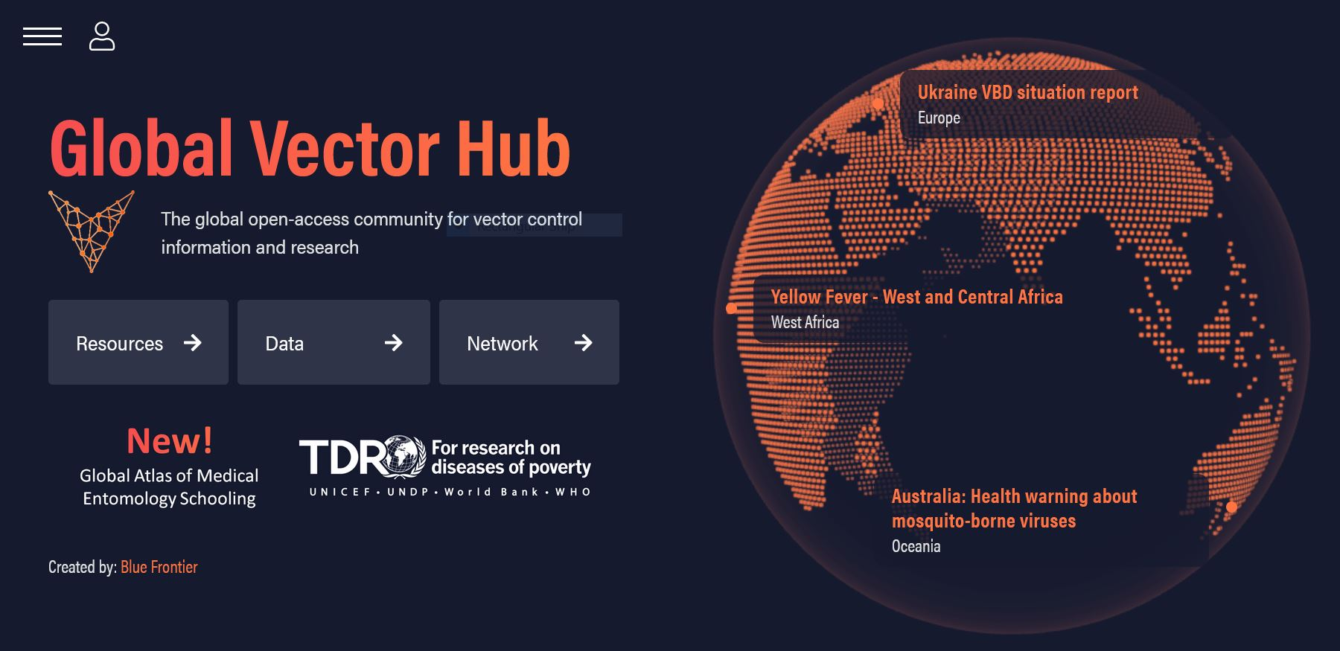
The Global Vector Hub platform
https://globalvectorhub.lshtm.ac.uk/

Slide 4
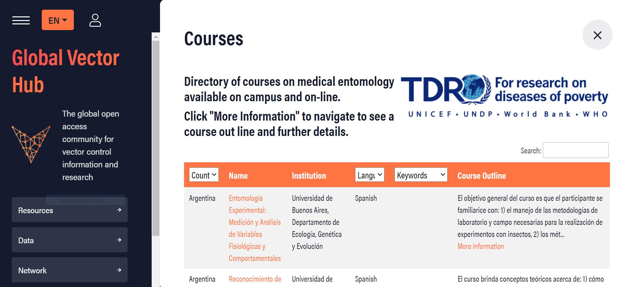
TDR & GVH course directory
Course directory: 133 training courses in medical entomology, from 32 countries, in 10 languages.

Slide 5
Join the Global Vector Hub
FOLLOW US ON TWITTER
@GlobalVectorHub
REGISTER
Register yourself, your work or your organisation at:
https://globalvectorhub.lshtm.ac.uk/register
GET IN TOUCH
frederik.seelig@lshtm.ac.uk
globalvectorhub@lshtm.ac.uk

Slide 6
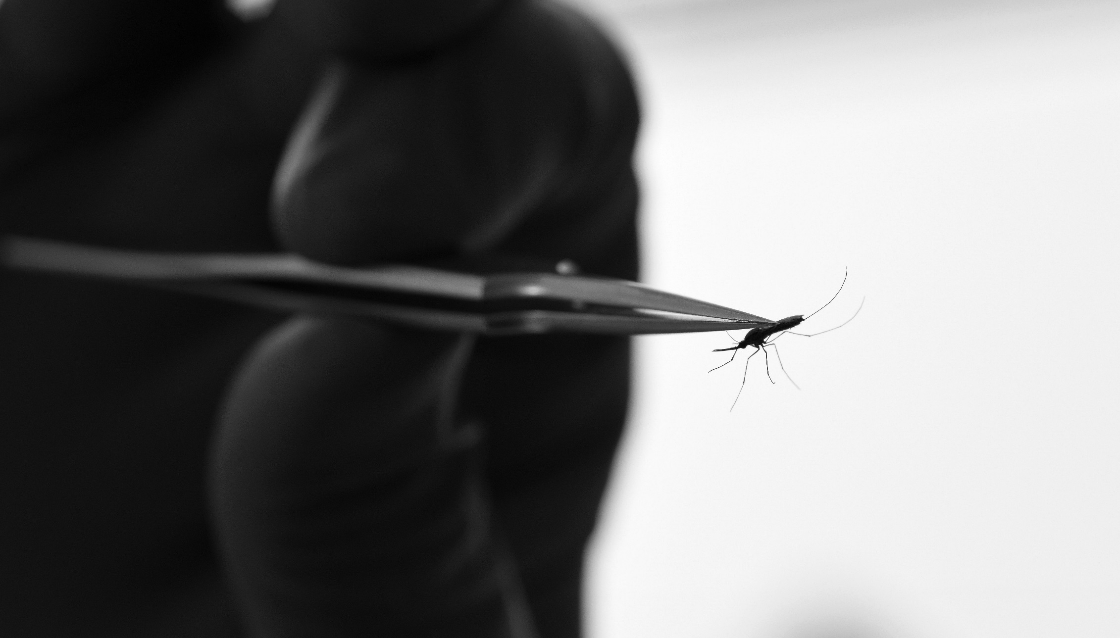
Developed by
Thank you!
Funded by

