Slide 1



A One Health approach to the control and prevention of rabies
Emma Taylor, PhD Candidate
emmalouise.taylor@surrey.ac.uk
@emmyloutaylor
https://www.linkedin.com/in/emma-taylor/
Dr Dan Horton, University of Surrey
Dr Joaquin Prada, University of Surrey
Dr Ryan Wallace, USA, CDC
Funder: Doctoral College Studentship Award, Santander Researcher Award 2018/19

Slide 2




Why should we care? - the global burden of rabies
Rabies is a
disease of global concern
100% preventable
150
countries and territories globally
More than 59,000 deaths per year –
40% of people bitten are children under 15 years of age
100 children die per day globally
99%
of human rabies cases are caused by dog bites

Slide 3
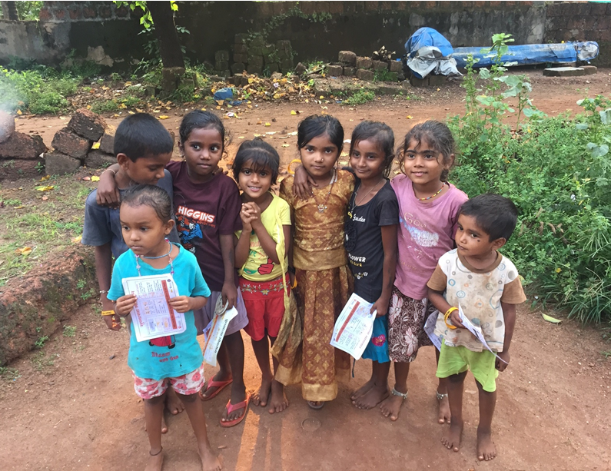
Introduction to PhD – Epidemiology and Global Health
Disease Dynamics Model
Economic Evaluation
Dog Behaviour
Research Question: Will a suite of modelling techniques informing dynamics, and area-specific key performance indicators improve decision making and inform control strategies for rabies?
Aim: Provide a framework for the integration of demographics and population dynamics, surveillance data, rabies capacities deployment, economic evaluation, and portfolio analysis, in a temporal and spatially explicit manner.
improve strategic risk management, and resource allocation
Fig. 1 Schematic of representation of PhD project and combination of modelling approaches being applied to rabies control

Slide 4
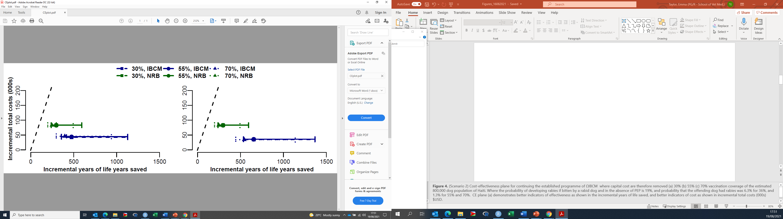
Cost Effectiveness Analysis:
Integrated Bite Case Management rabies control programme
Economic Evaluation
Disease Dynamics Model
  IBCM provides better health outcomes at a lower cost across the vaccination coverages compared to NRB.
  Changing vaccination coverage has little impact on total costs.
  A vaccination intervention that achieves 70% coverage, over five years is more likely to lead to rabies elimination.
Fig. 2 A cost effectiveness evaluation for setting up a IBCM style programme from scratch for a new region where there is currently no rabies control programme in place, using limited laboratory and diagnostic capabilities (NBCM) as a reference, and compared to a NRB approach. Diagonal dashed line shows the maximum acceptable ICER. Both IBCM and NRB interventions fall below the maximum acceptable ICER and so can be deemed as cost effective. Solid green and blue lines illustrates the range of uncertainty in prevalence of disease which changes incremental year of life years saved but doesn’t effect incremental total cost (000s).
Taylor et al., in prep

Slide 5
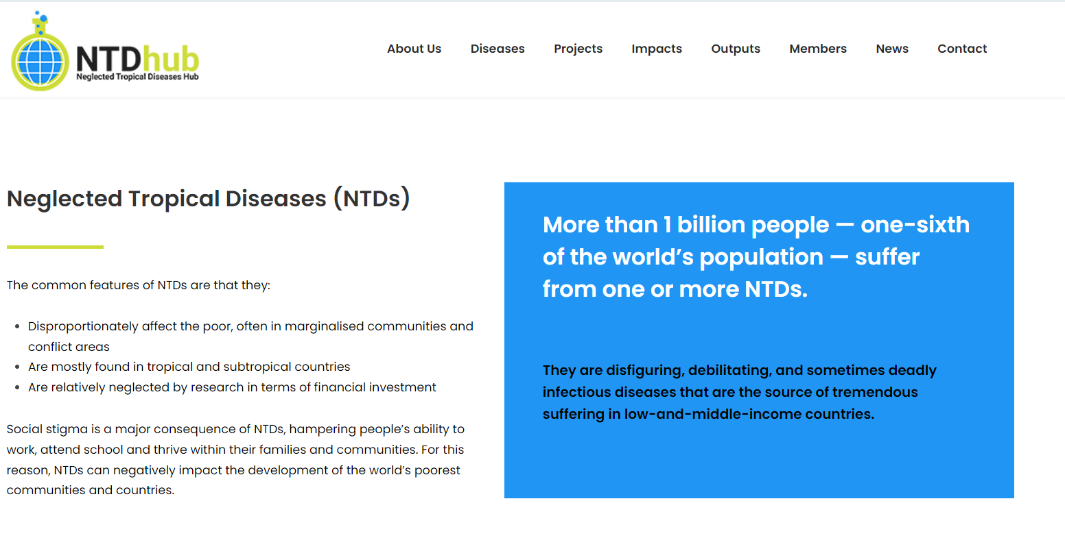







Acknowledgements
Dr Daniel Horton
Dr Joaquin Prada
Dr Ryan Wallace (CDC)
Dr Eduardo Undurraga (Pontificia Universidad Católica de Chile)

