Slide 1

Clinical diagnostics in parasitology: what EQAs tell us

Slide 2
UK NEQAS Parasitology Participants

Slide 3
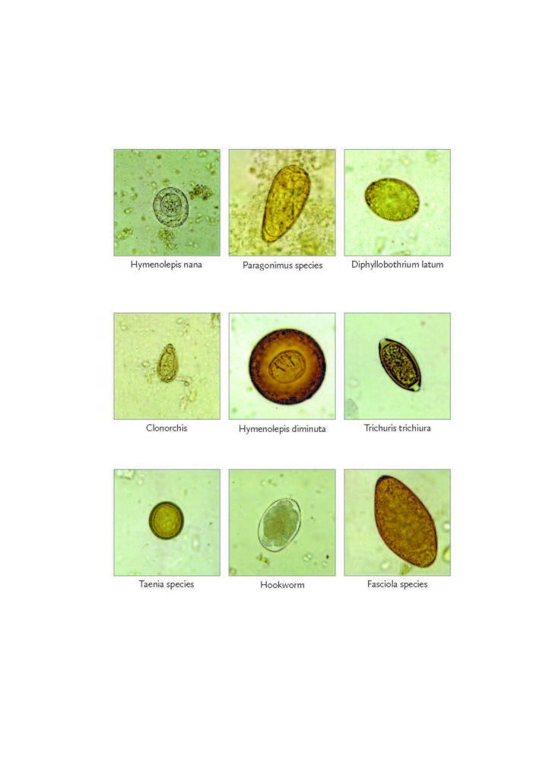
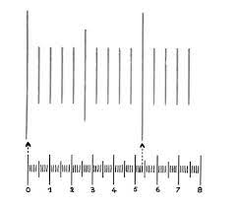
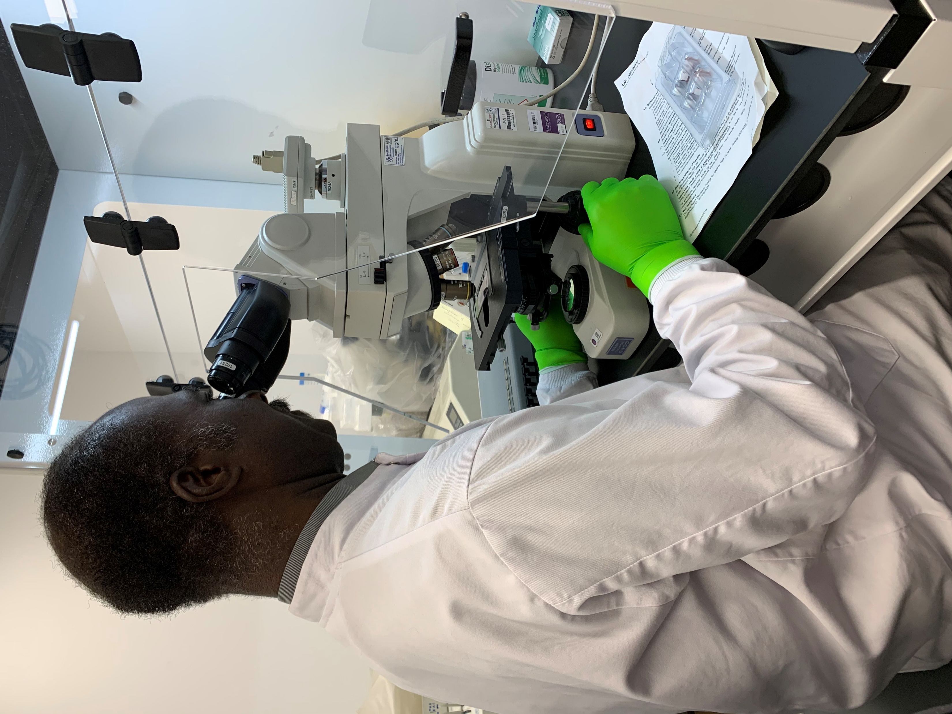
Faecal Parasitology scheme- microscopy based detection
Specimens consist of liquid specimens (i.e. faecal samples, urine samples and cyst fluid) and faecal smears.
A range of specimens that are not only educational but also encourage participants to critically examine their routine method to take individual action to investigate and remedy any defects revealed from their score.
The teaching sheets included in each distribution are designed for education purposes.
The principal of the successful identification of faecal parasites:
  Measurement
  The use of an eyepiece graticule is of the utmost importance, especially for cyst identification
  Morphology and appearance
  Stains
Notes:
The use of an eyepiece graticule is of the utmost importance, especially for cyst identification.
In protozoan cysts, the number of nuclei and the presence of inclusions e.g. glycogen mass and chromidial bar, red blood cells aid the identification of protozoa cysts and trophozoites. In helminth eggs the presence or absence of features such as an operculum, spine or hooklets are diagnostic pointers to the identity of the parasite.
In helminth eggs, the shape of the egg, the thickness of the shell, the colour of the ovum diagnostic pointers to the identity of the parasite.
Stains also aid in identification of the parasite. The addition of iodine to formol ether concentrates highlights the internal structure of cysts and helps distinguish between vegetable matter and cysts. Permanently stained faecal smears are useful in demonstrating the nuclear pattern of cysts.

Slide 4
Results- analysis of Faecal Parasitology scheme

Slide 5

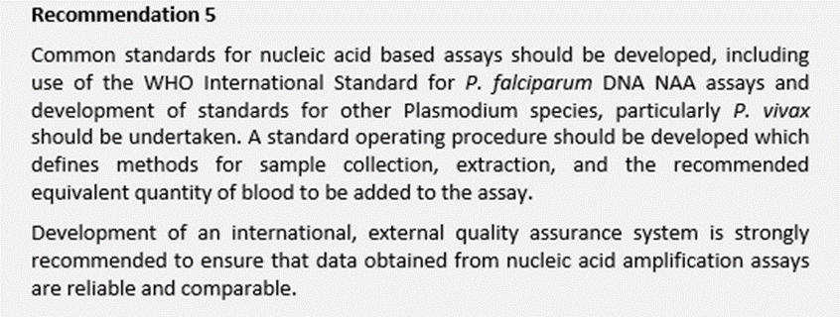

Need for the Malaria Molecular scheme

Slide 6
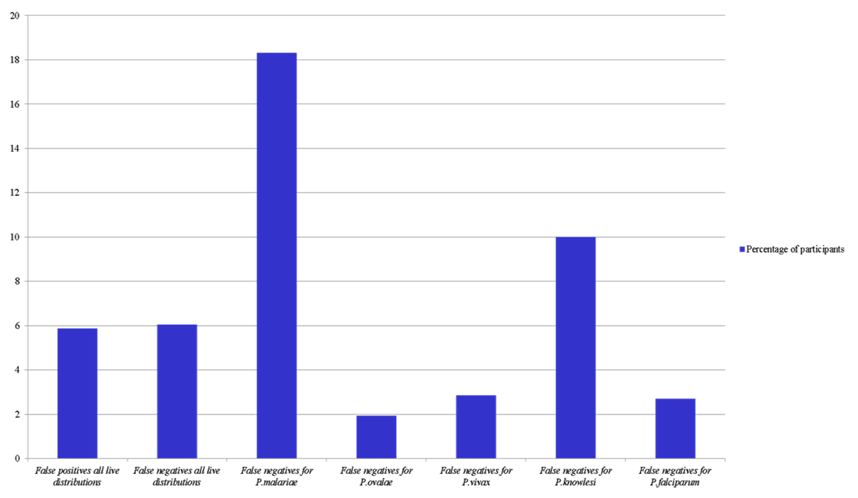
Percentage of false negatives and positives

Slide 7

Common problems identified by the Malaria Molecular schemes
Suitability of protocols of the extraction and/or amplification processes
Using protocols for limited species
False positives mostly due to transposition errors and were less common.
False negatives seem to be species dependent (P. knowlesi and P. malariae).
Higher error rate for lower parasitaemia samples (false negatives).
False-positives against malaria-negative samples were less common than false-negatives against Plasmodium-containing samples
Misalignment in laboratory results can be expected, especially as the parasite density goes down.
Factors that were found to significantly affect performance were due to the characteristics of the samples themselves (format, species, parasite density), and not the laboratory location (geography) or the reported methodology used (nucleic acid extraction, amplification, or DNA vs RNA target)
Referee laboratories performed better than non-referee laboratories.

