Slide 1
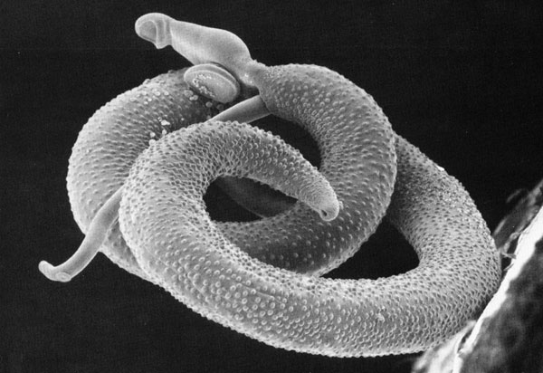
Molecular epidemiology and evolution of Antigen Coding Genes (ACGs) from the multi-host parasite Schistosoma japonicum
Daniel Parsons – PhD student
Anthony Walker, Aidan Emery, Joanne Webster, Jessica Buxton and Scott Lawton

Slide 2
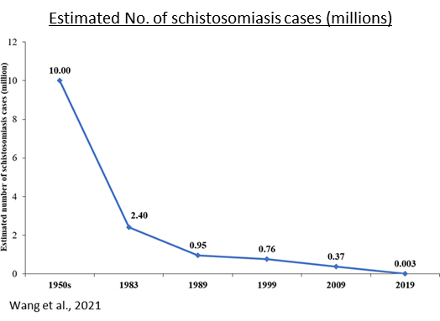
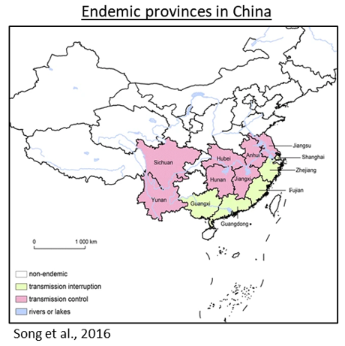
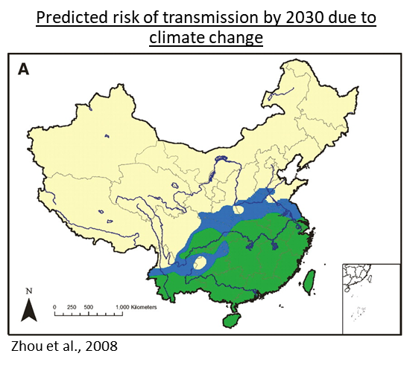
Zoonotic schistosomiasis in China
Control of schistosomiasis has been extremely successful, although some local resurgence detected in some provinces in China.
Zoonotic nature of S. japonicum arguably the most challenging factor facing control and end-game elimination in the region.
Precise impact of multi-host transmission on parasite evolution and antigen coding gene (ACG) diversification is unclear.
To what extent does zoonotic transmission contribute to parasite antigen diversity, and how does it impact parasite antigen evolution?

Slide 3
Selected Antigen Coding Genes (ACGs)
TSP-23-LEL
TSP-2-LEL
TAL-1
VAL-7-SCP
Tegument-bound, transmembrane, cell surface-anchored protein.
Interacts with the host via Large Extracellular Loop (LEL) domain.
Proposed vaccine candidate antigen.
Tegument-bound, transmembrane, cell surface-anchored protein.
Interacts with the host via Large Extracellular Loop (LEL) domain.
Stage 2 vaccine trials in S. mansoni.
Tegument-associated calcium-binding protein.
Main functions permitted via dynein light chain-like (DLC-like) domain.
Proposed vaccine candidate antigen.
Excreted/Secreted protein.
Interacts with host via Sperm-Coating Protein (SCP) domain (α-β-α sandwich).
Proposed vaccine candidate antigen.
Implicated in host immune system evasion
LEL = Red / SEL = Blue
LEL = Red / SEL = Blue
Gold = DLC-like
Gold = SCP

Slide 4
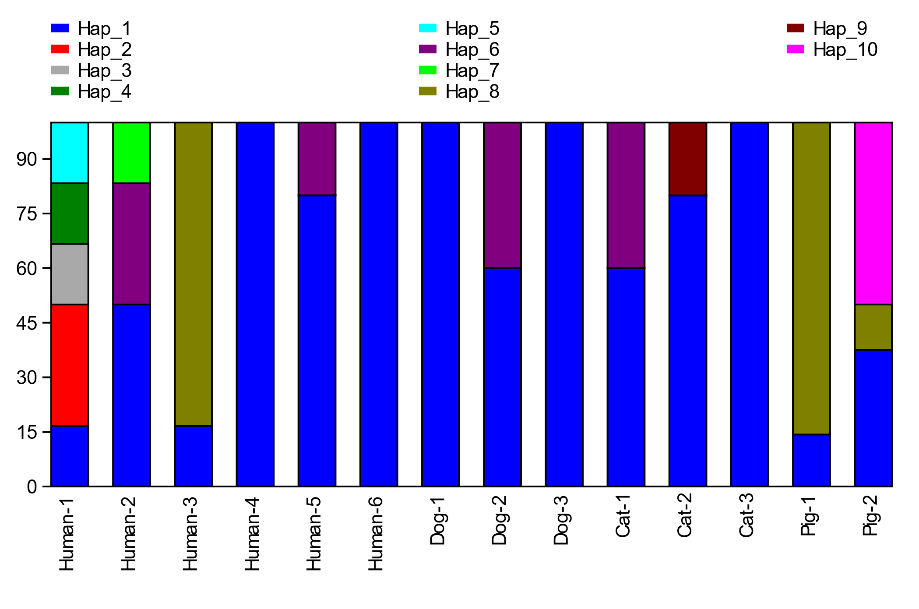
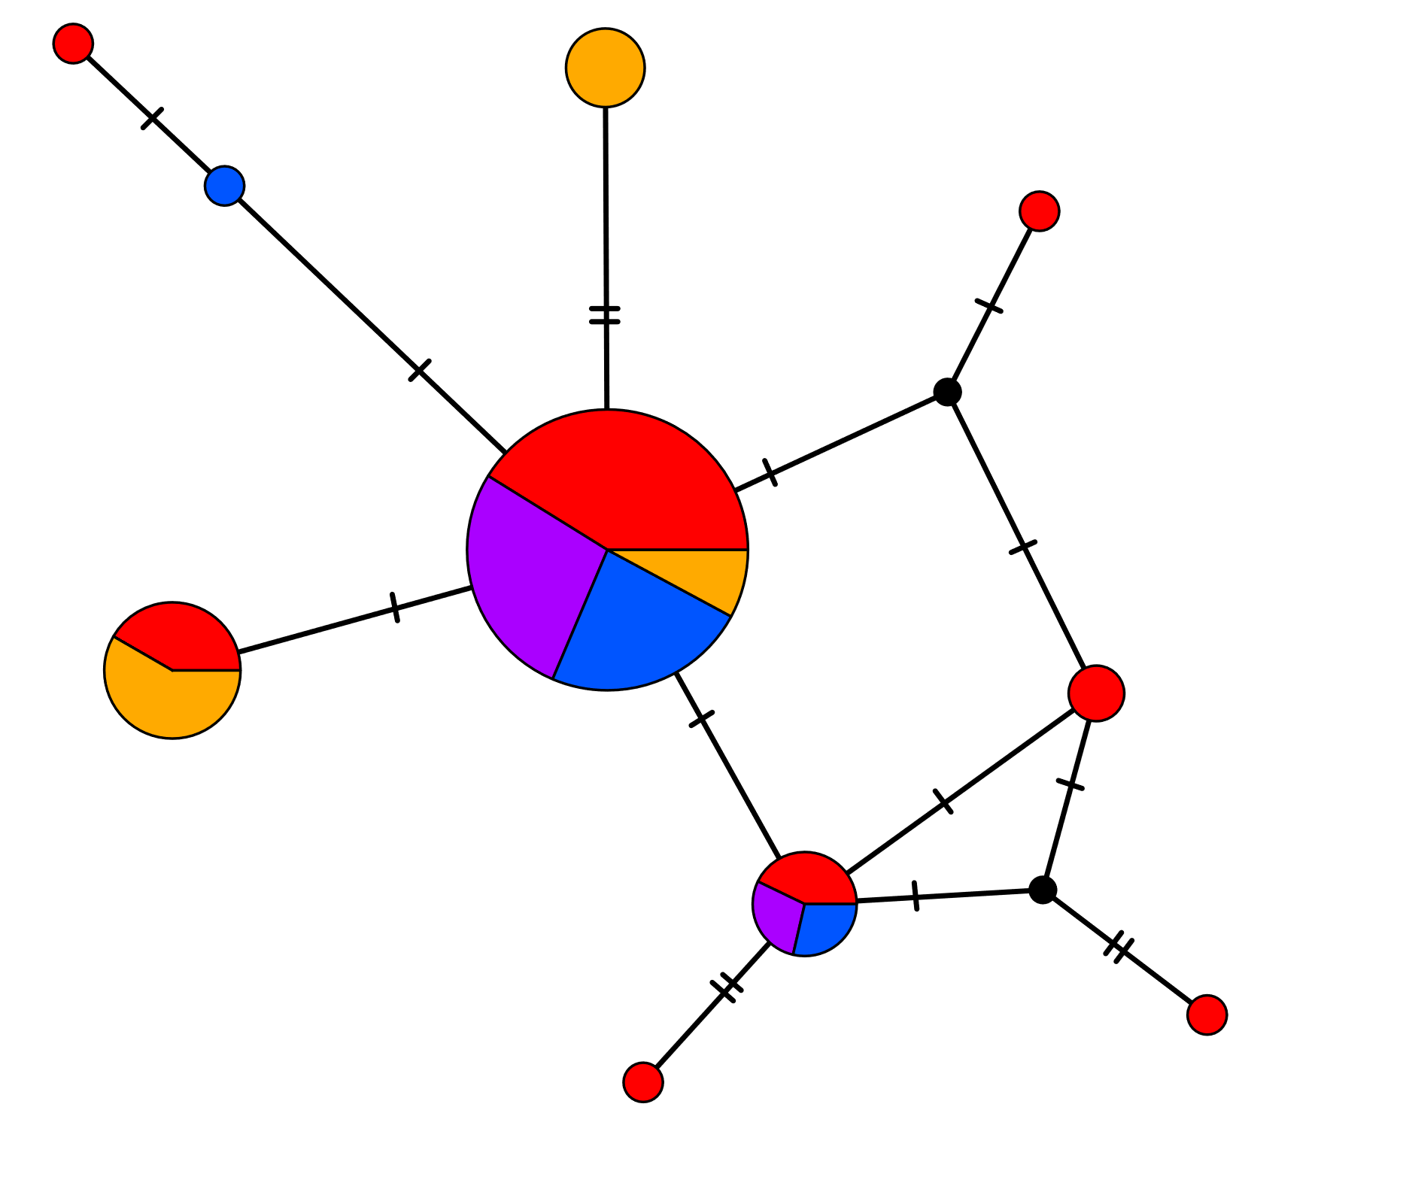
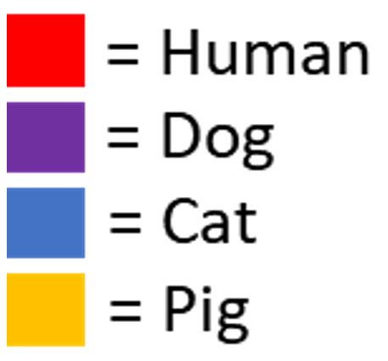
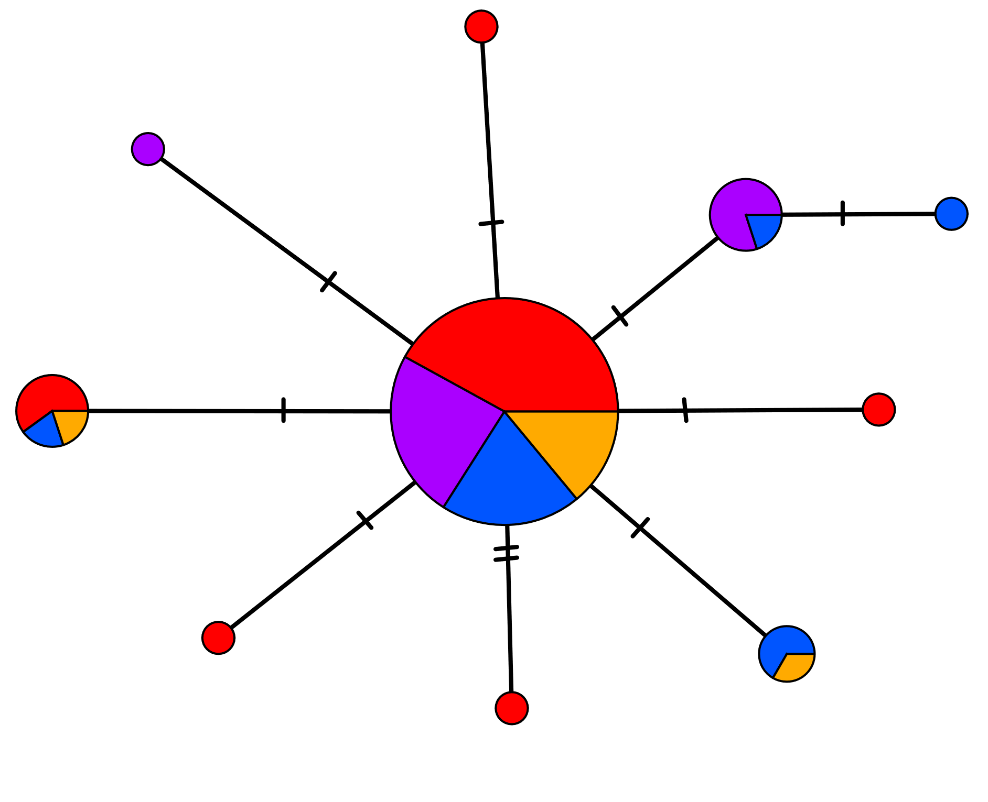
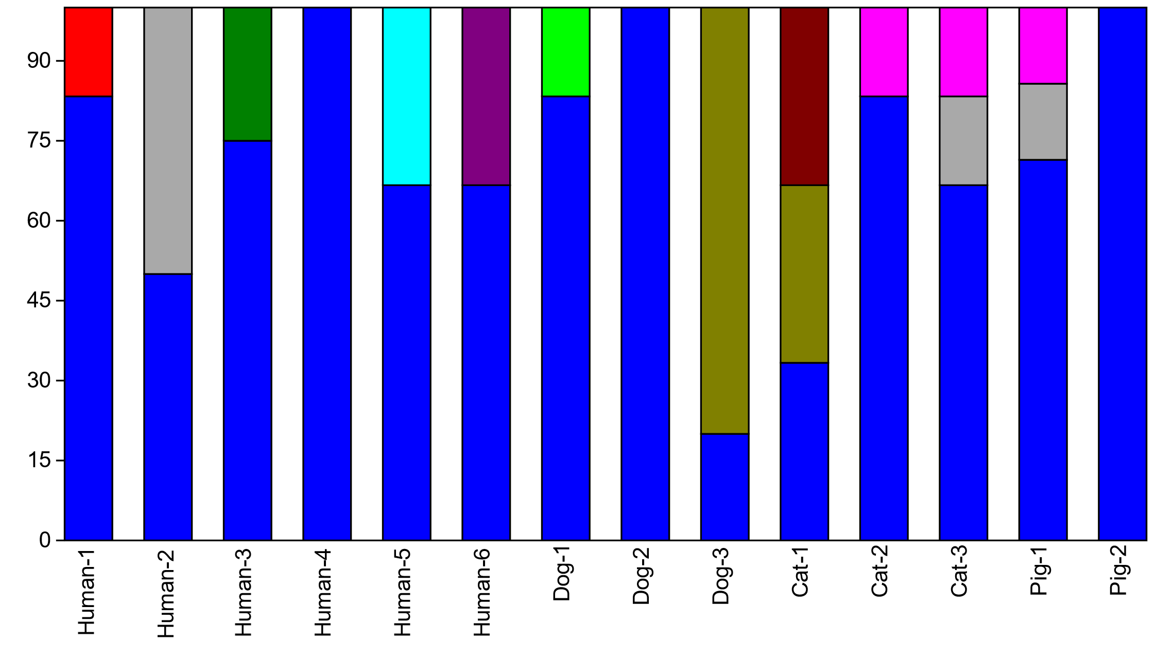
Research in Progress: Inter- & Intra- definitive host ACG variation
Haplotype frequency & distribution by host species
SjTSP-23-LEL
SjVAL-7-SCP

Slide 5
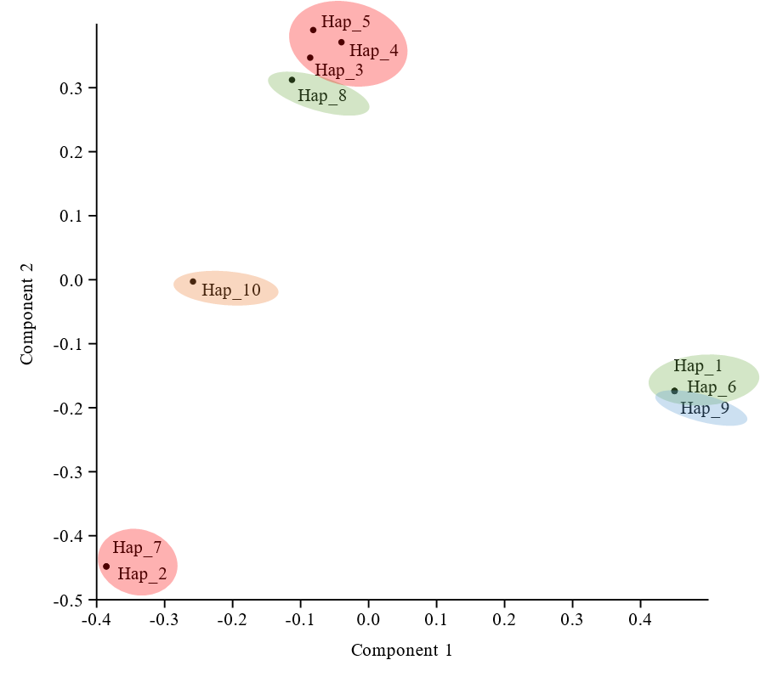
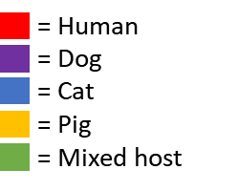
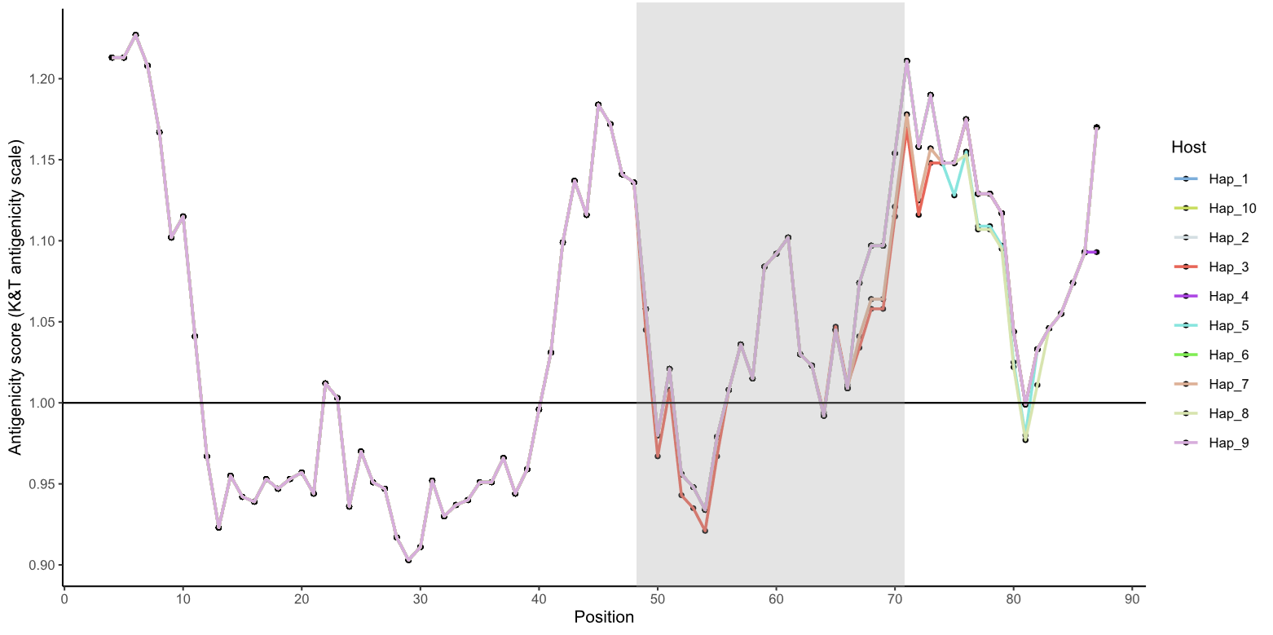
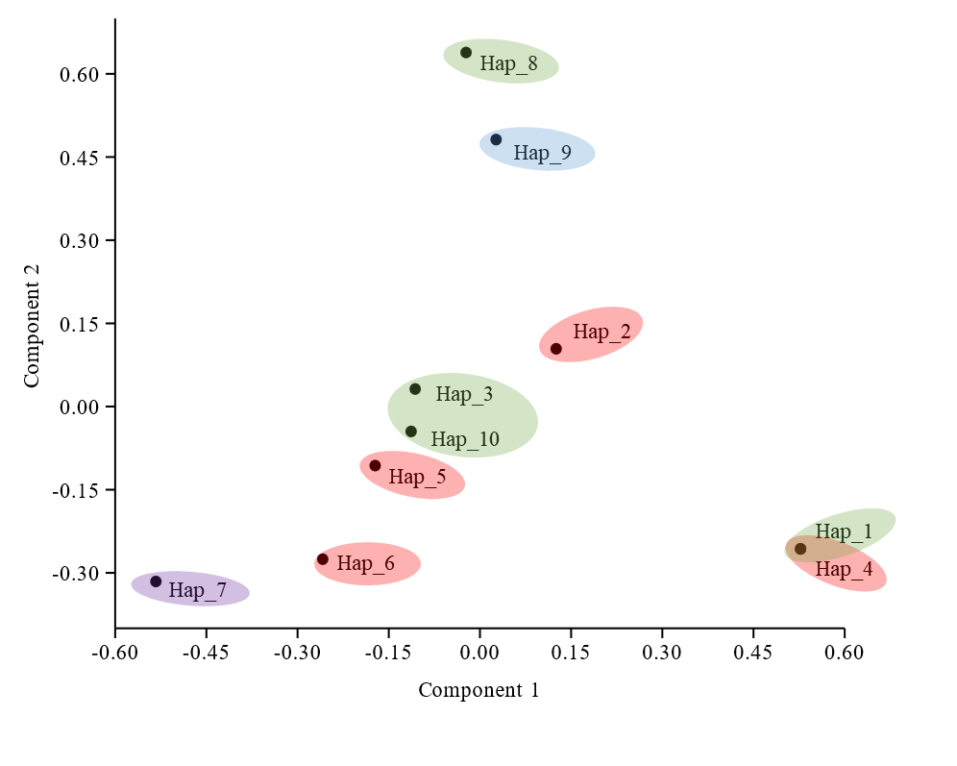
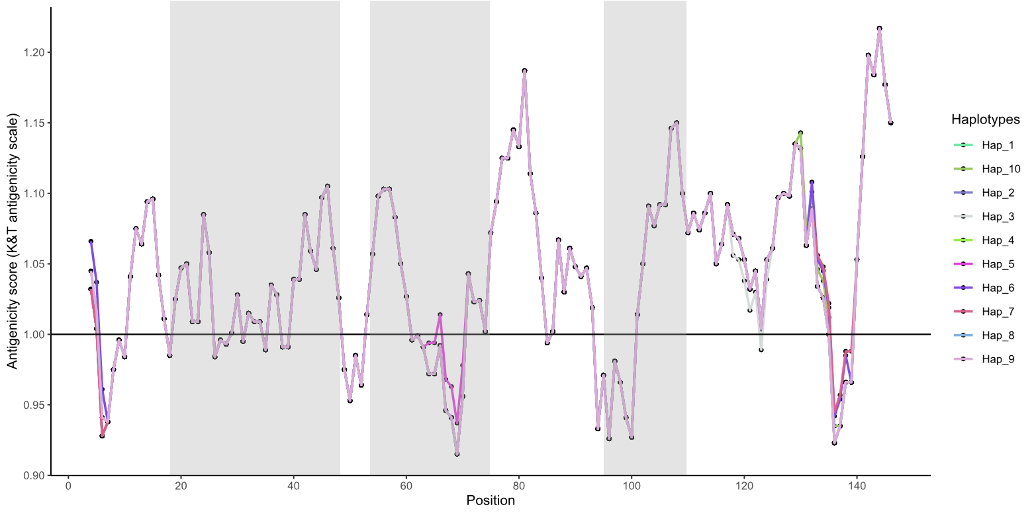
Research in Progress: Implications of ACG variation
Structural variation by haplotype
Antigenic variation by haplotype
Ab binding-site
Haplotypes
SjTSP-23-LEL
SjTSP-23-LEL
Haplotypes
SjVAL-7-SCP
SjVAL-7-SCP

Slide 6
Takeaway points
Human hosts contain the greatest number of unique antigen haplotypes –
Are novel antigen variants being generated in some humans?
&/or are humans sampling diverse parasite genotypes spatially and temporally?
All host species contain antigen haplotypes unique to each host.
Evidence of parasite transmission &/or sampling between host species.
Amino acid substitutions were predicted to induce antigenic and structural variation that may enable evasion of host immune recognition
Thanks for listening!
(and to my supervisors and colleagues for assistance in conducting this work)

