Slide 1
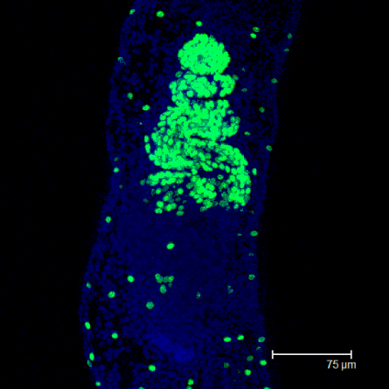
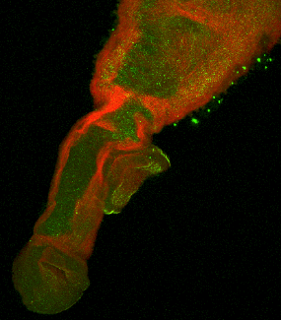
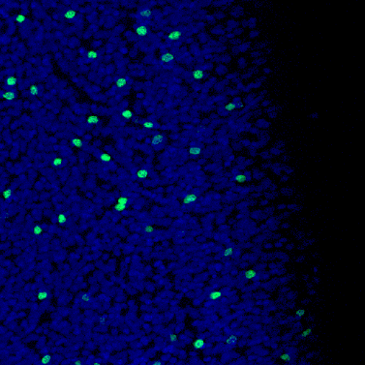
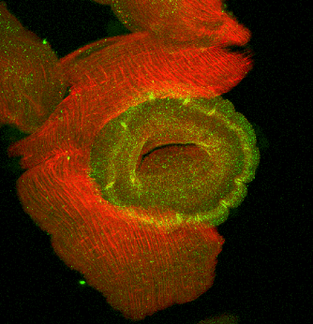
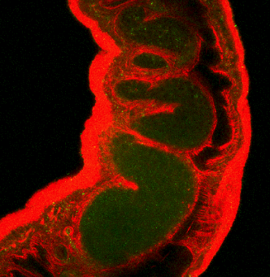
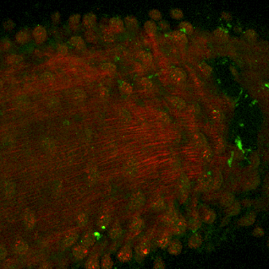
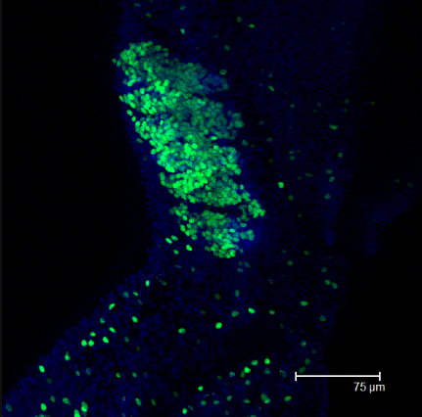


Cell signalling during male-female interactions by Schistosoma mansoni
Eman Shakir
PhD Student
Supervisors: Prof. Tony Walker, Dr. Ruth Kirk
Advisor: Dr. Gabriel Rinaldi
Slide 1 of 6
Notes:
Hello everyone, Today I will be talking to about my research project

Slide 2
Background
Human schistosomiasis is an important neglected tropical disease
Interactions between adult male & female schistosomes are important for schistosome maturation & egg laying
These interactions could involve cell signalling pathways regulated by protein kinases, there are 260 protein kinases in S. mansoni
Research question – Do Excretory-Secretory Products (ESPs) produced by one sex influence protein kinase signalling & functional responses in the opposite sex?
Slide 2 of 6
Notes:
Human Schistosomiasis affects more 240 million people globally. Praziquantel is the drug of choice, however it is only effective against the adult worms & drug resistance might be emerging.
We need to better understand the biology of schistosomes for novel therapeutics
Molecular interaction between m-f adult worms are crucial for development & maturation of the worms, but we understand little of the molecular nature of these interactions
Such interactions could involve protein kinases which are a large family of enzymes that have a key role in the control of cell differentiation, proliferation and development
My PhD has focused on investigating the effects of male/female excretory/secretory products (ESPs) on the opposite sex. I have been investigating responses & effects of ESPs through signalling pathways but also through functional outcomes.

Slide 3
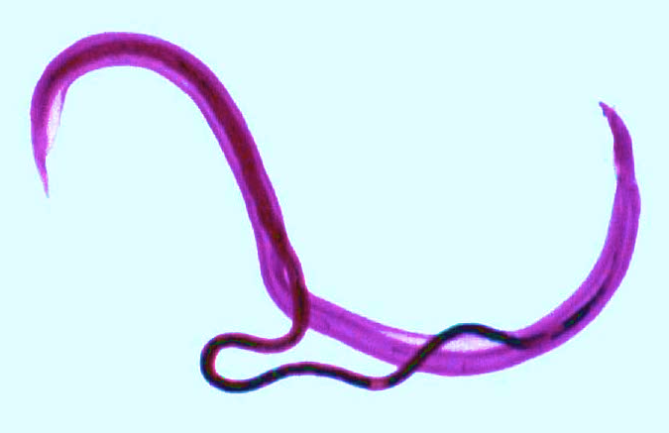
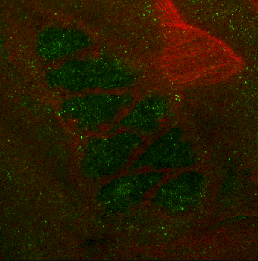
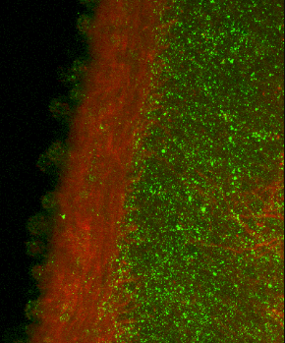
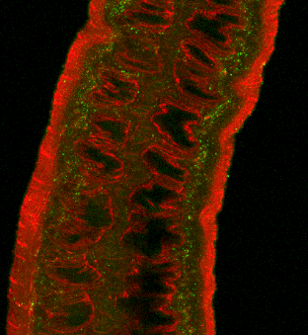
Research Findings
Male ESPs stimulate p38 MAPK & ERK signalling in female worms & vice versa
The ESPs bound to the opposite sex worm surface (tegument)
This activation was localized using confocal microscopy to within the tegument & the reproductive organs of the worms
Blocking p38 MAPK & ERK signalling (using SB203580 & U0126) before opposite sex ESP exposure reduced p38 MAPK & ERK phosphorylation in the tegument
The effect of ESPs on proliferating stem cells in the opposite sex worms
♂
♀
Testes ♂
Tegument ♂
Vitellaria ♀
Ovaries ♀
Activated ERK
Slide 3 of 6
Notes:
My research has shown that male ESPs stimulate p38 MAPK & ERK signllaing pathways in the female worms & vice versa, whereby the activation of p38 MAPK & ERK significantly increased in response to opposite sex ESP exposure.
activation of these pathways was localized using confocal microscopy to. the tegument, the ovaries & the testes of the opposite sex. Here on the on the slide are some examples of the activation observed within these tissues
both p38 MAPK & ERK activation was reduced in response to opposite sex ESPs exposure following incubation of worms in the p38 MAPK inhibitor SB203580 & U0126 (ERK inhibitor) in both males & females.
& Today I will be talking about the effect of ESPs on cell proliferation in the opposite sex worms

Slide 4
Female ESPs stimulate cell proliferation in males - a p38 MAPK & ERK dependant response
Testes
Tegument
***
***
***
***
***
***
Proliferation rate decreased after 5 days in the absence of females
Proliferation rate was rescued in testes & tegument after exposure to female ESPs
SB203580 & U0126 attenuated the increased cell proliferation observed after exposure to female ESPs
Slide 4 of 6
Notes:
Schistosome contain specialized stem cells in their reproductive and somatic tissues.
This experiment here aimed to investigate the effect of opposite sex ESP exposure on stem cell proliferation using EDU assay
EdU can be incorporated into newly synthesized DNA & it's fluorescently labelled with Alexa Fluor dye
The Control worms were processed at day 0 & chased with EDU for 24 h. Worms were then stained & processed for confocal microscopy
A series of Z stacks were captured to count EdU+ cells
& as you can see here there is a high number of EDU+ cells in both the testicular lobes & the tegument of male worms in day 0 control treatments
worms were also incubated in single sex groups for 5 days. Then at day 5 worms were exposed to opposite sex ESPs or not & then chased with EdU for 24 h
After 5 days in the absence of the opposite sex, cell proliferation substantially reduced in both the testicular & the tegument. However, cell proliferation was significantly rescued when male worms were incubated with the female ESP.
We then wanted to see if we are able to inhibit the increase of EDU+ cells which was due to the exposure to female ESPs --> here the Worms were pre-incubated for 1 h with SB203580 or U0126 before exposure to female ESPs & the EdU chase.
As can be seen there was a significant decrease in the number of EDU+ cells in worms pre-incubated with inhibitors & exposed to female ESPs.

Slide 5
Slide 5 of 6
Male ESPs stimulate cell proliferation in females - a p38 MAPK & ERK dependant response
***
Vitellaria
***
Ovaries
***
***
***
***
***
Proliferation rate decreased after 5 days in the absence of males
Proliferation rate was rescued in the ovaries, vitellaria & tegument after exposure to male ESPs
SB203580 & U0126 attenuated the increased cell proliferation observed after exposure to male ESPs
Tegument
***
***
Notes:
So we then wanted to explore the effect of male ESPs on the female stem cell proliferation
Day 0 female worms show a high number edu+ cells in the ovaries, vitellaria & tegument.
On day 5, the number of edu+ cells increases significantly following exposure to male ESPs in the ovaries, vitellaria & tegument. When compared to day 5 female worms without exposure to male ESPs
When the female worms were incubated in inhibiters prior to exposure to male ESPs, there was a significant decrease in the number of EDU+ cells also in the ovaries, vitellaria & tegument
This demonstrates that the p38 MAPK & ERK pathway play a role in regulating cell proliferation in both male and female worms

Slide 6
Conclusion
ESPs regulate cell proliferation in opposite sex worms through ERK/p38 MAPK-dependent mechanisms
What is the nature of the stimulatory ESP molecule(s)?
Detailed LC-MS/MS analysis of ESPs identified 845 protein hits; 74 were unique to male worms & 49 to females
Ultimately blocking these interactions could prevent development, sexual maturation, or egg laying of the worms providing a novel method of controlling human schistosomiasis
Remaining Question
Slide 6 of 6
Notes:
To conclude …
However, we still don’t know what these stimulatory molecules are so we did a detailed mass spec…

