Slide 1
Impact of potential COVID-19-induced disruption of NTD services on transmission of & progress against NTDs
London Centre for NTD Research anniversary event, 31st March 2022

Slide 2
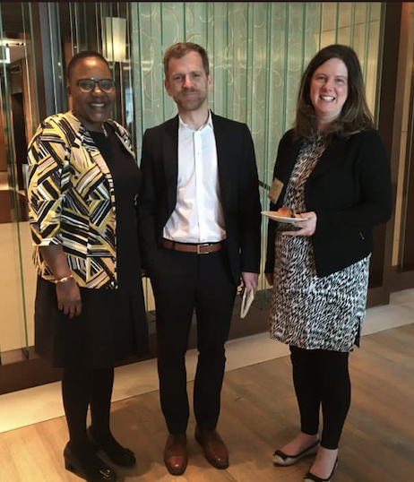
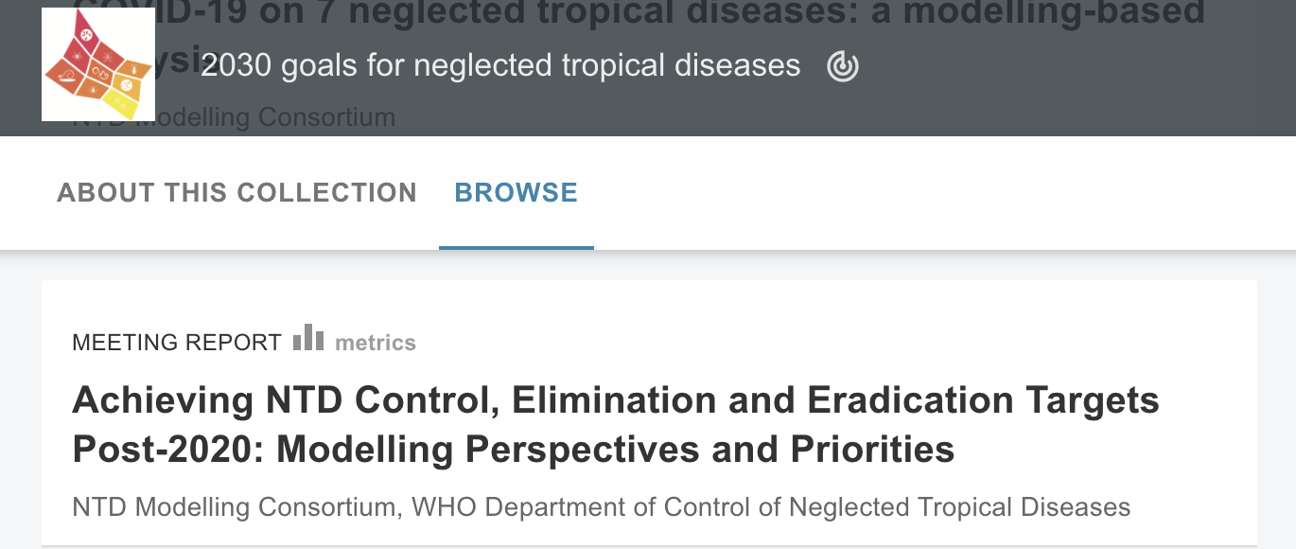
Mwelecele Ntuli Malecela
Dr Mwele Malecela was a inspirational leader, a warm, generous and patient person and a rigorous, open-minded , insightful scientist who was an unparalleled advocate for the use of high quality science and implementation to serve the people affected by NTDs. Our sincere condolences to her family, her friends and her colleagues. Her loss must be very difficult to bear.
Two examples (from very many) of how our colleagues remember her impact:
Facilitating an informal meeting on the 2030 goals
https://gatesopenresearch.org/documents/4-97

Slide 3
Mwelecele Ntuli Malecela
Dr Mwele Malecela was a inspirational leader, a warm, generous and patient person and a rigorous, open-minded , insightful scientist who was an unparalleled advocate for the use of high quality science and implementation to serve the people affected by NTDs. Our sincere condolences to her family, her friends and her colleagues. Her loss must be very difficult to bear.
Two examples (from very many) of how our colleagues remember her impact:
Facilitating an informal meeting on the 2030 goals
Inspiring early career scientists, particularly women
“What an awful loss to the NTD community”
“I only spoke to her once but she gave me her full attention”
“I didn’t really know her but I feel so sad because she made it feel achievable”
“She made me feel like I could go and talk to her or email her”
https://gatesopenresearch.org/documents/4-97

Slide 4
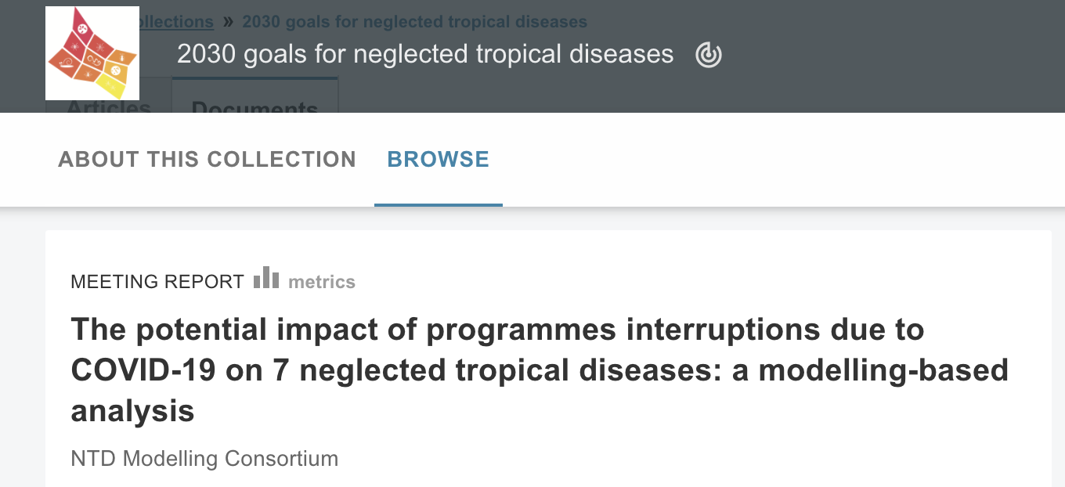
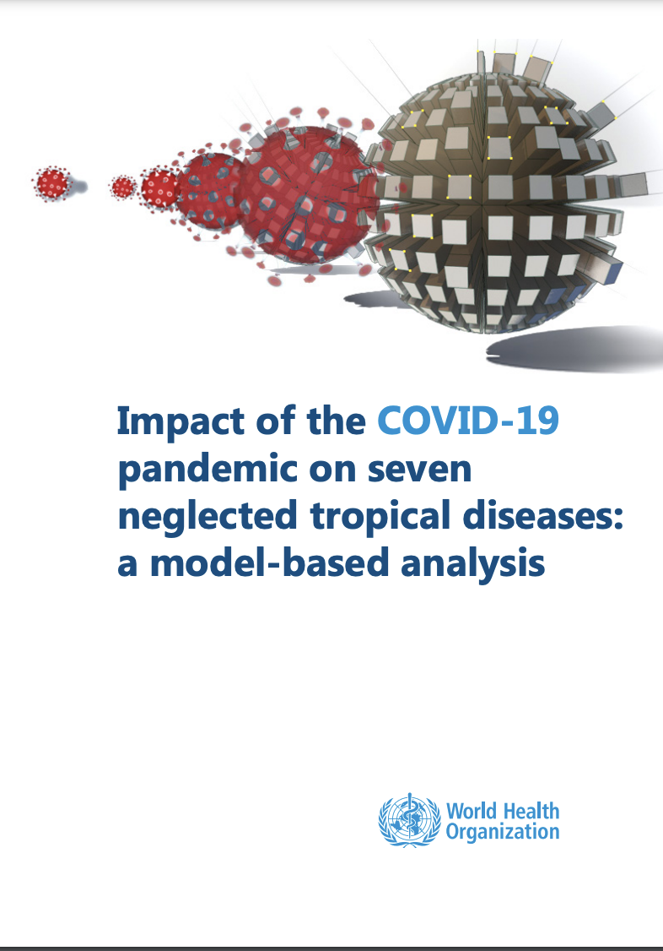
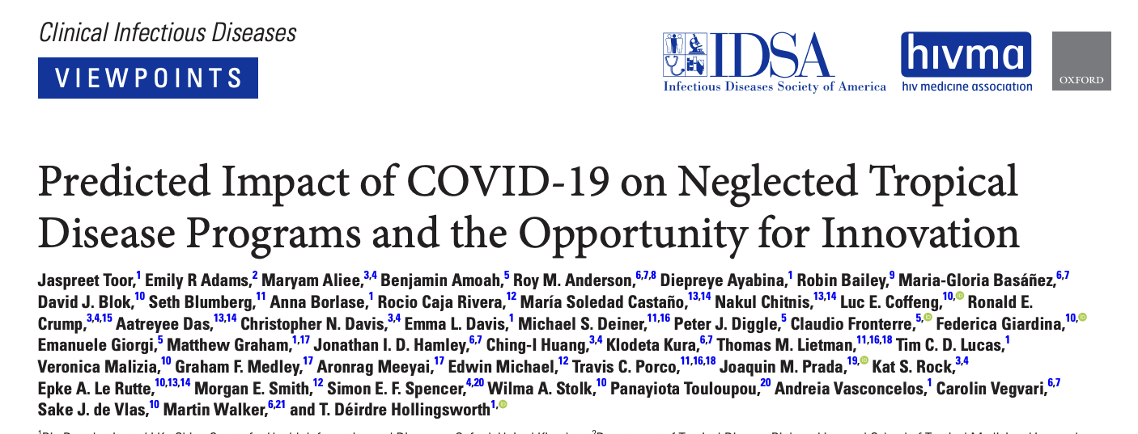
COVID-19 and NTDs
https://gatesopenresearch.org/documents/4-115
https://academic.oup.com/trstmh/issue/115/3
https://academic.oup.com/cid/article/72/8/1463/5912106
https://www.who.int/publications/i/item/9789240027671

Slide 5
Modelling the impact of COVID-19-related interruptions
COVID-19 responses have caused disruptions to mass drug administrations (MDAs) and other activities
How long can NTD interventions be postponed before progress towards the 2030 goals is affected adversely?
For which diseases and in which settings will impacts of disruptions be greatest?
What mitigation and recovery strategies can be implemented once activities resume,
in order to regain ground lost due to COVID19-related programme interruptions
minimize the risks of recrudescence of infection and disease
and even accelerate progress towards the goal?
March 2021
MDA resumed after 1-year delay
March 2019
MDA successfully delivered
March 2020, MDA postponed

Slide 6
Impact on PC diseases
Annual MDA with 1 year of missed treatment
Annual MDA with no interruption
Delays to MDA rounds will lead to a greater numbers of infections in the community
Prevalent infections untreated AND new cases.

Slide 7
Impact on PC diseases
Annual MDA with 1 year of missed treatment
Additional burden of infection
Additional time (and rounds) to reach the 2030 goal
Annual MDA with no interruption
Delays to MDA rounds will lead to a greater numbers of infections in the community
Prevalent infections untreated AND new cases.
More rounds of treatment to reach 2030 disease targets

Slide 8
Impact on PC diseases
Annual MDA with 1 year of missed treatment
Additional burden of infection
Additional time (and rounds) to reach the 2030 goal
Annual MDA with no interruption
Delays to MDA rounds will lead to a greater numbers of infections in the community
Prevalent infections untreated AND new cases.
More rounds of treatment to reach 2030 disease targets
The longer the delay to the scheduled MDA,
greater the resurgence in infection,
greater the number of rounds required to get back on track.
In high transmission settings, the resurgence of infection is faster
number of rounds required to catch up will also be higher.

Slide 9
Impact on PC diseases
Recovery strategy
(H: high coverage; A: community wide)
- reduces burden of infection
- reduces time to reach the goal
Annual MDA with 1 year of missed treatment
Additional burden of infection
Additional time (and rounds) to reach the 2030 goal
Annual MDA with no interruption
Delays to MDA rounds will lead to a greater numbers of infections in the community
Prevalent infections untreated AND new cases.
More rounds of treatment to reach 2030 disease targets
The longer the delay to the scheduled MDA,
greater the resurgence in infection,
greater the number of rounds required to get back on track.
In high transmission settings, the resurgence of infection is faster
number of rounds required to catch up will also be higher.
Potential remedial strategies include extra rounds of MDA and different coverage or treatment strategies

Slide 10
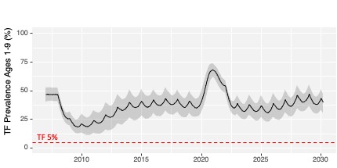
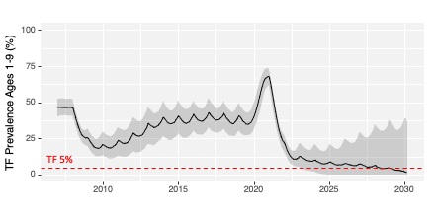
Trachoma - mitigation and acceleration strategies
Hypo-endemic settings
missing an MDA due to COVID will not significantly delay control efforts
Meso-endemic settings
delay is approximately the COVID delay itself
an extra, make-up MDA will bring a program right back on track
In Hyper-endemic settings
missing an MDA will delay programs more than a year in achieving their goal
In the most hyper-endemic hotspots, we have a bigger problem …
with current transmission, annual MDA will not achieve control, even without COVID delay
but enhanced MDA could accelerate control post-COVID
Annual MDA
Enhanced MDA
Borlase et al 2021 TRSTMH
Notes:
In the least-affected areas, those where there less than 10% of the children have any evidence of recent infection, …
The meso-endemic areas, these are the areas where 10-30% of the children might be infected in the absence of a control program. These were on track to achieve control with annual MDA …
In the hyper-endemic areas, we have a problem. Infection returns so quickly post MDA that the COVID delay will …
In the most Hyper-endemic areas … here are some simulations that Anna Borlase did ...

Slide 11
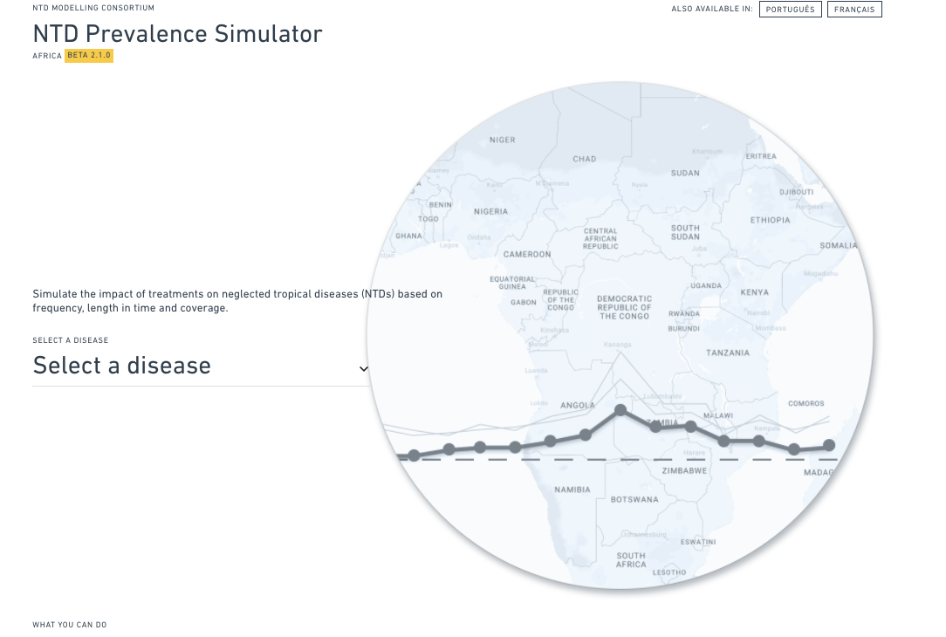
Providing sub-national results to support planning
Core to modelling for policy
Answer the right question
Provide the answer in a usable form
“best is to provide an interactive interface, where if the policymaker does not agree with the starting assumptions of the model, they can change them” Whitty, 2015 BMC Medicine
Consulted with program managers and other stakeholders in partnership with ESPEN
Design responsive to their needs
Number of ‘back-end’ challenges
Beta version and first update launched in 2021
Ongoing development
https://ntdpreview.artrabbit.studio/
Notes:
In the least-affected areas, those where there less than 10% of the children have any evidence of recent infection, …
The meso-endemic areas, these are the areas where 10-30% of the children might be infected in the absence of a control program. These were on track to achieve control with annual MDA …
In the hyper-endemic areas, we have a problem. Infection returns so quickly post MDA that the COVID delay will …
In the most Hyper-endemic areas … here are some simulations that Anna Borlase did ...

Slide 12
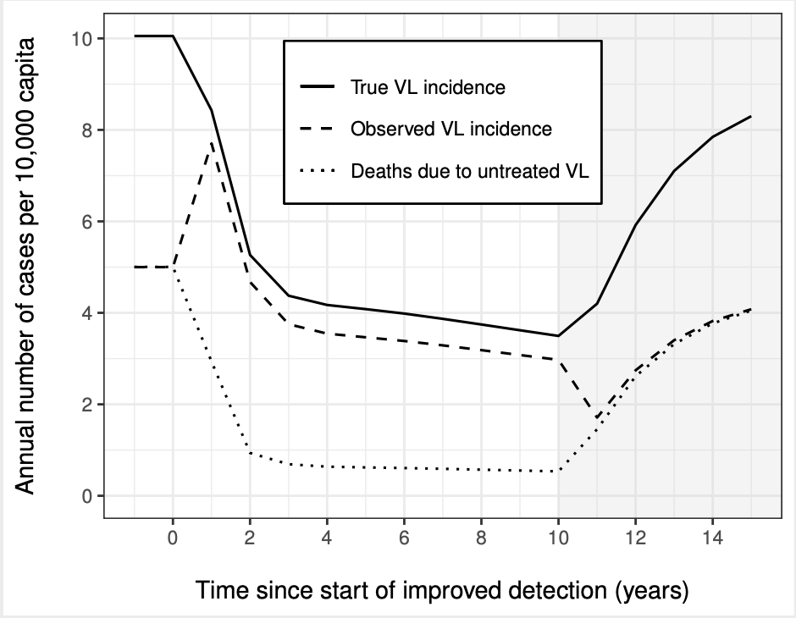
Case finding
Resurgence rates more difficult to estimate.
Uncertainties in natural history of infection (role of asymptomatic individuals, duration of immunity).
Number of newly diagnosed cases are a consequence not only of new infections, but also the detection effort.
COVID19-related interruptions likely to lead to fewer cases being detected
whereas the true underlying rate of new infections will likely increase
Delays to goal will depend on the phase of programme and transmission setting
Maintaining passive surveillance followed by treatment can help prevent (temporary) increases in mortality
Potential mitigation strategies include extending the duration or re-implementing active case detection and vector control
Cases diagnosed
True incidence
Deaths due to untreated VL
Adapted from Coffeng et al Journal of infectious diseases 2019

Slide 13
Case finding
Resurgence rates more difficult to estimate.
Uncertainties in natural history of infection (role of asymptomatic individuals, duration of immunity).
Number of newly diagnosed cases are a consequence not only of new infections, but also the detection effort.
COVID19-related interruptions likely to lead to fewer cases being detected
whereas the true underlying rate of new infections will likely increase
Delays to goal will depend on the phase of programme and transmission setting
Maintaining passive surveillance followed by treatment can help prevent (temporary) increases in mortality
Potential mitigation strategies include extending the duration or re-implementing active case detection and vector control
Cases diagnosed
True incidence
Deaths due to untreated VL
Increased case detection leads to reduction in transmission
Adapted from Coffeng et al Journal of infectious diseases 2019

Slide 14
Case finding
Resurgence rates more difficult to estimate.
Uncertainties in natural history of infection (role of asymptomatic individuals, duration of immunity).
Number of newly diagnosed cases are a consequence not only of new infections, but also the detection effort.
COVID19-related interruptions likely to lead to fewer cases being detected
whereas the true underlying rate of new infections will likely increase
Delays to goal will depend on the phase of programme and transmission setting
Maintaining passive surveillance followed by treatment can help prevent (temporary) increases in mortality
Potential mitigation strategies include extending the duration or re-implementing active case detection and vector control
Cases diagnosed
True incidence
Deaths due to untreated VL
Decreasing case detection leads to increasing transmission
Delays in detecting increased incidence and increased deaths
Adapted from Coffeng et al Journal of infectious diseases 2019

Slide 15
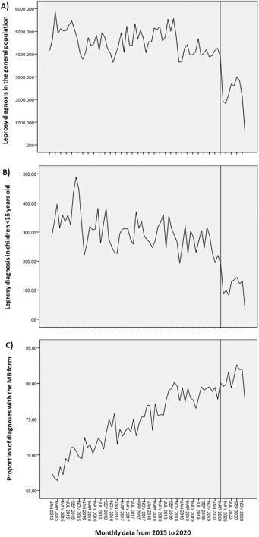
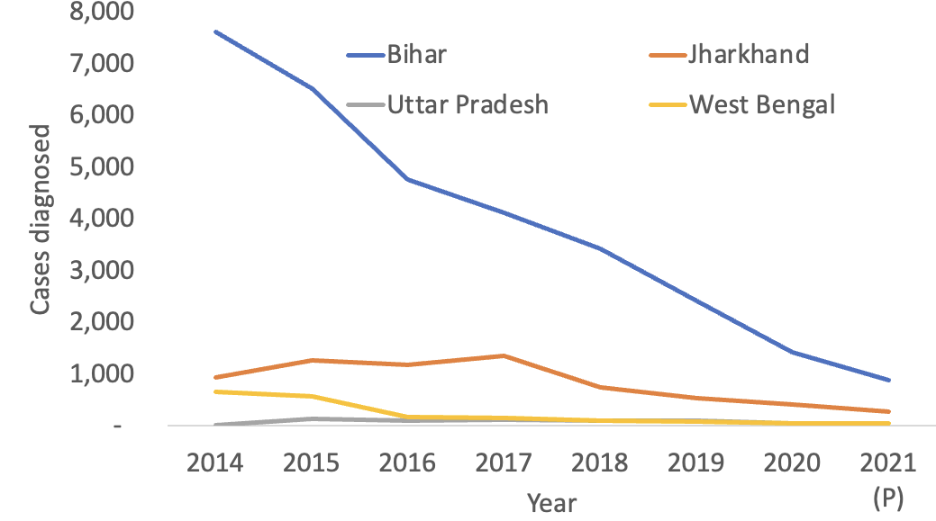
Case finding in 2022
Source: National Vector-Borne Disease Control Program
Leprosy, Da Paz 2022 Lancet Regional Health

Slide 16
Key messages: part 1
Delays in MDA or interruptions to other interventions due to COVID19 will lead to
increases in infection and morbidity,
increased time and resources (e.g. total numbers of rounds of MDA) to reach agreed Roadmap targets.
The underlying dynamics of each NTD, local transmission dynamics, duration of delay, chance and implementation of recovery strategies will influence the ultimate impact.
Amongst the 7 diseases we work on,
Impact is likely to be greatest for schistosomiasis, trachoma and visceral leishmaniasis in the Indian sub-continent, especially in high transmission areas

Slide 17
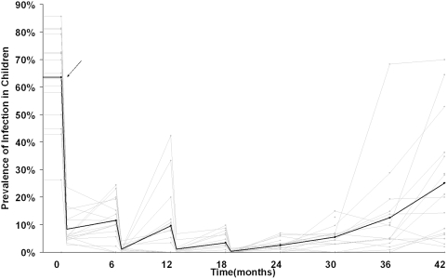
Model-based predictions
There will be variation between settings in
response to MDA delay
response to MDA rounds - coverage, systematic lack of access or adherence
response to proposed remedial intervention strategies
The impact on progress in any given population may be lesser or greater than presented here (Figure)
Local variability - e.g. hotspots
The predicted impact of remedial intervention strategies should be interpreted with special caution as
some of these have not been tested in programmes
important assumptions made on, for example coverage upon resumption (Figure)
Lakew et al, PLOS NTDs 2009
Different villages (light grey lines) had different responses to the same interventions.

Slide 18
Key messages: part 2
Delays in MDA or interruptions to other interventions due to COVID19 will lead to
increases in infection and morbidity,
increased time and resources (e.g. total numbers of rounds of MDA) to reach agreed Roadmap targets.
The underlying dynamics of each NTD, local transmission dynamics, duration of delay, chance and implementation of recovery strategies will influence the ultimate impact.
Impact is greatest for schistosomiasis, trachoma and VL, especially in high transmission areas
Proposed recovery strategies may help to get progress towards goals back on track;
will require empirical evaluation in the context of ongoing programmes.
In some populations, opportunity to accelerate progress towards agreed 2030 disease targets.
Evaluate remedial strategies within context of mitigating the impact and accelerating progress
Resumption may require novel, integrated survey designs due to limited resources
Working with ESPEN to provide modelling analyses to support sub-national decisions

Slide 19
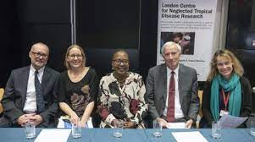
LCNTDR
Built on a vision of building a diverse community
Eliminating neglected tropical diseases requires mutli/cross/inter-disciplinary research and partnership
Building on a number of existing relationships
Lightning rod for NTD research
Increased collaboration across institutions
Essential networking and awareness for early career researchers
Many thanks to Professor Sir Roy Anderson
Collaborative leadership
Created a community
Range of impressive outputs
Built and maintained funding

Slide 20
LCNTDR
Built on a vision of building a diverse community
Eliminating neglected tropical diseases requires mutli/cross/inter-disciplinary research and partnership
Building on a number of existing relationships
Lightning rod for NTD research
Increased collaboration across institutions
Essential networking and awareness for early career researchers
Many thanks to Professor Sir Roy Anderson
Collaborative leadership
Created a community
Range of impressive outputs
Built and maintained funding
Good luck to Professor Joanne Webster
An exciting future for this community

