Slide 1



Disability inclusion and mental health in relation to NTDs
Hannah Kuper
International Centre for Evidence in Disability

Slide 2
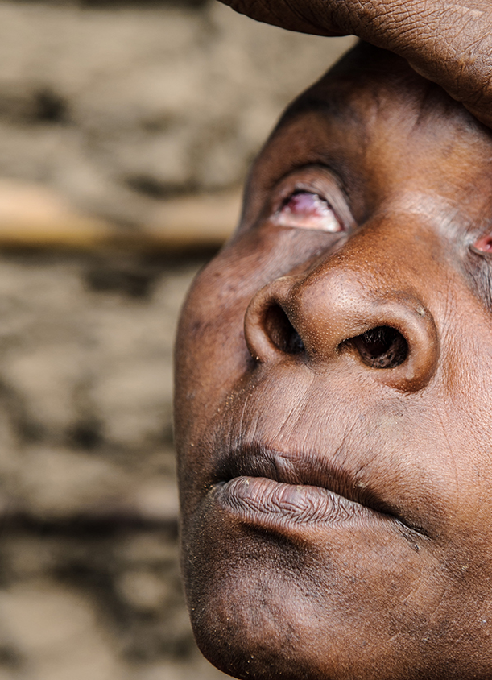
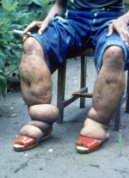
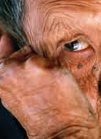
NTDs and disability strongly linked

Slide 3
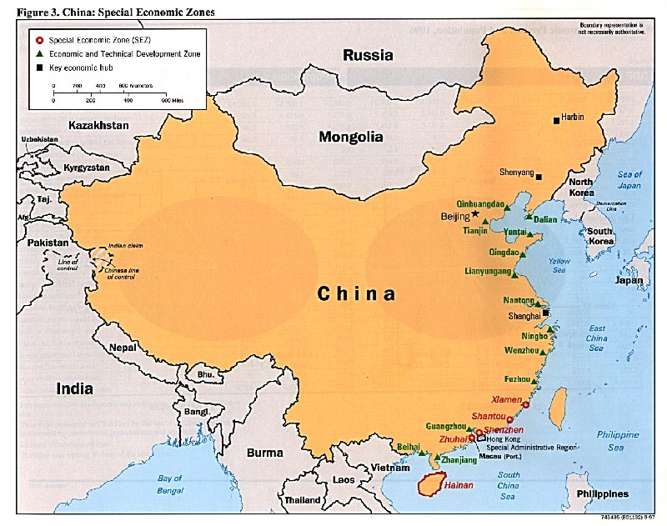
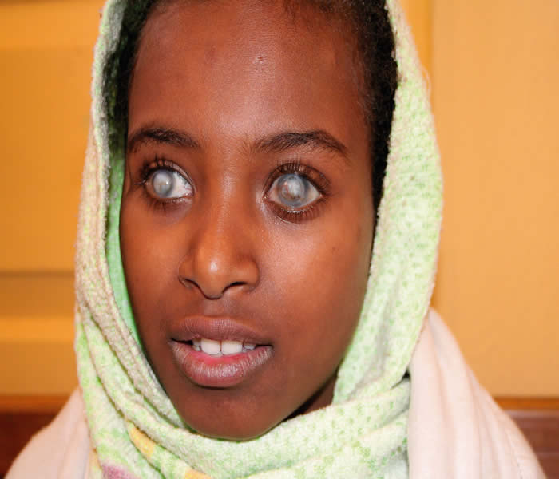
Why is Disability relevant to NTDs?
1 billion people with disabilities
NTDs can cause disabilities

Slide 4
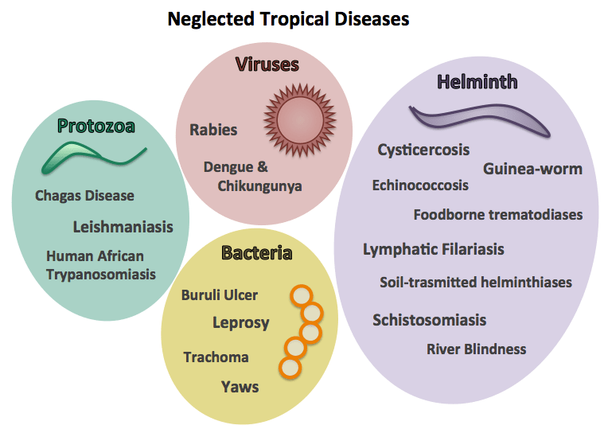

Slide 6
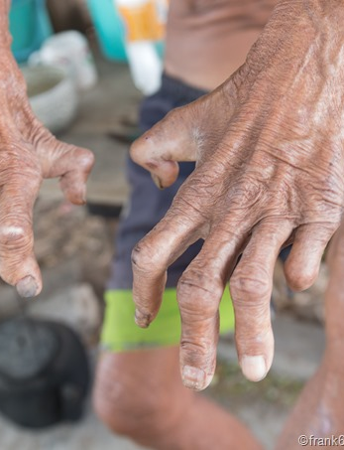
NTDS can cause impairments and have mental health impacts

Slide 7
What should be done?

Slide 8
Make NTD programmes disability-inclusive
Planning
Monitoring
Assessment of barriers
Participatory development of solutions
Testing and implementing solutions

Slide 9
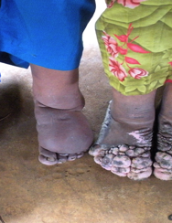
Meet the needs of people with NTD-related disabilities

Slide 10

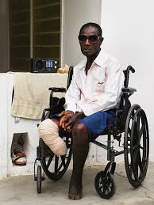
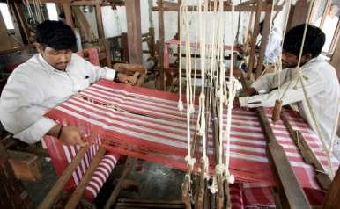
Include rehabilitation

Slide 11
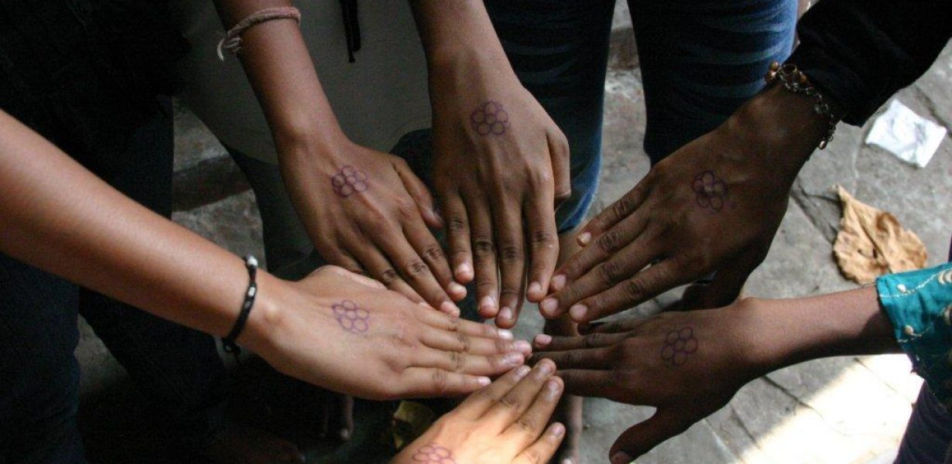
Include mental health support and tackling attitudes

Slide 12
Why is disability not yet considered in NTD programmes?

Slide 13



Slide 14
Disability is still neglected

Slide 15
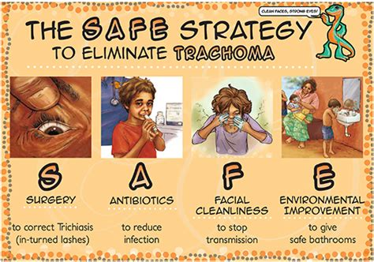



Slide 16
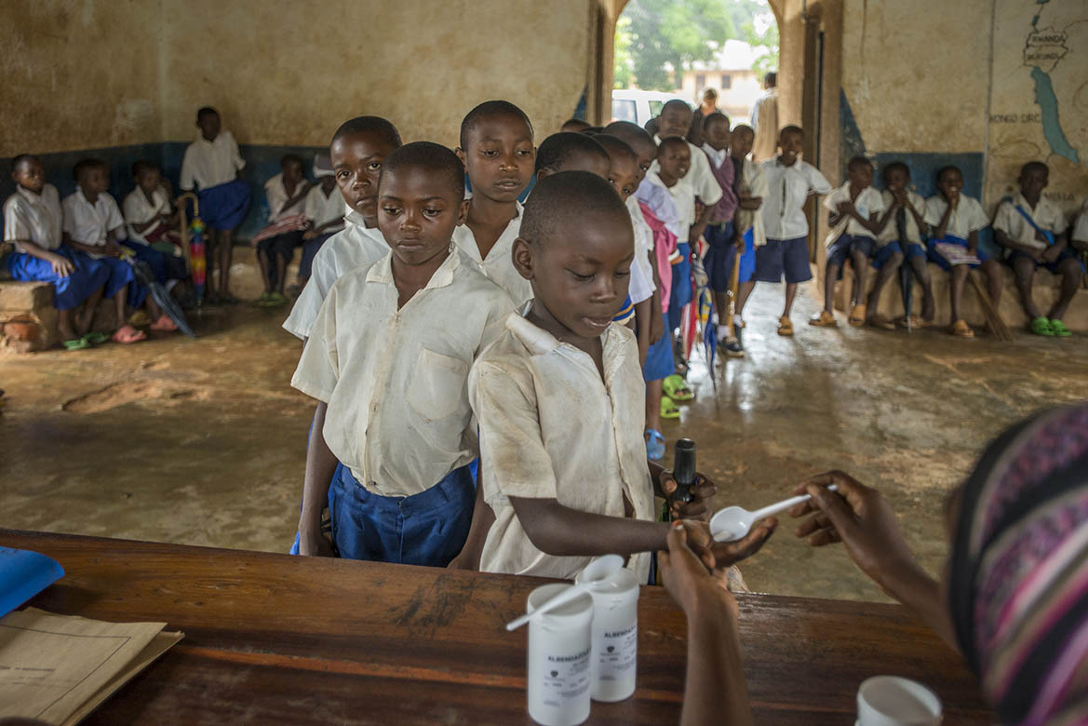
Programmes will be so effective that rehabilitation isn’t needed!

Slide 17

Large evidence gaps persist

Slide 18
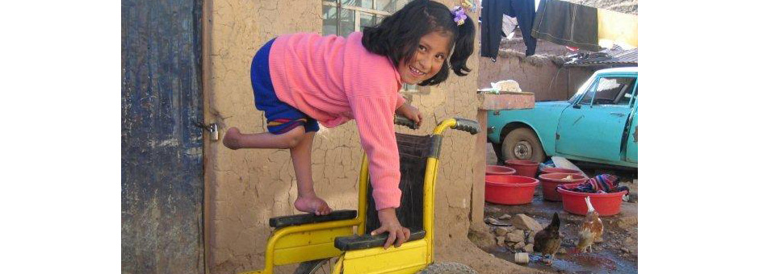
Thank you for your time and attention

