Slide 1






Mini-FLOTAC as an alternative, non-invasive diagnostic tool for Schistosoma mansoni and other trematode infections in wildlife reservoirs
Catalano S*, Symeou A, Marsh KJ, Borlase A, Léger E, Fall CB, Sène M, Diouf ND,
Ianniello D, Cringoli G, Rinaldi L, Bâ K, and Webster JP
*scatalano@rvc.ac.uk

Slide 2
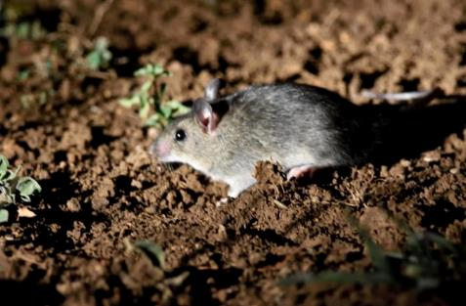
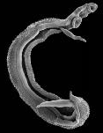
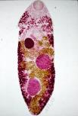
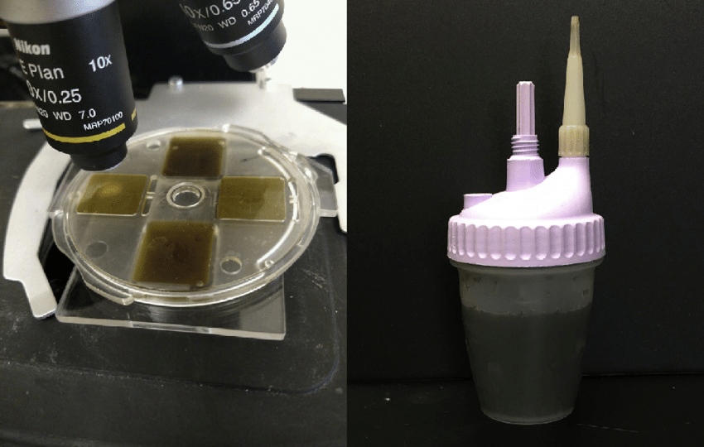


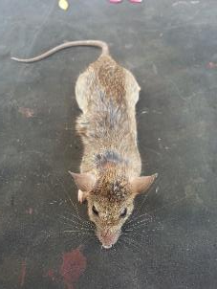
Overview
Mastomys huberti
credit iGoTerra.com
Mini-FLOTAC
Post-mortem
Diagnostics applied to the epidemiological role of M. huberti in the transmission of S. mansoni and other trematodes in northern Senegal
vs

Slide 3
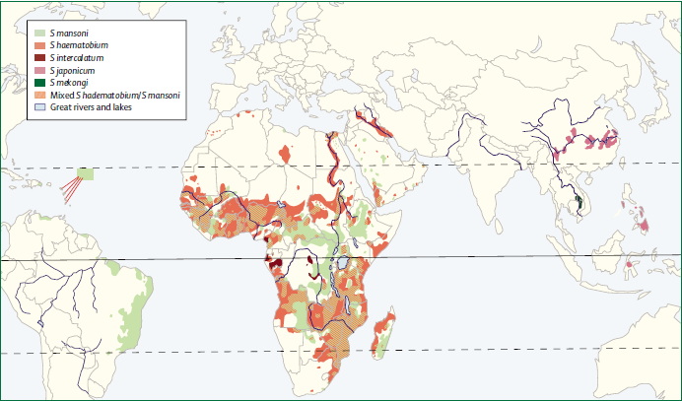








credit Gryseels et al. 2006
Notes:
… however, schistosomiasis is also a zoonotic disease, with a number of animals as reservoirs… Many are the mammals acting as reservoir of S. japonicum in Asia, among them dogs, monkeys, domestic and wild ruminants, pigs, and rats. Wild rodents are of primary importance not just as potential hosts of S. japonicum, but also for S. mansoni in the Caribbean, Brazil and sub-Saharan Africa. One epidemiological study comes from Senegal, however, the only molecular study on rodent reservoirs was done in Kenya and Schistosoma hybrids were found. About S. haematobium, it has been mainly reported in monkeys of different parts of the African continent, however one of the very few molecular studies found hybrids in livestock from Senegal.

Slide 4




Introduction
credit Cringoli et al. 2010

Slide 5
Introduction

Slide 6

Objective
Mini-FLOTAC
Post-mortem
vs
Testing Mini-FLOTAC as an alternative tool to detect S. mansoni and other digeneans within
non-invasive sampling schemes

Slide 7
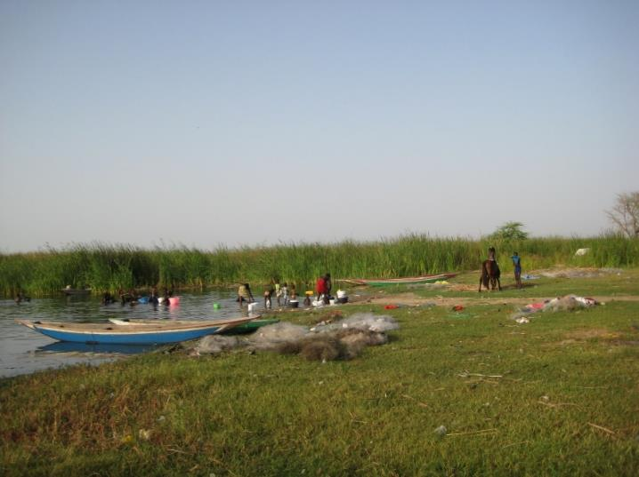
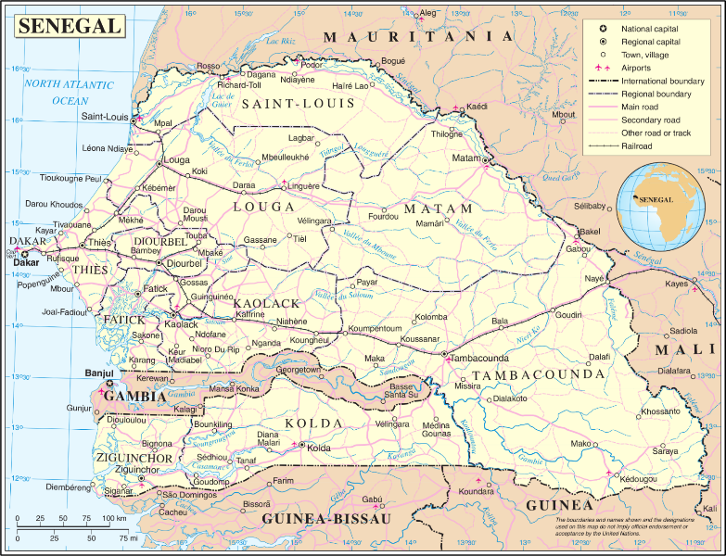
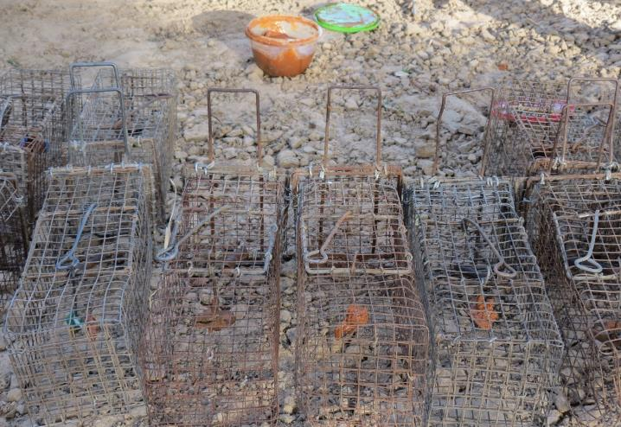
Methods

Slide 8



Methods
Necropsies vs Mini-FLOTAC (89 individuals M. huberti)
Parasitological exam at post-mortem
Faecal samples from rectum (weight 0.1-0.7) stored in 1.5ml 10% buffered formalin and analysed after > 1 month

Slide 9
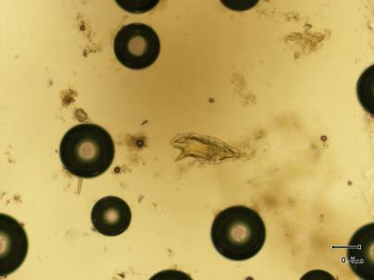
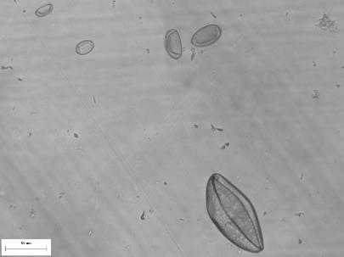
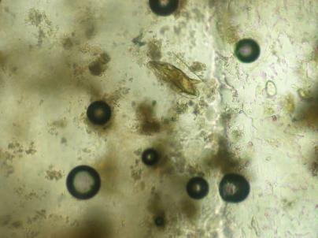
Results – General
Parasite | M. huberti necropsy (n = 89) adult worm counts | M. huberti Mini-FLOTAC (n = 89) eggs per gram of faeces | Infection prevalence Infection intensity
Plagiorchis sp. | 87.6% 18; 1-61 | 85.4% 4,300; 25-134,900 | P = 0.83 P = 0.19
Schistosoma mansoni | 23.6% 8; 2-64 | 23.6% 262; 15-1,237 | P = 1.00 P = 0.058
Echinostoma caproni | 16.9% 2; 1-34 | 20.2% 232; 18-52,275 | P = 0.85 P = 0.053
Anchitrema cf. sanguineum | 3.4% 9; 1-24 | 1.1% 750 | NA

Slide 10

Results – S. mansoni
Bayesian true prevalence
28.3% (BCI 19.4-38.5)
Post-mortem sensitivity
82.9% (BCI 63.7-94.7)
Mini-FLOTAC sensitivity
83.1% (BCI 64.0-94.6)
Parasite | M. huberti necropsy (n = 89) adult worm counts | M. huberti Mini-FLOTAC (n = 89) eggs per gram of faeces | Infection prevalence Infection intensity
Plagiorchis sp. | 87.6% 18; 1-61 | 85.4% 4,300; 25-134,900 | P = 0.83 P = 0.19
Schistosoma mansoni | 23.6% 8; 2-64 | 23.6% 262; 15-1,237 | P = 1.00 P = 0.058
Echinostoma caproni | 16.9% 2; 1-34 | 20.2% 232; 18-52,275 | P = 0.85 P = 0.053
Anchitrema cf. sanguineum | 3.4% 9; 1-24 | 1.1% 750 | NA

Slide 11
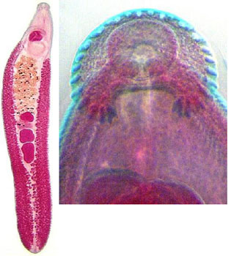
Results – Other digeneans
Echinostoma caproni
credit web.Stanford.edu
Anchitrema cf. sanguineum
credit Rodney Bray

Slide 12
Discussion
Positives
Further understanding on trematode biodiversity
Mini-FLOTAC as alternative diagnostic tool
    Reduced training and processing time
    Longitudinal data collection
    Storage in formalin prior to analysis
Limitations
Unreliable estimates of infection intensity
    BUT indicative of high egg excretion rates
Long storage time and low quantity of faecal matter
    BUT sensitivity not affected
Future implementation
Application in endemic areas
Mark-capture studies
Combination of Mini-FLOTAC and DNA-based methods

Slide 13



England:
Joanne Webster
Elsa Léger
Anna Borlase
Kirsty Marsh
Louise Vince
Sara Laskowski
Lucy Yasenev
Alice Morrell
Topaz Reid
Amelia Symeou
David Rollinson
Bonnie Webster
Muriel Rabone
Fiona Allan
Aidan Emery
Tom Pennance
Senegal:
Alassane Ndiaye
Cheikh Thiam
Boubacar Bâ
Cheikh Fall
Samba Diop
Mapaté Gaye
Abdoul Bâ
Khalilou Bâ
Nicolas Diouf
Mariama Sène

