Slide 1
“qPCR-based diagnostics: how close are we to translating C_{q} values to intensity of infection?”
Marina Papaiakovou, D. Timothy J. Littlewood |Natural History Museum | June 6, 2019

Slide 2
For those unfamiliar with the technique…
→ DNA strand denaturation
→ probe (which adds specificity and the advantage of real-time detection due to fluorophore addition) and FWD/REV primer binding
→ polymerase extension
→ cleavage of fluorophore
accumulation of fluorescence
crossing threshold detectable by laser
software output as ‘cycle’ (C) where the signal can be quantitated (_{q}) = C_{q} value
https://pediaa.com/difference-between-pcr-and-qpcr/
Notes:
One of the few ones I could find, and it is not completely accurate. Imagine the strands separated when the probe/primers bind
Also, moving forward from Cq values and from presence absence to quantitation of the target copy present is something we are still looking into… More in a bit

Slide 3
Where qPCR ‘outsmarts’ Kato-Katz...
Sensitivity (maximized)
Species-specificity (maximized)
User-related variability (minimized)
Throughput (maximized)
                …to name a few
…and yet there is no health intervention or programmatic effort that recruits qPCR as the cornerstone diagnostic tool for assessing infection levels…
WHY?
Notes:
Many studies have shown the sensitivity of qPCR over coprological methods and most people will argue that qPCR is still costly to implement in field settings…

Slide 4
Where Kato-Katz still ‘outsmarts’ qPCR...
Faecal matter
DNA extraction
qPCR
C_{q} value/Target copy number present
Correlation to eggs present in X grams of stool?
Estimate worm burden
Intensity of infection?
In terms of correlating its output to worm load, microscopy is more ‘quantitative’ than qPCR as there are FEWER variables that cannot be controlled OR measured…
qPCR
Faecal matter
Mixing stool/slide preparation
Read via microscopy/calculate eggs present
Microscopy
Notes:
Microscopy has been used for many many years in diagnosis of soil-transmitted helminths (mostly in field settings) due to simplicity, cost, convenience.. But also due to the ability to quantitate (somewhat sufficiently for the purposes) the level of the infection present. And this is where microscopy outweighs qPCR (as the costs of qPCR are also going down over the years)…
However, in low-infection settings or post-MDA programs it is very easy to miss infections present

Slide 5
…or can they?
Notes:
Can the uncertainties be controlled or measured?

Slide 6
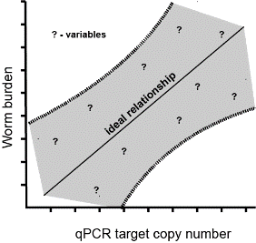
Poop
DNA
Sufficient homogenization of stool is essential
  homogenizers come to the rescue
Only a tiny volume (50-250mg) is used from the entire sample (2-5g) collected
  still PCR way more sensitive than microscopy
DNA recovery from stool can be as little as 30 % !!
  use of internal extraction control
Target DNA present is doubled after every cycle (assuming 100% efficiency (E) of qPCR)
100% E is almost NEVER achieved (temperature variation, inhibition present, reagent exhaustion)
E is routinely calculated based on titration of purified standards (by linear regression)
E is also important in accurately calculating how much target is present
DNA
qPCR
qPCR
Eggs

Slide 7
Sources of variability
Cell number/ STH egg, varies (b, c)
qPCR target copy number/ haploid genome MAY vary (?)
Presence/pattern of target (if repeat-based) VARIES TOO (d, e)
Presence of ‘free’ DNA found in stool remains UNKNOWN
Papaiakovou M., et al., 2019

Slide 8
Pointy Qs remaining
Does presence equal infection? (especially when using qPCR with environmental sampling?)
What does the presence of ‘4,000 target copies’ in your sample tell you biologically?
How many times is your target present in an haploid genome?
How do you translate qPCR to level of infection (C_{q} values/copy numbers to egg number)?
How do you account for the DNA loss during the DNA extraction?
Is it worth investing in?
Papaiakovou M., et al., 2019

Slide 9
More details…

Slide 10
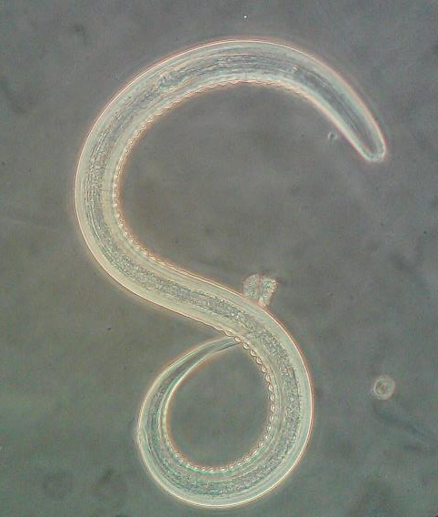
Questions?

