Slide 1








Complexities of snail xenomonitoring in relation to schistosomiasis transmission monitoring
Bonnie Webster
Tom Pennance, Fiona Allan, Aidan Emery, Muriel Rabone, Toby Landeryou, Joanne Webster, Amadou Garba, Shaali Ame, Teckla Angelo, Yves-Nathan Tian-Bi, David Rollinson.

Slide 2
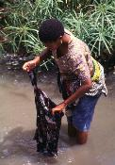


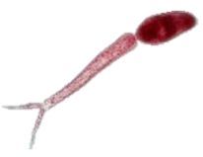





Snail Xenomonitoring is used to inform on transmission, to certify transmission interruption and surveillance
African Human Schistosomiasis

Slide 3
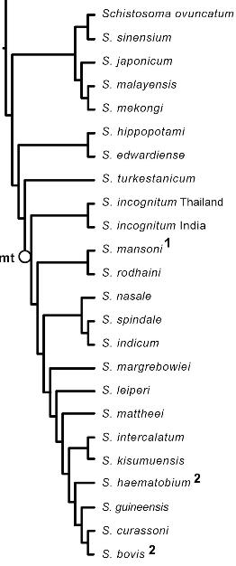
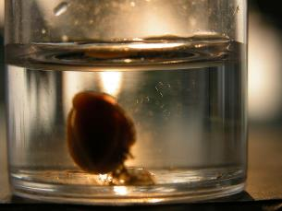




Asia
Africa
?
Asia
India
E. Europe
Africa
Biomphalaria spp.
India
+
Asia
?
Bulinus spp.
Africa
Due to the focus on human schistosomiasis snails are often assumed to be shedding human schistosomes
= Bovids

Slide 4
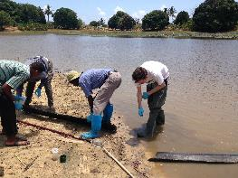
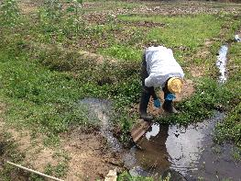
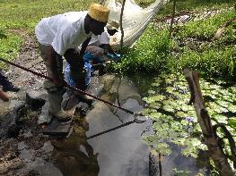
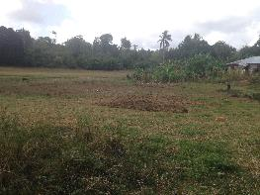
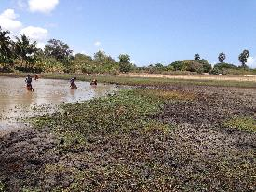
Snail surveys and collections
Ponds and lakes
Streams, Rivers and Paddies
Springs
Dry sites recorded (seasonal)
Water contact recorded
Sites mapped

Slide 5
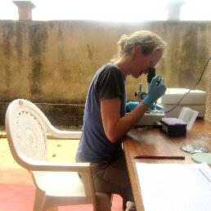
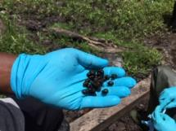
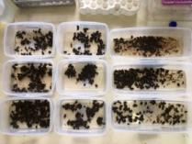
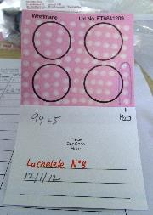
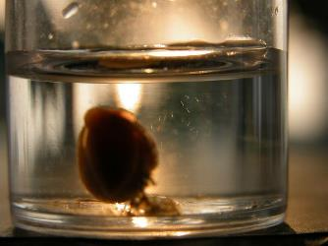

Cercariae identification
All snails checked individually for shedding
Cercariae stored for molecular identification

Slide 6
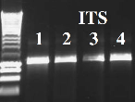
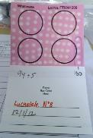


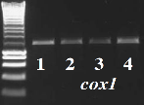
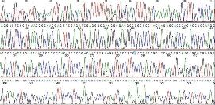
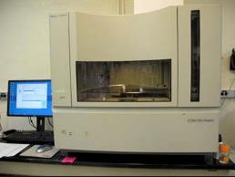
Cercariae identification
PCR
1000bp
Nuclear ITS DNA
2mm punch
Mitochondrial cox1 DNA
FTA alkaline DNA elution method
(provides enough DNA for ~12 PCRs)
1200bp
Data analysis and cercariae identification by comparison to reference data
Sanger Sequencing

Slide 7
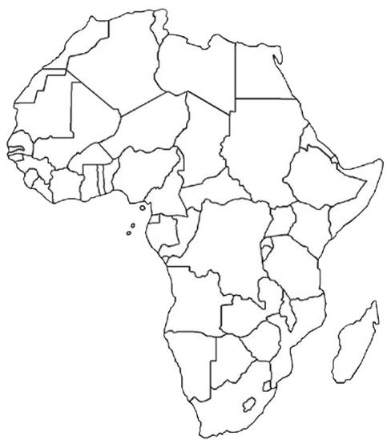

Transmission Monitoring Projects
Niger
S. haematobium
Tanzania
S. mansoni
Cote D’Ivoire
S. haematobium
Zanzibar
S. haematobium

Slide 8
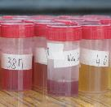
Zanzibar, Pemba Xenomonitoring
(Tom Pennance, Said Mohammed, Shaali Ame, Khamis Suleiman, Armour Amour)
Pemba
Urogenital schistosomiasis; S. haematobium
ZEST: Zanzibar Elimination of Schistosomiasis Transmission
(Steffi Knopp and David Rollinson
Fatma Kabole, Said Mohammed)
2012-2016
Unguja
S. haematobium was the only species transmitted in Zanzibar.

Slide 9
Zanzibar, Pemba Xenomonitoring
(Tom Pennance, Said Mohammed, Shaali Ame, Khamis Suleiman, Armour Amour)
4 categories of sites were included
surveys ~3 months apart to assess longitudinal transmission (2016-2018)
High Decliners
High Non-responders
Low Non-responders
Low Decliners
Prevalence

Slide 10


Bulinus globosus transmits S. haematobium on Zanzibar
B. forskalii
B. nasutus
B. globosus
X
X
S. haematobium
? Regarding role of B. nasutus in transmission

Slide 11
Pemba Survey 1
9 WCS
463 snails
3 WCS
187 snails
11 WCS
0 snails
9 WCS
136 snails
10 WCS
0 snails
3 WCS
143 snails
8 WCS
79 snails
13 WCS
286 snails
WCS = Water contact sites
Transmission Hotspots

Slide 12
Pemba Survey 1
6 snails shedding
9 WCS
463 snails
3 WCS
187 snails
11 WCS
0 snails
9 WCS
136 snails
10 WCS
0 snails
3 WCS
143 snails
8 WCS
79 snails
13 WCS
286 snails
1 snail shedding
WCS = Water contact sites
Transmission Hotspots

Slide 13


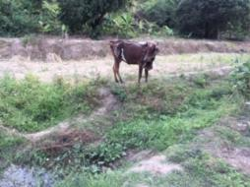
1 S. haematobium
Pemba Survey 1
6 B. globosus shedding
9 WCS
463 snails
5 S. bovis
S. haematobium
13 WCS
286 snails
1 B. globosus shedding
Never reported on Zanzibar and infected snails are assumed to be shedding human schistosomes
(Pennance et al. 2018)
Transmission Hotspots

Slide 14

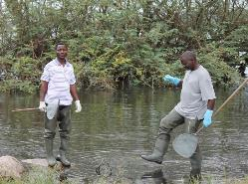
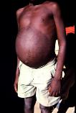
Tanzania, Mwanza Xenomonitoring
(Teckla Angelo, Safari Kinunghi, Fiona Allan, Tom Pennance, Kate Poulton, Elena Luigi)
Can we detect transmission in low prevalence areas ?
Hotspot
  Biomphalaria choanomphala - deeper in Lake Victoria
  B. sudanica - shallow banks and marshes of Lake Victoria

Slide 15
Tanzania, Mwanza Xenomonitoring
Can we detect transmission in low prevalence areas ?
Hotspot
4 surveys 2016-2017;

Slide 16

Tanzania, Mwanza Xenomonitoring
Can we detect transmission in low prevalence areas ?
Hotspot
4 surveys 2016-2017; ~9000 Biomphalaria were collected from 46 HWC
Also >2000 Bulinus were collected

Slide 17
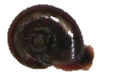

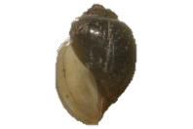

Tanzania, Mwanza Xenomonitoring
~9000 Biomphalaria; 11 were infected
Biomphalaria spp.
~2000 Bulinus; 4 were infected
Bulinus spp.

Slide 18

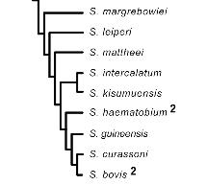
Tanzania, Mwanza Xenomonitoring
S. mansoni group
~9000 Biomphalaria; 11 were infected
Biomphalaria spp.
~2000 Bulinus; 4 were infected
Bulinus spp.
S. haematobium group

Slide 19

Tanzania, Mwanza Xenomonitoring
3 shedding S. rodhaini
8 shedding S. mansoni
Biomphalaria spp.
1 shedding S. kisumuensis
Only been found in Kenya before
3 shedding S. haematobium
Bulinus spp.

Slide 20

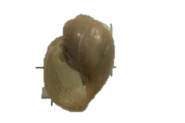
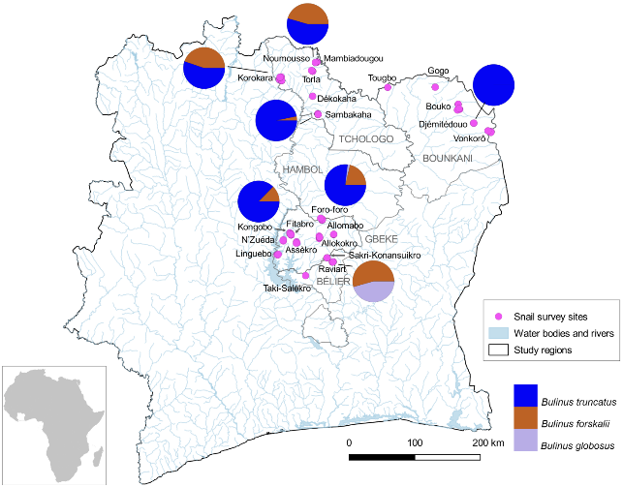
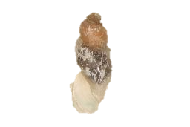
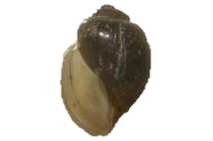
Côte D’Ivoire Xenomonitoring
(Yves-Nathan Tian-Bi, Fiona Allan, David Rollinson, Eliézer N’Goran, Muriel Rabone)
Assessing S. haematobium transmission
  B. truncatus
  B. forskalii
  B. globosus
3 surveys 2016-2017;

Slide 21
Côte D’Ivoire Xenomonitoring
18
25 snails infected
  B. truncatus
  B. forskalii
7
  B. globosus
3 surveys 2016-2017; 3602 snails were collected from 92 HWC

Slide 22



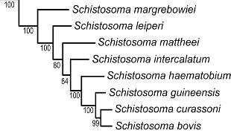

Côte D’Ivoire Xenomonitoring
13 infected with S. bovis
18
2 infected with S. haematobium
  B. truncatus
5 were infected with S. haematobium-bovis hybrids
Highly prevalent in West Africa
  B. forskalii
7
3 infected with S. haematobium
5 were infected with S. haematobium-bovis hybrids
  B. globosus

Slide 23
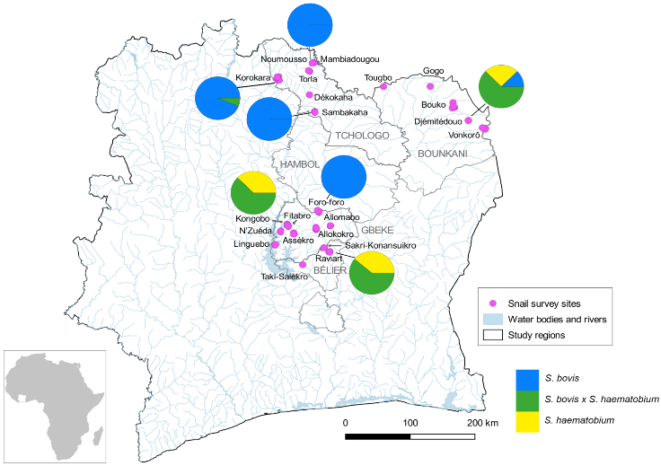
Côte D’Ivoire Xenomonitoring)

Slide 24
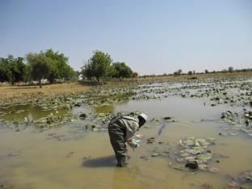
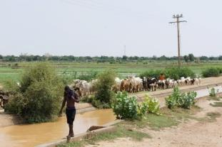
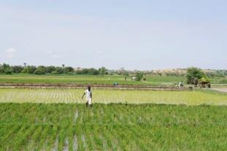
Niger Xenomonitoring
(Joanne Webster, Tom Pennance, Amadou Garba, Fiona Allan, David Rollinson, Muriel Rabone, Anouk Gouvras)
2011 - 2016

Slide 25
Niger Xenomonitoring
  B. truncatus
  B. forskalii
  B. globosus

Slide 26
Niger Xenomonitoring
  B. truncatus
  B. forskalii
>10,000 snails collected 116 were infected
  B. globosus

Slide 27
Niger Xenomonitoring
infected with S. haematobium
were infected with S. haematobium-bovis hybrids
infected with S. bovis
  B. truncatus
infected with S. bovis
  B. forskalii
infected with S. haematobium
were infected with S. haematobium-bovis hybrids
  B. globosus

Slide 28

Niger Xenomonitoring
  B. truncatus
  B. forskalii
  S. bovis (92)
  S. haematobium-bovis (18)
  S. haematobium (6)
  B. globosus

Slide 29
Conclusions
Detailed snail xenomonitoring studies can inform on schistosomiasis transmission (humans and animals).
Need to understand which species are being transmitted in different geographical areas.
Cercariae need to be molecularly identified so that assumptions are not made – particularly in relation to human schistosomiasis transmission.
Species specific molecular markers are needed for pre-patent infection Xenomonitoring.
These studies allow new transmission in foci to be identified;
  S. bovis in Zanzibar
  S. haematobium-bovis hybrids in Côte D’Ivoire
  S. kisumuensis in Tanzania

Slide 30
Conclusions
Detailed snail xenomonitoring studies can inform on schistosomiasis transmission (humans and animals).
Need to understand which species are being transmitted in different geographical areas.
Cercariae need to be molecularly identified so that assumptions are not made – particularly in relation to human schistosomiasis transmission.
Species specific molecular markers are needed for pre-patent infection Xenomonitoring.
These studies allow new transmission in foci to be identified;
  S. bovis in Zanzibar
  S. haematobium-bovis hybrids in Côte D’Ivoire
  S. kisumuensis in Tanzania

Slide 31
Conclusions
Detailed snail xenomonitoring studies can inform on schistosomiasis transmission (humans and animals).
Need to understand which species are being transmitted in different geographical areas.
Cercariae need to be molecularly identified so that assumptions are not made – particularly in relation to human schistosomiasis transmission.
Species specific molecular markers are needed for pre-patent infection Xenomonitoring.
These studies allow new transmission in foci to be identified;
  S. bovis in Zanzibar
  S. haematobium-bovis hybrids in Côte D’Ivoire
  S. kisumuensis in Tanzania

Slide 32
Conclusions
Detailed snail xenomonitoring studies can inform on schistosomiasis transmission (humans and animals).
Need to understand which species are being transmitted in different geographical areas.
Cercariae need to be molecularly identified so that assumptions are not made – particularly in relation to human schistosomiasis transmission.
Species specific molecular markers are needed for pre-patent infection Xenomonitoring.
These studies allow new transmission in foci to be identified;
  S. bovis in Zanzibar
  S. haematobium-bovis hybrids in Côte D’Ivoire
  S. kisumuensis in Tanzania

Slide 33

Conclusions
Detailed snail xenomonitoring studies can inform on schistosomiasis transmission (humans and animals).
Need to understand which species are being transmitted in different geographical areas.
Cercariae need to be molecularly identified so that assumptions are not made – particularly in relation to human schistosomiasis transmission.
Species specific molecular markers are needed for pre-patent infection Xenomonitoring.
These studies allow new transmission foci to be identified;
  S. bovis in Zanzibar
  S. haematobium-bovis hybrids in Côte D’Ivoire
  S. kisumuensis in Tanzania

Slide 34



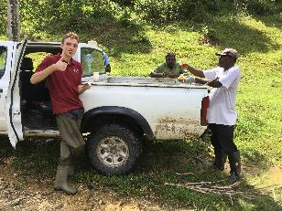


Thanks
Colleagues, collaborators + students
David Rollinson
Aidan Emery
Fiona Allan
Muriel Rabone
Tom Pennance
Steffi Knopp
Penny Rostron
Kate Poulton
Said Mohammed (PHL)
Shaali Ame (PHL)
Fatma Kabole
Yves-Nathan Tian-Bi
Eliézer N’Goran
Amadou Garba (RISEAL)
Amina Hamidou (RISEAL)
Joanne Webster (RVC)
Teckla Angelo (NIMR)
Safari Kinunghi (NIMR)
Funders
Dan Colley, Carl Campbell, Charlie King, Sue Binder
All the in country snail team members

